Slide 1
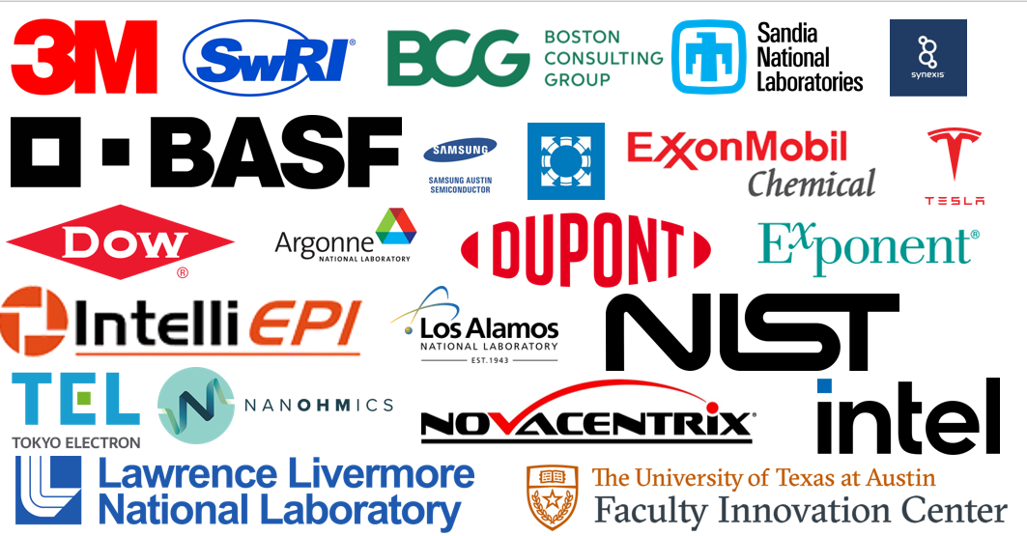
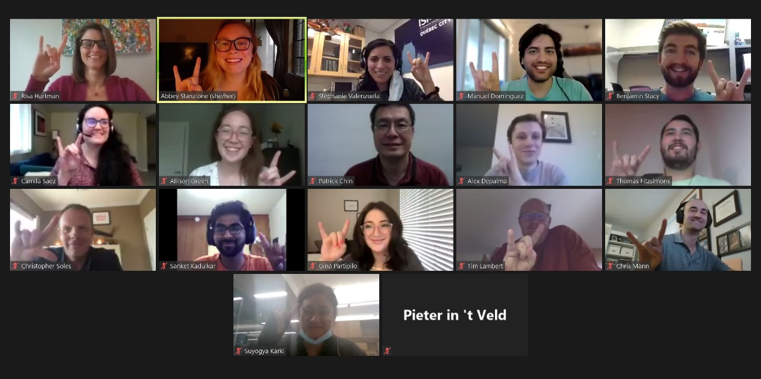
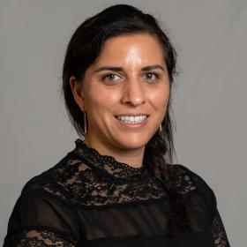
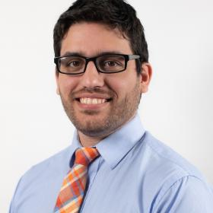
CDCM Industrial Mentorship Program Prepares Students for the Workforce of Tomorrow
MRSEC: DMR- 1720595
2022
The Industrial Mentorship Program connects undergraduate students, graduate students and post-doctoral fellows to a mentor in industry. This program is designed to (i) expose participants to fundamental research as it relates to societal and economic development; (ii) enable them to broaden their networks; and (iii) facilitate a successful transition into the workforce. This program entered its fourth program cycle during 2021-2022 with a record number of mentees – 37 in total, with 10 of those students from the CIMA PREM at Texas State University. The 2021-2022 mentor cohort consisted of thirty-six industry professionals from twenty-two different companies like 3M, BASF, DuPont, Intel, Samsung and Tesla. Mentors were asked to meet with their mentees, monthly (Oct. – May) and work with their mentees to develop goals and objectives for their time together (e.g., assist in securing internship or job, enhance interpersonal skills, learn about that particular company/industry, etc.). Travel grants were also available to enable mentees to visit their mentor companies for tours, networking, and presenting their research. Outcomes from this program are measured each year with mentees from the 20-21 cohort reporting they either agreed, or strongly agreed, that they have a better understanding of career opportunities in their field, are more knowledgeable about industry trends, feel more confident to take the next steps in their career, improved their interpersonal skills and/or their professional communication skills, and grew their professional network and built relationships through their mentor. This program has impacted more than 75 CDCM students since its inception.
CDCM MRSEC – University of Texas at Austin
2021-2022 Mentor Companies
Virtual Kickoff Event: Mentors and Mentees attended
I was able to gain insight into what working in industry is like, while working with someone to further develop my confidence in a professional setting. My mentor was very helpful in helping me find my voice and self-worth in this setting.
– Stephanie Valenzuela (mentee, 2020-2021)
The mentorship program has been incredibly beneficial to me because it has given me more insight and help into the next step of my career. My mentor has been highly instructive and helpful in preparing me for knowing my career goals and the items I need to prepare to be successful when applying and interviewing for a position.– Manuel Dominguez (mentee, 2020-2021)

