Slide 1
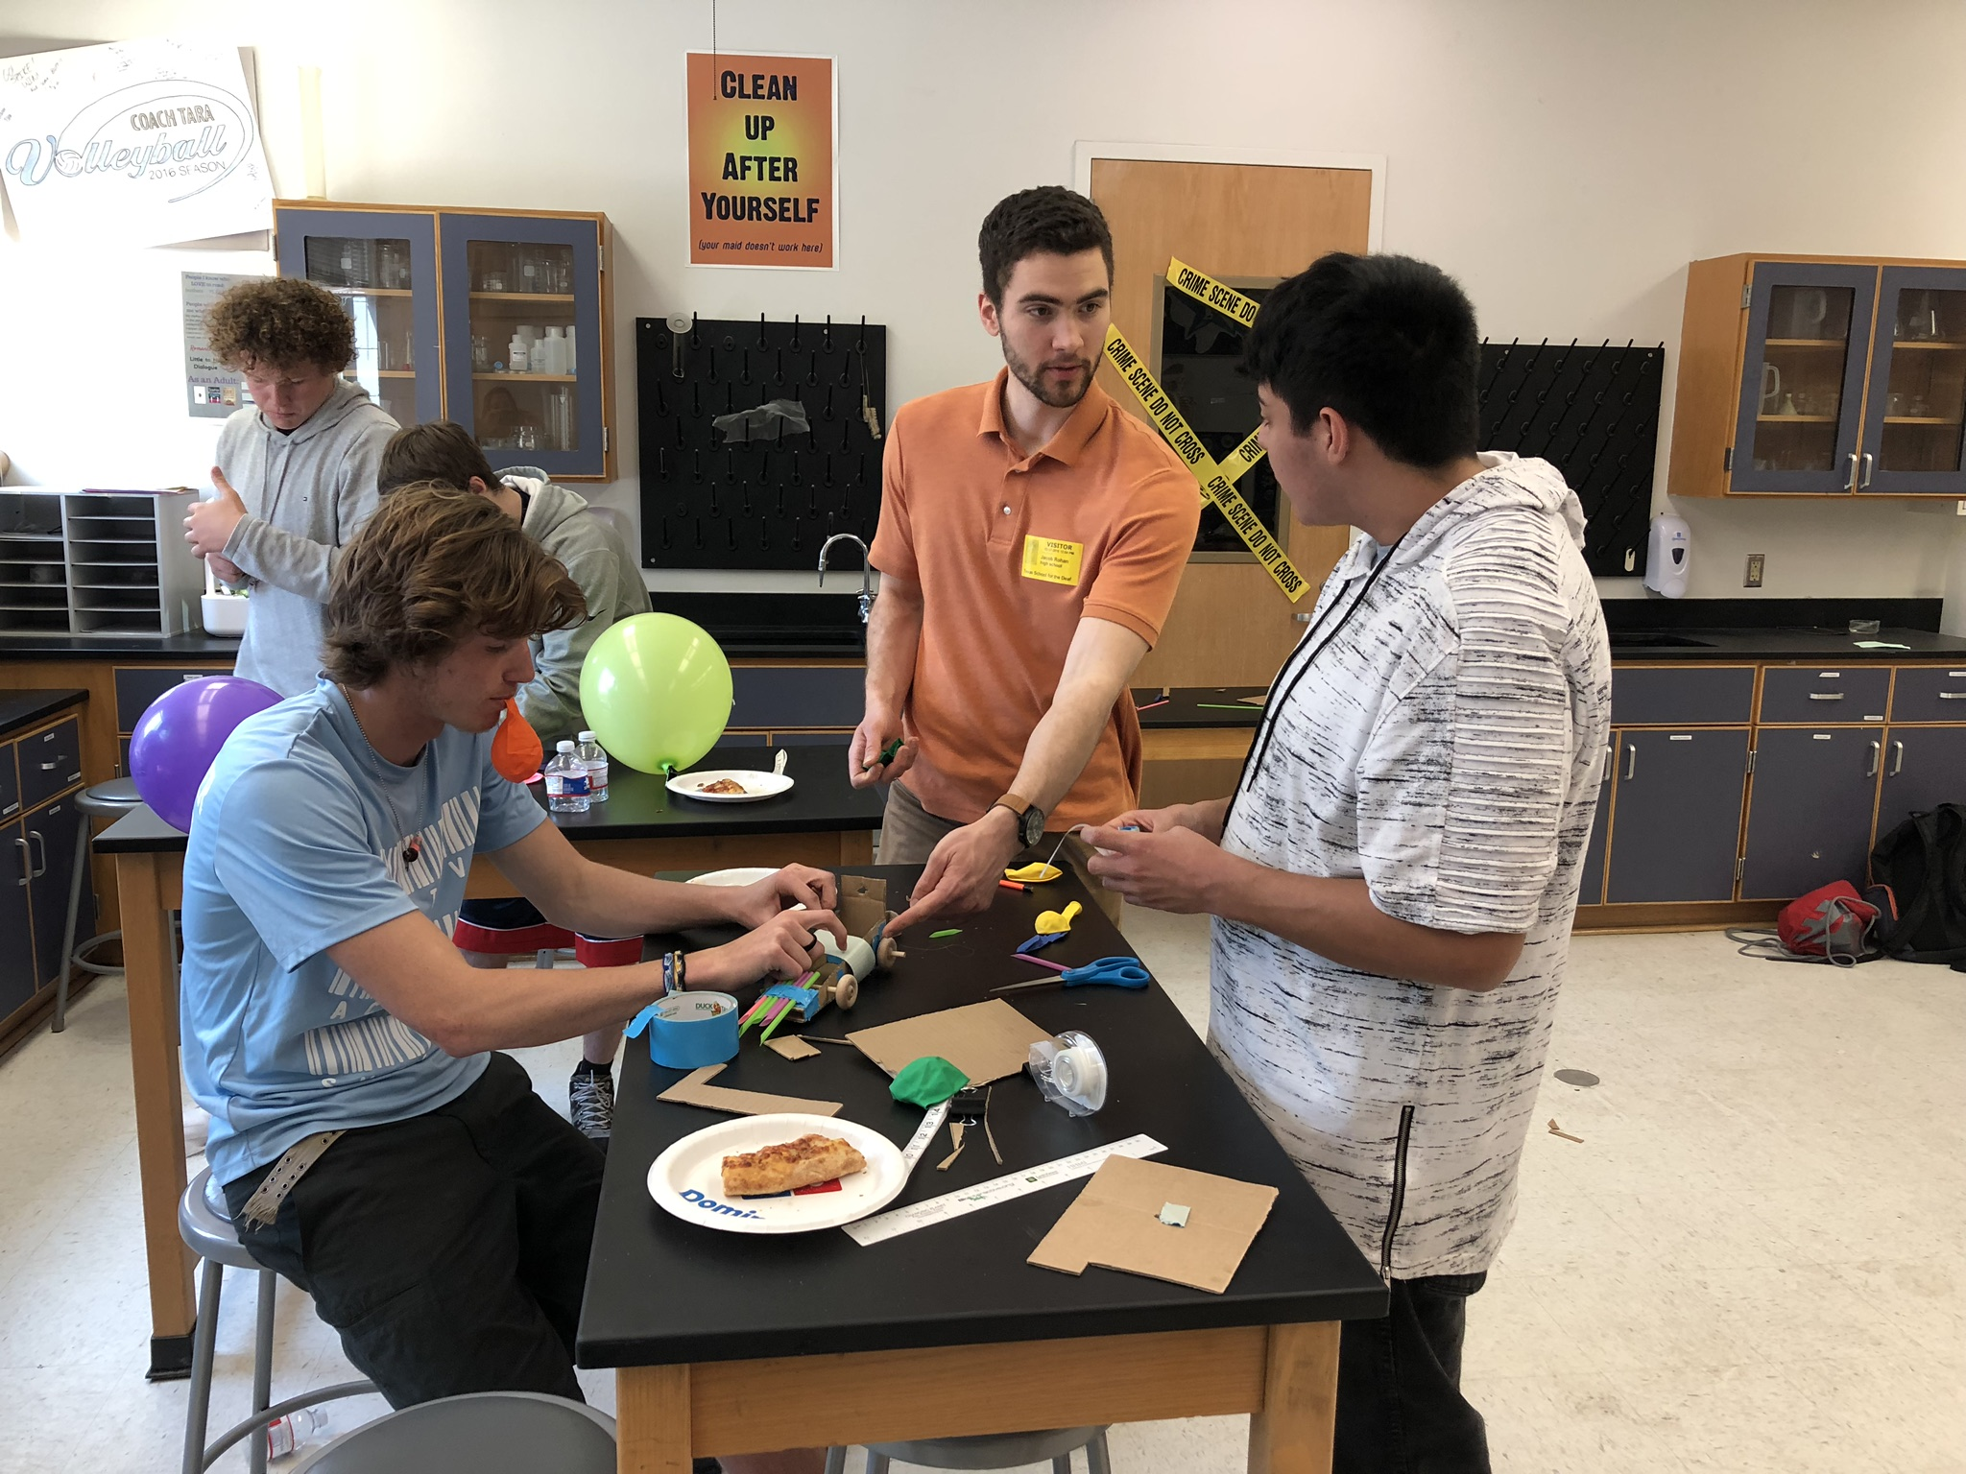
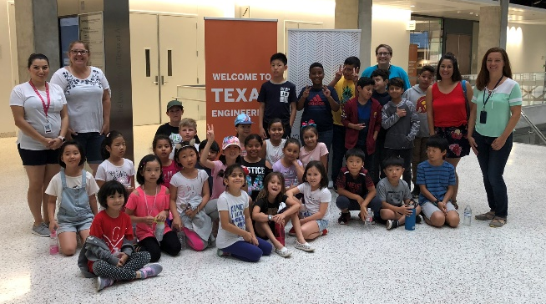
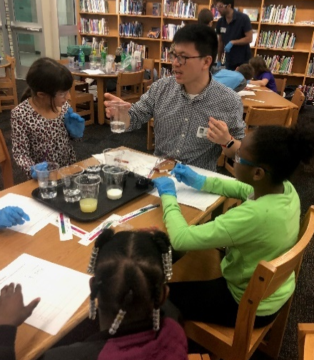
CDCM is Creating Informal, Accessible K-12 Education for All Students
MRSEC: DMR- 1720595
2020
The CDCM Stuff program engages diverse young learners and public audiences in the beauty, excitement, and impact of materials science and materials-based technologies. CDCM has facilitated 39 events during this reporting period, impacting more than 2300 community participants. To foster accessibility in science outreach, CDCM has worked closely with the Texas School for the Blind and Visually Impaired (TSBVI) and the Texas School for the Deaf in Austin, on programs to engage their students in hands-on, accessible scientific activities. CDCM has hosted three STEM days at TSVBI that engage blind and visually impaired students ranging from 8 to 17 years of age. Materials-based accessible activities are facilitated at the event by CDCM personnel, allowing the students to interact with science and engineering in a hands-on and engaging manner. CDCM also facilitates a science club at the Texas School for the Deaf serving 16 deaf and hard of hearing students. Students are engaged in active learning with hands-on activities and experiments that allow them to explore all aspects of science. CDCM successfully expanded its afterschool science club program into 4 additional elementary and middle schools this year. CDCM graduate student, staff and faculty developed engaging, hands on curriculum for this series including activities such as a forensics challenge, density column design and experimentation, leaf chromatography experiment, and strawberry DNA extraction challenge.
CDCM MRSEC – University of Texas at Austin
CDCM STUFF Program: Materials Science for the Masses
Designing activities accessible for all is a critical piece of CDCM’s STUFF outreach program and the Center has developed lasting partnerships with the Texas School for the Blind (Annual STEM Day, left picture) and the Texas School for the Deaf (Science Club, right picture).
CDCM hosts on-campus learning tours for local schools (Round Rock ISD Newcomers fieldtrip pictured, left picture) and has launched 6 science clubs at local K-8 campuses (Cunningham Elem. Science Club, right picture)

