Slide 1
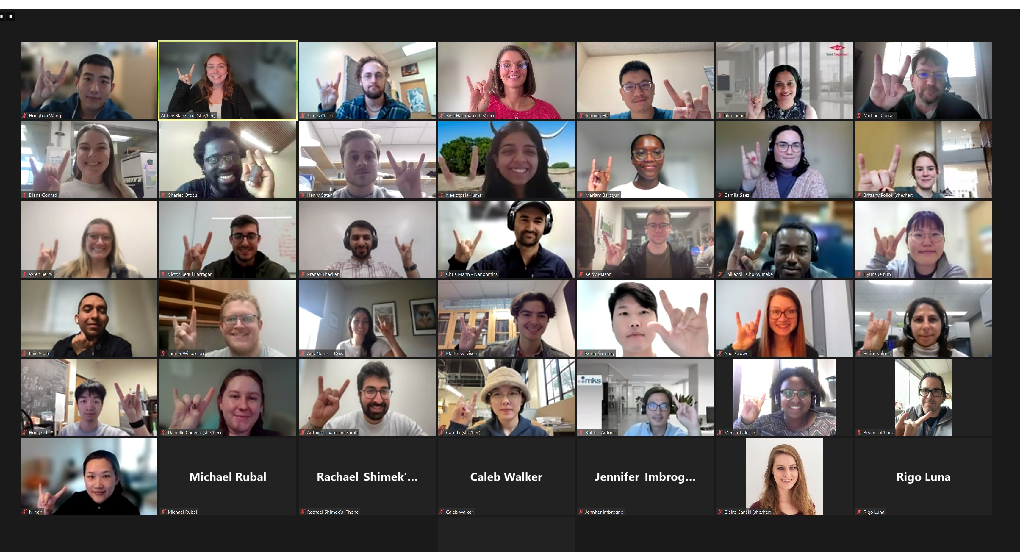
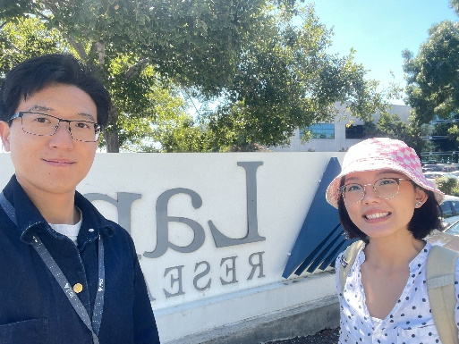
UT Austin MRSEC
DMR-1720595
CDCM Industrial Mentorship Program Prepares Students for the Workforce of Tomorrow
CDCM MRSEC – University of Texas at Austin
The Industrial Mentorship Program connects undergraduate students, graduate students and post-doctoral fellows to a PhD level mentor in industry. This program is designed to (i) expose participants to fundamental research as it relates to societal and economic development; (ii) enable them to broaden their networks; and (iii) facilitate a successful transition into the workforce. The Industrial Mentor program entered its sixth program cycle during 2023-2024 and since it’s inception, 147 students have participated as mentees in the program, with 30 of those from the CIMA PREM at Texas State University.
Outcomes from this program are measured each year through an external evaluator. A strong majority, 95% of 147 mentees, report they either agreed, or strongly agreed, that they have a better understanding of career opportunities in their field, are more knowledgeable about industry trends, feel more confident to take the next steps in their career, improved their interpersonal skills and/or their professional communication skills, and grew their professional network and built relationships through their mentor.
Mentees also report the program provides both direct (job offers) and in-direct (internship offers, job networking) assistance in securing a job. Since it’s inception, 7 students have secured positions at their mentor’s companies, 8 have secured internships, and more than 35 reported the program in-directly assisted them in finding a position post-graduation.
Companies participating in the Industrial Mentorship Program
The Program Kicks Off in October and boasts ~60 people who participate as mentors and mentees on the call.
Mentee Site Visits at Mentor Companies (25 in total during 2018-2024)
Cam Li, Yixuan Yu, Lam Research
Miriam Balogun, Austin Keller, Dow
Notes:
What Has Been Achieved: The Industrial Mentorship Program connects undergraduate students, graduate students and post-doctoral fellows to a mentor in industry. This program is designed to (i) expose participants to fundamental research as it relates to societal and economic development; (ii) enable them to broaden their networks; and (iii) facilitate a successful transition into the workforce. Mentors were asked to meet with their mentees, monthly (Oct. – May) and work with their mentees to develop goals and objectives for their time together (e.g., assist in securing internship or job, enhance interpersonal skills, learn about that particular company/industry, etc.). Travel grants were also available to enable mentees to visit their mentor companies for tours, networking, and presenting their research.
This program entered its sixth program cycle during 2023-2024 and since it’s inception, 147 students have participated as mentees in the program, with 30 of those from the CIMA PREM at Texas State University.
Importance of the Achievement: This Program directs assists CDCM and CIMA PREM undergraduates, graduate students and post-docs determine the next steps of their career, post-graduation. Many students are unsure what they would like to do once they graduate and this program give them a first-hand look into what a role in industry will be like in a company they are interested in.
Outcomes from this program are measured each year through an external evaluator. A strong majority, 95% of 147 mentees, report they either agreed, or strongly agreed, that they have a better understanding of career opportunities in their field, are more knowledgeable about industry trends, feel more confident to take the next steps in their career, improved their interpersonal skills and/or their professional communication skills, and grew their professional network and built relationships through their mentor.
Mentees also report the program provides both direct (job offers) and in-direct (internship offers, job networking) assistance in securing a job. Since it’s inception, 7 students have secured positions at their mentor’s companies, 8 have secured internships, and more than 35 reported the program in-directly assisted them in finding a position post-graduation.
How is the achievement related to the Center, and how does it help it achieve its goals? CDCM seeks to educate center students around possible career paths and prepare them to enter the workforce confidently and with applicable skills. This program matches students to industry mentors as a way to educate students around careers in industry and career pathways available to them.

