Slide 1
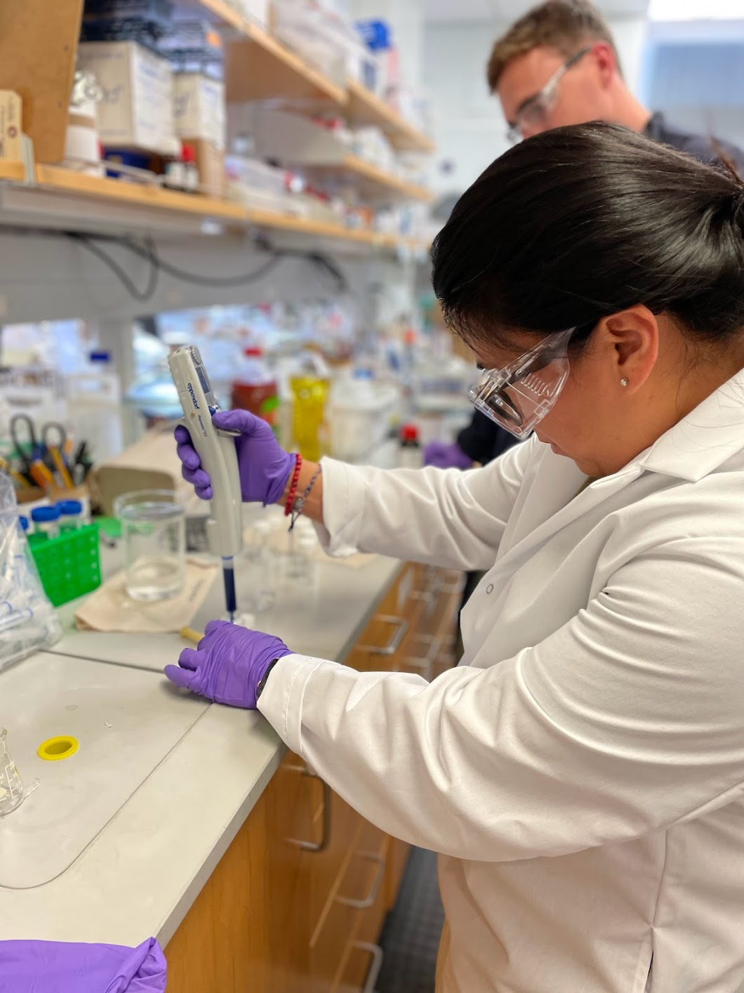
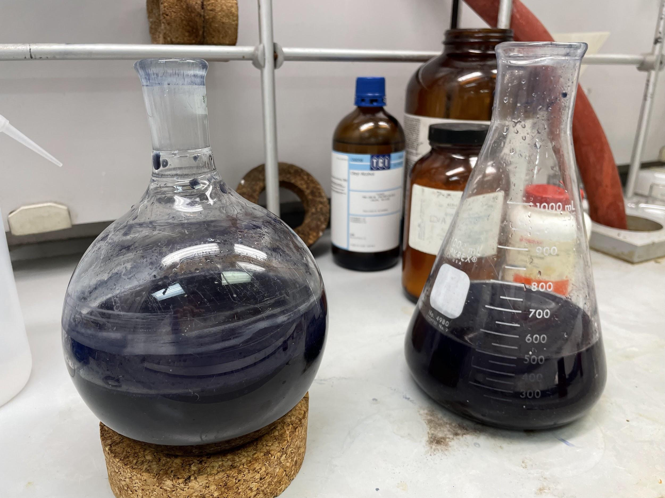
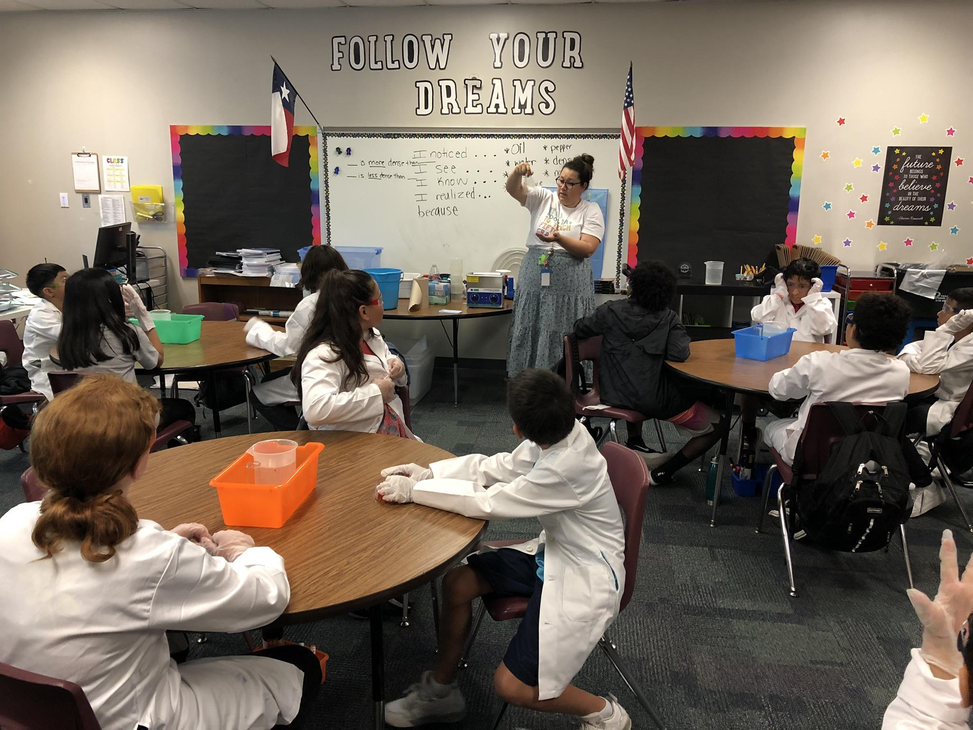
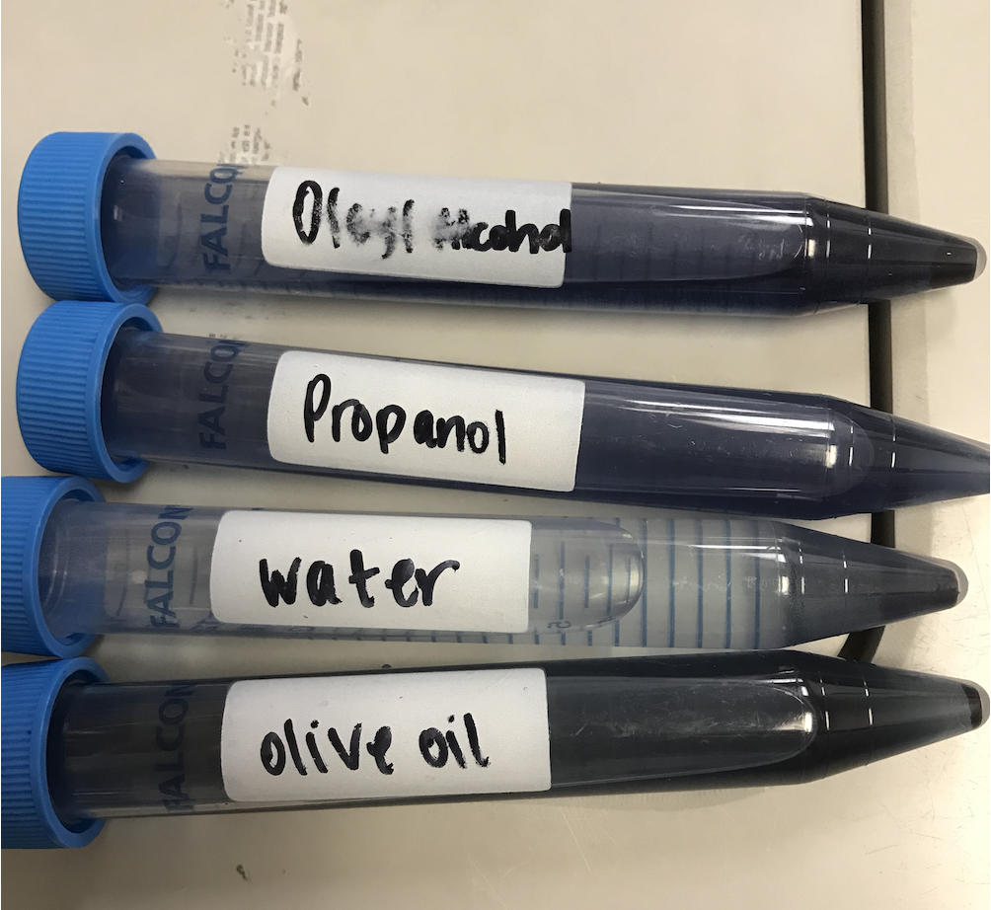

UT Austin MRSEC
DMR-1720595
K-5 Research Experience for Teachers (RET)
Risa Hartman, UT Austin
CDCM’s Research Experiences for Teachers (RET) program engages elementary school teachers in materials research at UT Austin during the summer and has created lasting impact over the past six years. The program aims to increase teacher efficacy in research practices and guide teachers in integrating what they learn into their instructional practice. The end goals are to enhance students’ engagement in science and increase students’ awareness of and interest in STEM fields.
Fifty (50) teachers have been recruited from Title 1 and Dual language schools in Austin to participate in the RET program between 2018-2023. Those teachers have impacted more than 1400 students through the implementation of their RET lessons.
CDCM employs an external evaluator to not only assess the impact of the RET program on teachers and their students during the year teachers participate in the RET, but also longitudinally tracks program impact over time. Teacher confidence in integrating science or engineering concepts into their curriculum, facilitating lab-like activities or experiments effectively and educating students about careers in STEM was assessed in the longitudinal surveys. Teacher’s confidence increased in each of these areas over time but the most significant increase was measured the spring after they had participated in the RET program.
RET Stephanie Escalante working in the lab (left and middle); RET Stephanie Escalante implementing her RET lesson.
MRSEC RET Program Impact (2018-2023)
Teachers in the RET Program | 50
RET lessons created and published on CDCM website or TeachEngineering.org | 50
Students impacted through RET lessons | >1400
Conference/workshop presentations disseminating RET lessons | 27
RET class fieldtrips to MRSEC labs (plus virtual) | 25
Science Clubs initiated at RET schools | 9
Past RETs serving as mentors in program | 10
Publications co-authored by an RET | 1
Notes:
What Has Been Achieved: Local Austin Teachers are able to gain confidence as researchers by getting hands-on experience in a research lab. Teachers work in pairs on research projects with their graduate and faculty mentors. The teachers also participate in professional development workshops throughout the summer that help them to develop STEM-focused lessons to implement into their classrooms during the academic year. The culmination of their summer work is presented at the Poster Session at the conclusion of the program.
Teachers also create and implement exciting and relevant STEM lessons to their students during the academic year. Teachers have created professional development trainings for their fellow school teachers, to disseminate their knowledge. During 2018-2024, all 50 RETs developed engaging STEM lessons for their classrooms, 40 posted on the CDCM website and 10 CDCM RET alumni had their curricular materials accepted and published on the peer-reviewed website Teachengineering.org (an open source platform for educators around the world to access high quality, inquiry and design based modules). All of the RETs also conducted professional development trainings within their school or districts to disseminate knowledge learned. Additionally, on each of Post-Summer Survey from 2018-2023, 100% of teachers agreed or strongly agreed that they gained valuable experience, they would apply what they learned to classroom instruction, their ability to teach science and engineering effectively increased, their students will benefit from their participation in the RET summer program, they are excited to put what they learned into practice, working alongside UT scientists and engineers helped expand their knowledge of developments in STEM, and they received valuable mentorship during the program.
Importance of the Achievement: Teachers are not only leaving the program more confident in teaching STEM lessons in their classrooms but they have disseminated their learnings from the summer to the broader community by creating professional development trainings they have developed and through attending local conferences such as CAST (Science Teachers Association of Texas), UTRGV STEM Conference, Adelante, and the Texas STEM Conference.
How is the achievement related to the Center, and how does it help it achieve its goals? CDCM seeks to establish a materials science community of practice and broaden participation in materials science at all levels. The importance of engaging students with science during elementary school is well recognized , and by equipping carefully selected teachers to teach about science as a process for learning about the world, rather than simply a collection of facts, CDCM leverages not only their influence on generations of their students, but also influence their fellow teachers and schools. In assessments of RET classroom students, 88% indicate an increased interest in science, and 65% would like to take more STEM electives in middle school.

