Slide 1
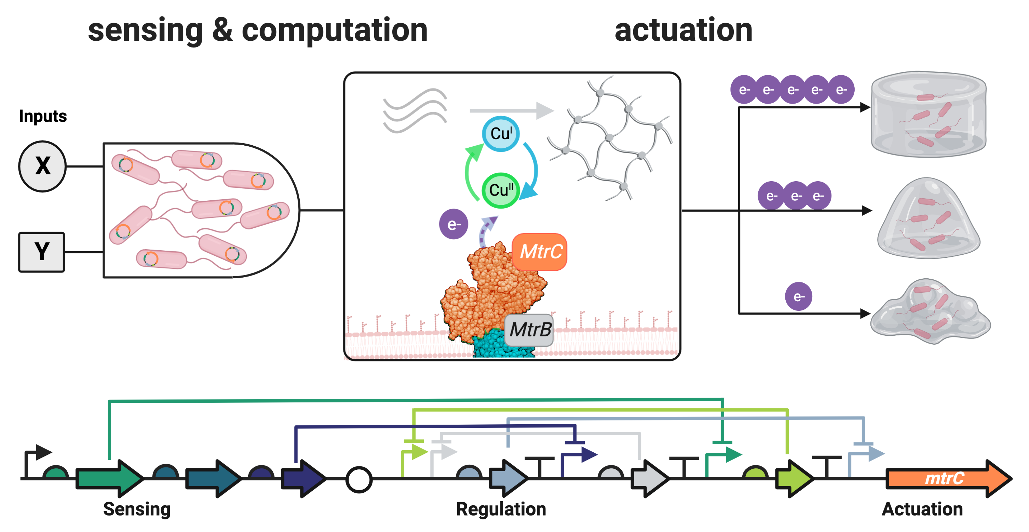
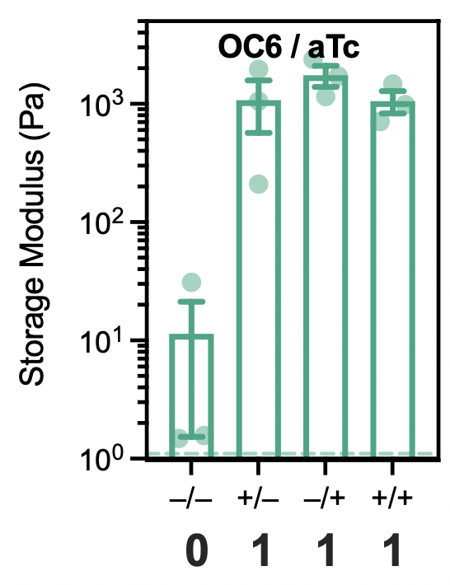
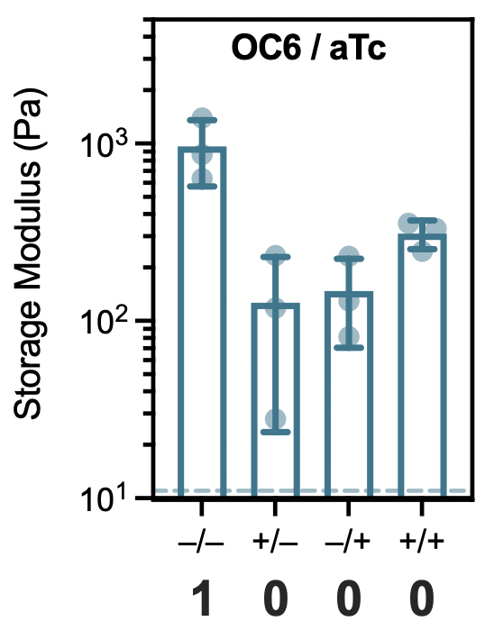
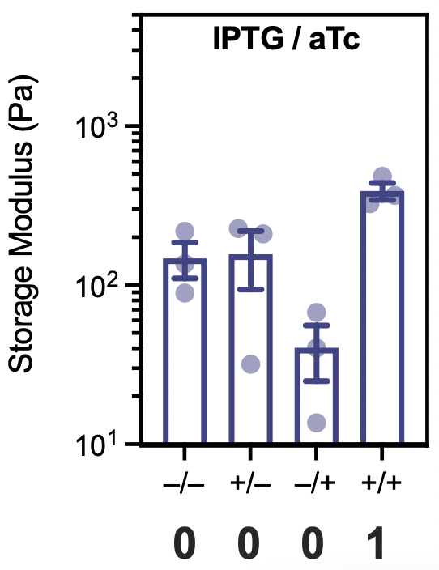
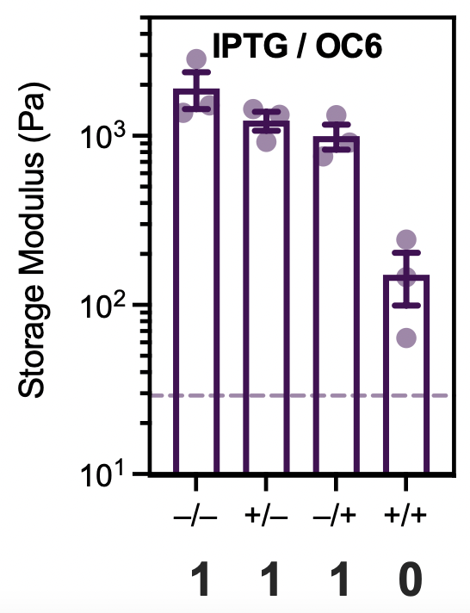
UT Austin MRSEC
DMR-1720595
Hydrogel Crosslinking Regulated using Genetic Logic
B.K. Keitz, A.M. Rosales: UT Austin
Living polymer networks, including tissues and biofilms, actively respond to complex combinations of environmental inputs, leading to differentiation, regeneration, and development. Synthetic materials are generally not capable of these complex computational abilities. We used extracellular electron transfer (EET), an anaerobic form of microbial respiration, to address this challenge. In our system, embedded bacteria sense chemical inputs (IPTG, aTc, OC6), compute an appropriate response according to genetically engineered logic, and activate radical polymerization – resulting in the formation of a hydrogel. This process allows chemically simple hydrogels to form in response to Boolean combinations of chemical inputs. We also demonstrated that these bacteria can activate alternate redox chemistries, such as ‘Click chemistry’, using the same genetic logic.
Our work is significant because it establishes a foundation for applying the transcriptional regulatory motifs found in patterning, embryogenesis, and tissue formation toward the control of a wide range of synthetic polymer networks.
Graham, Partipilo, et al bioRxiv, 2021. Doi: 10.1101/2021.10.17.464678
OR
NOR
AND
NAND
Notes:
What Has Been Achieved: Here we describe synthetic polymer networks (i.e., hydrogels) that cross-link in response to multi-input logic computations performed by embedded bacteria. Our approach coopts extracellular electron transfer (EET), a respiratory mechanism that couples metal reduction/oxidation to carbon oxidation/reduction in electroactive microbes, to reduce exogenous metal catalysts that control polymer network crosslinking. Leveraging transcriptional control over EET genes in the model electroactive bacterium Shewanella oneidensis, we deploy engineered bacteria as distributed computing and actuating elements within a solution-phase network precursor. Upon sensing dilute chemical stimuli, S. oneidensis strains transcriptionally regulate the expression of EET proteins, which subsequently reduce and activate a metal radical polymerization catalyst that cross-links the network. Using this platform, we first show that atom-transfer radical-polymerization (ATRP) cross-linking can be dynamically coupled to gene expression to predictably control polymer network mechanics through transcriptional regulation. We then expand the logical complexity of these networks by engineering two-input genetic Boolean circuits (OR, NOR, AND, and NAND) for controlling EET protein expression and resultant gel mechanics. Finally, capitalizing on the ability of EET to interface with diverse metal species, we demonstrate that the same transcriptional logic can control another well-known cross-linking chemistry, copper(I)-catalyzed alkyne-azide cycloaddition (CuAAC). By coupling biological computation to the activity of metal cross-linking catalysts, we showcase EET’s potential as a universal interface for programming polymer network properties and forward-engineering living materials using genetic circuits. Importance of the Achievement: Ultimately, the direct genetic link between microbial physiology and redox chemistry could be used to rationally bioengineer synthetic polymer networks for target applications. For example, our design’s programmability holds promise for intervention-less and dynamic cross-linking platforms, where engineered microbes are incorporated into tissue architectures, biosensors, soft actuators, or additive manufacturing substrates. Even relatively small changes in local micromechanics are crucial in living systems, and the ability to transcriptionally tune within this window may open new biomimetic opportunities. How is the achievement related to the IRG, and how does it help it achieve its goals? This project was the stretch goal of a 2017 MRSEC Seed Project and demonstrates how the biotic-abiotic interface can be bridged through electron transfer – allowing for dynamic control over material properties via engineered bacteria.
Where the findings are published: Graham AJ, Dundas CM, Partipilo G, Miniel Mahfoud IE, Fitzsimons T, Rinehart R, Chiu D, Tyndall AE, Rosales AM, Keitz BK. Transcriptional Regulation of Synthetic Polymer Networks. bioRxiv, 2021. Doi: 10.1101/2021.10.17.464678

