Slide 1
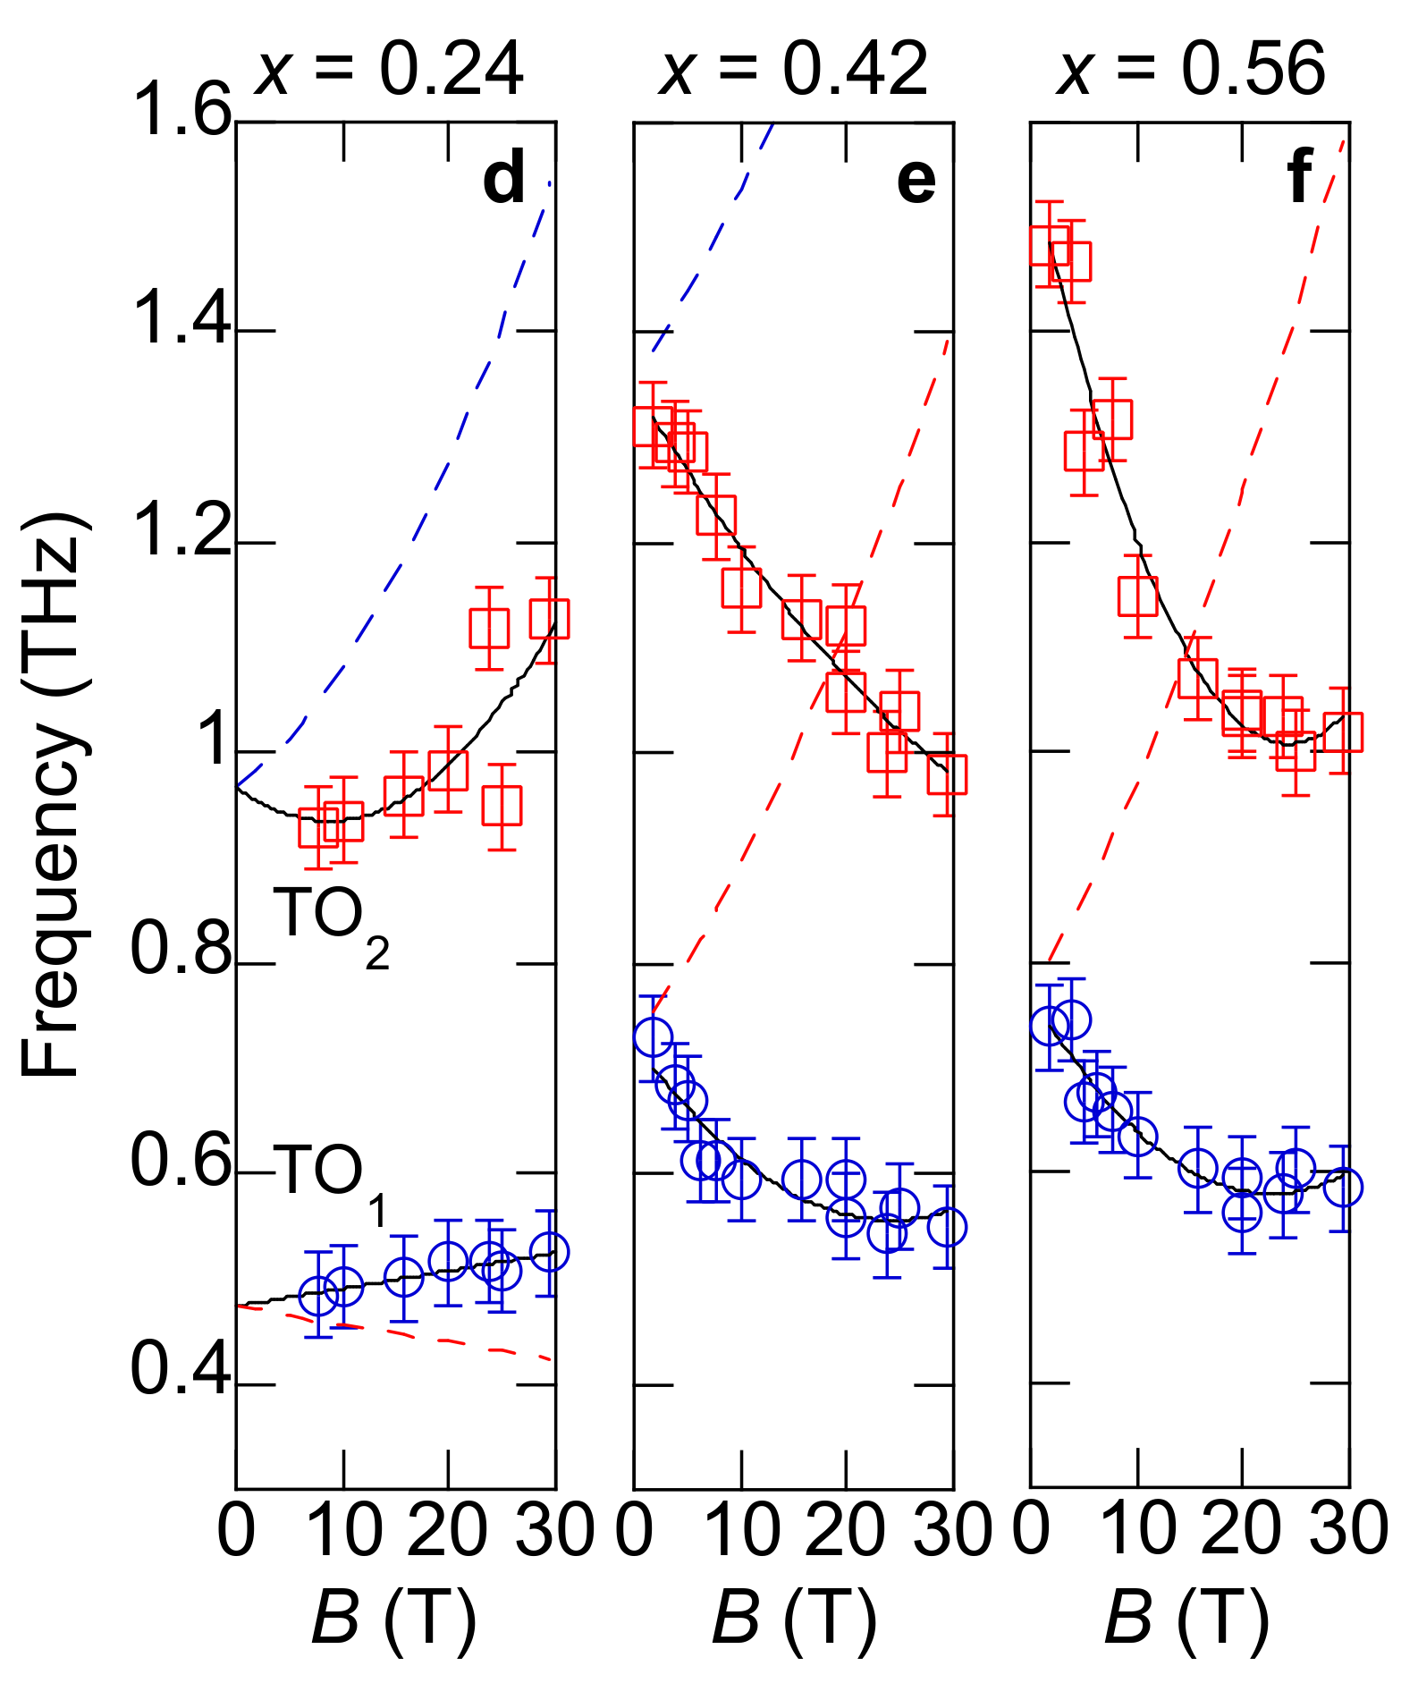
UT-Austin MRSEC
DMR-1720595
Interplay between phonon chirality and electronic topology
J. Kono and G. Fiete groups
Phonons are important collective excitations in materials. Typically, they do not respond to magnetic field and do not carry a magnetic moment (chirality).
Phonon chirality can be induced via two mechanisms (i) adiabatic evolution with electronic states that break time-reversal symmetry (e.g. magnetism) and (ii) phonon induced mixing of different electronic energy levels.
Chiral phonons observed in topological crystalline insulator Pb1-xSnxTe using THz magneto-spectroscopy
Phonon magnetic moment changed sign across topological phase transition and was two orders of magnitude higher in the topological phase
Connection between chiral phonons and electronic topology opens new ways to control matter
Sci. Adv. 9, eadj4074 (2023)
Notes:
What Has Been Achieved: The researchers used polarization-dependent terahertz magnetospectroscopy to observe Zeeman splittings and diamagnetic shifts in a series of Pb1-xSnxTe films, which transition from a topologically trivial insulator to a topological crystalline insulator (TCI) phase as the Sn concentration increases beyond 0.32. This study demonstrates a substantial phonon magnetic moment films in the TCI phase exhibited phonon magnetic moment values significantly larger—by two orders of magnitude—than those in the topologically trivial sample
Importance of the Achievement: Of particular interest is the fact that, unlike regular phonons, chiral phonons carry angular momentum and therefore directly couple to magnetic fields. Furthermore, chiral phonons can themselves be used to produce large effective magnetic fields. From the fundamental perspective, theoretical reports have suggested that large phonon magnetic moments can arise from mechanisms that must involve electronic contributions. In this context, their experimental study reveals for the first time the strong influence of electronic band topology on chiral phonons, which was probed by measuring the phonon magnetic moment across a topological phase transition in intense fields up to 30 T. The implications of their results, together with the ability to drive chiral phonons with magnetic fields and circularly polarized laser pulses, offer control over electronic topology. Our work opens up new avenues for topology-based devices and applications through magnetic field-based phonon control of electronic states.
How is the achievement related to the IRG, and how does it help it achieve its goals? ? The IRG focus on understanding collective excitations and excited states and their relationship to topology. This work is a great example of how electron topology endows new properties to collective excitations, phonons, in this case via collaborative work.
Where the findings are published: Sci. Adv. 9, eadj4074 (2023)

