Slide 1
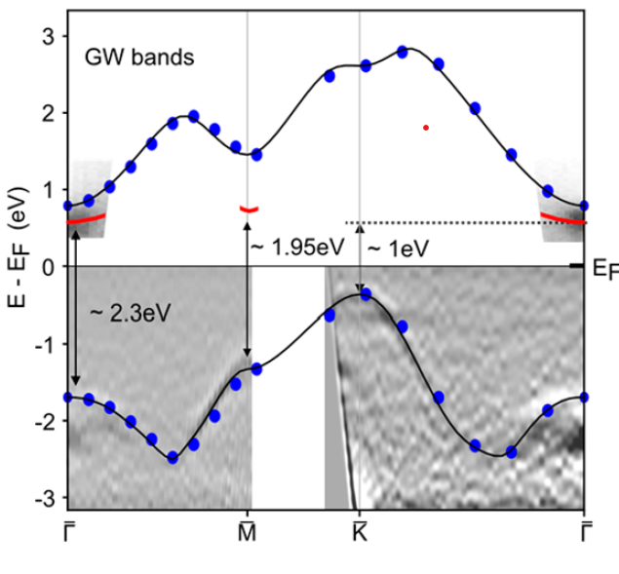
(University of Texas-Austin) MRSEC, DMR-1720595
Confined Monolayer Ag as a Large Gap 2D Semiconductor
Shih, MacDonald, Li (UT MRSEC); Crespi, Robinson (Penn State MRSEC)
Ag is a well-known example of metal in its bulk form
Epitaxially grown monolayer Ag confined between bilayer graphene and SiC is found to develop a large band gap (> 1eV)
This finding is a striking example of extreme quantum confinement in the monolayer limit
Development of a time-resolved angle-resolved photoemission spectroscopy tool enables us to probe quantum materials in momentum-, energy-, and time-domains
Notes:
What Has Been Achieved: Using time-resolved ARPES, the band gap of an epitaxially grown Ag monolayer is determined and found to develop a >1 ev band-gap. The Ag is sandwiched between bilayer graphene and SiC
Importance of the Achievement: Confined monolayer Ag between graphene and SiC has been predicted to be a semiconductor resulting from hybridization of Ag and the SiC substrates. Conventional APRES cannot probe the excited states. By using tr-ARPES we reveal the energy and momentum location of the conduction band minimum, showing that this confined Ag monolayer is indeed an artificial 2D semiconductor with a large band gap of 1 eV
How is the achievement related to the IRG, and how does it help it achieve its goals? This IRG is aimed at controlling and probing the excited electronic states of materials. This achievement highlights the combination of tailoring new materials with novel electronic structures (developed at PSU-MRSEC) and probing the excited states with tr-ARPES (developed at UT-MRSEC).
Where the findings are published: https://doi.org/10.1021/acs.nanolett.2c02501
Nano Lett. 2022, 22, 7841−7847

