Slide 1
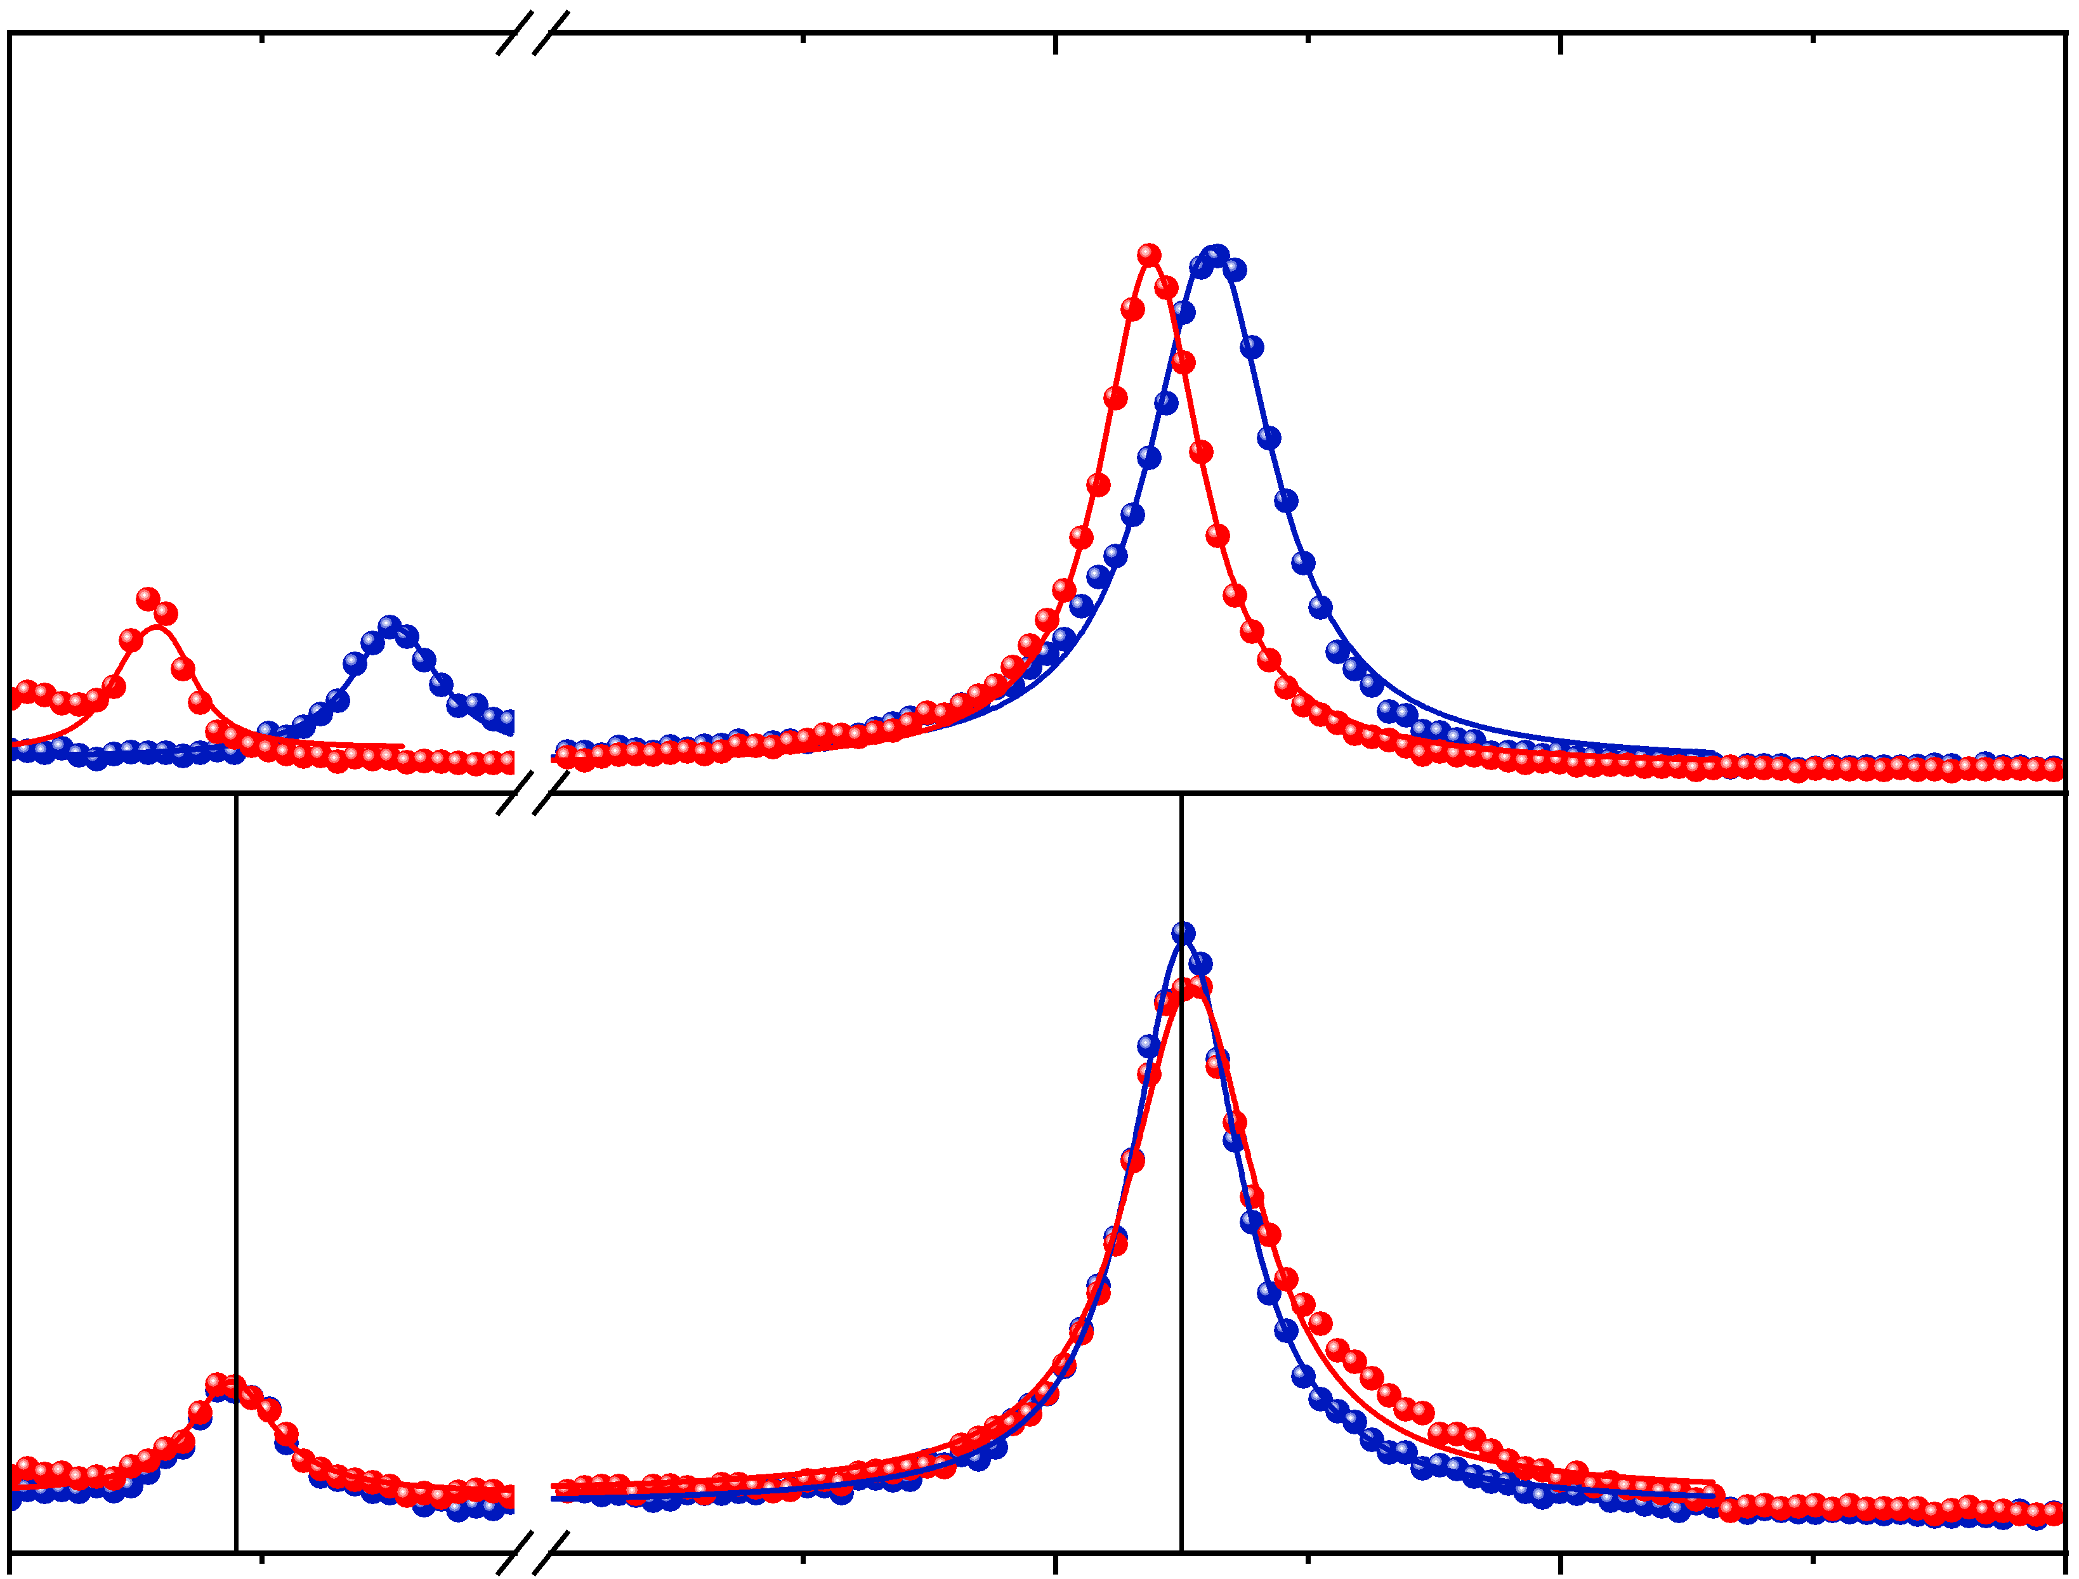
UT-Austin MRSEC
DMR-1720595
Spin–orbit exciton–induced phonon chirality in a quantum magnet
Phonons are important collective excitations in materials. Typically, they do not respond to magnetic field and do not carry a magnetic moment (chirality).
Phonon chirality can be induced via two mechanisms (i) adiabatic evolution with electronic states that break time-reversal symmetry (e.g. magnetism) and (ii) phonon induced mixing of different electronic energy levels.
A quantum magnet CoTiO₃ hosts interesting bosonic excitations such as topological magnons and spin–orbit excitons
the interaction between spin–orbit excitons and phonons endows chirality to two phonon modes and leads to large phonon magnetic moments observed in magneto-Raman spectra
X. Li, J. Zhou, and G. Fiete groups
O
(a)
(c)
$${∆E}_{g}^{(2)}\sim {2 cm}^{−1}$$
$$H_{∥^{c}}$$
7T, 12K
Co
$${σ_{+}}/{σ_{−}}$$
$${σ_{−}}/{σ_{+}}$$
Ti
Intensity ( a. u. )
$${∆E}_{g}^{(1)}\sim 7{cm}^{−1}$$
c
a
b
(d)
$${∆E}_{g}^{(2)}\sim { 0 cm}^{−1}$$
$$H_{∥^{a}}$$
7T
$$H_{∥^{c}}$$
(b)
Intensity ( a. u. )
$${∆E}_{g}^{(1)}\sim 0{ cm}^{−1}$$
a
c
b
210
270
285
300
Raman shift (${cm}^{−1}$ )
D. Lujan, J. Choe, et. al. PNAS, 121, e2304360121, 2024
Notes:
What Has Been Achieved: The interplay of charge, spin, lattice, and orbital degrees of freedom in correlated materials often leads to rich and exotic properties. Recent studies have brought new perspectives to bosonic collective excitations in correlated materials. For example, inelastic neutron scattering experiments revealed non-trivial band topology for magnons and spin–orbit excitons (SOEs) in a quantum magnet CoTiO3 (CTO). Here, we report phonon properties resulting from a combination of strong spin–orbit coupling, large crystal field splitting, and trigonal distortion in CTO. Specifically, the interaction between SOEs and phonons endows chirality to two
phonon modes and leads to large phonon magnetic moments observed in magneto-Raman spectra. The remarkably strong magneto-phononic effect originates from the hybridization of SOEs and phonons due to their close energy proximity. While chiral phonons have been associated with electronic topology in some materials, our work suggests opportunities may arise by exploring chiral phonons coupled to topological bosons.
Importance of the Achievement: Phonons are known as an important energy carrier and their interaction with electrons is critical for understanding exotic properties in correlated materials. They typically do not carry angular momentum or respond to an external magnetic field. Chiral phonons arising from circular ionic motions alone would only exhibit a small magnetic moment. In contrast, chiral phonons reported recently in several classes of materials including the pseudogap phase of cuprates and topological semimetals exhibit surprisingly large moments. Here, we report studies of chiral phonons in CoTiO3, a quantum magnet that hosts interesting bosonic excitations such as topological magnons and spin–orbit excitons (SOEs). The observed phonon chirality is attributed to phonon and SOE hybridization.
How is the achievement related to the IRG, and how does it help it achieve its goals? The IRG focus on understanding collective excitations and excited states and their relationship to topology. This work is an excellent example of revealing new properties of collective excitations via collaborative work.
Where the findings are published: PNAS, 121, e2304360121, 2024

