Slide 1
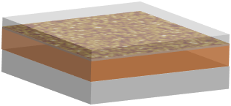
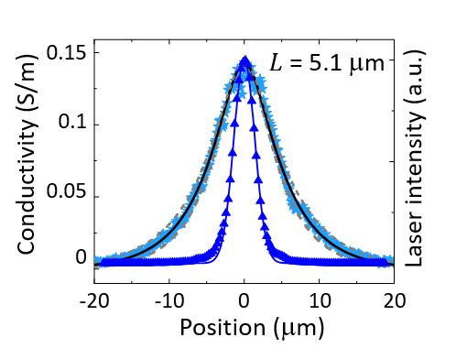
Temporally and Spatially Resolved Carrier Dynamics in Organic-Inorganic Hybrid Perovskites
MRSEC Award DMR-1720595
2022
K. Lai and X. Q. Li: Univ. of Texas at Austin
Organic-inorganic hybrid perovskite compounds are promising materials for high-efficiency photovoltaic devices. Understanding and optimization of electron and hole transport is essential to realizing high performance.
Temporally resolved light-assisted microwave impedance microscopy represents a significant technical advance of this unique capability, and enables submicron-scale probing of the dynamics of photogenerated electrons and holes.
Separation of electron and hole dynamics in Cs-doped FAPbI₃ thin film allows quantitative measurements of diffusion length and carrier lifetime.
1 GHz
iMIM
τ_{e} ~ 0.7 μs
PMMA
FACsPbI₃
Glass
tr-iMIM-Im
τ_{h} ~ 10 μs
0
20
40
Time (μs)
[Ma, XJ; Zhang, F; Chu, ZD; Hao, J; Chen, XH; Quan, JM; Huang, ZY; Wang, XM; Li, XQ; Yan, YF; Zhu, K; Lai, KJ. Superior photo-carrier diffusion dynamics in organic-inorganic hybrid perovskites revealed by spatiotemporal conductivity imaging. Nat. Commun. 2021, 12(1), 5009-. DOI: 10.1038/s41467-021-25311-1 .]
Notes:
This highlight illustrates a key characterization advance realized at the Center for Dynamics and Control of Materials – temporally resolved light-induced microwave impedance microscopy (MIM). In MIM, microwave-frequency dielectric response is measured with nanoscale spatial resolution by an atomic force microscope probe tip functionalized with a microwave strip line. In temporally resolved light-assisted MIM, modulated or pulsed laser illumination of the tip-sample junction enables dielectric response associated with photogenerated carriers, e.g., photoconductivity, to be measured with high spatial and temporal resolution. In the experiments shown here, this technique is used to probe the diffusion lengths and recombination lifetimes of electrons and holes in organic-inorganic hybrid perovskite materials, specifically Cs-doped FAPbI3, of intense current interest for photovoltaic applications. Device structures containing either electron or hole transport layers enable the dynamics of electrons and holes to be separated. These measurements provide key insights into material properties that strongly influence the performance of organic-inorganic hybrid perovskite materials in photovoltaic devices.
Publication citation for this work:
Ma, XJ; Zhang, F; Chu, ZD; Hao, J; Chen, XH; Quan, JM; Huang, ZY; Wang, XM; Li, XQ; Yan, YF; Zhu, K; Lai, KJ. Superior photo-carrier diffusion dynamics in organic-inorganic hybrid perovskites revealed by spatiotemporal conductivity imaging. Nat. Commun. 2021, 12(1), 5009-. DOI: 10.1038/s41467-021-25311-1 .

