Slide 1
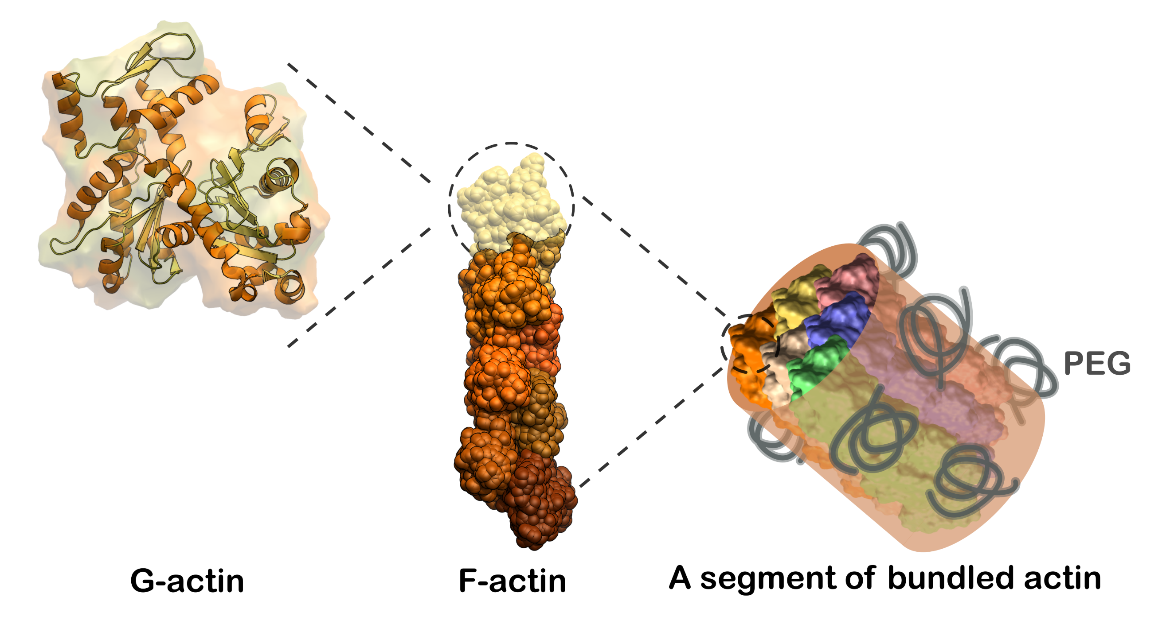
UT Austin MRSEC
DMR-1720595
Crowding alters secondary structure in F-actin bundles
José Alvarado & Carlos Baiz, University of Texas at Austin
The cytoskeletal component actin plays a crucial role in various cellular functions, including cell shape regulation and intracellular transport, by forming filaments and networks. Despite the current understanding of actin's morphological versatility, the impact of crowded environments—specifically how actin filaments organize into bundles and how this organization changes the protein secondary structure—remains under-explored. Here, we used two-dimensional infrared (2D IR) spectroscopy and structure based spectral calculations to map out structural changes of actin filaments under two degrees of crowding and bundling.
There is a transition from β-sheet to loop conformations with increased actin bundling.
Strongly bundled networks show a more "locked" β-sheet structure, with loops becoming less hydrated.
This structural transition underscores the loop's role in defining the network morphology and stability, which is crucial for the actin cytoskeleton's adaptability.
This understanding will aid in the design of actin gels that respond to dynamic, fueled changes in depletants, a key IRG goal.
F-actin possesses hierarchical order: G-actin (monomer), F-actin (polymer) and bundled actin with PEG depletants. The amount of loop conformations increases with increased actin bundling.
Notes:
What Has Been Achieved: Samples of actin filaments, weakly bundled networks, and strongly bundled networks were prepared with different molecular weights of PEG to induce crowding. The amide I vibrational mode of the actin backbone served as an infrared probe, offering insights into the secondary structures and backbone exposure of actin within these distinct morphological states. It was found that the strongly bundled networks had decreased beta-sheet structure and increased flexible loop structure compared to the weakly bundled networks and control actin networks without any PEG.
Importance of the Achievement: This structural transition underscores the loop's role in defining the network morphology and stability, which is crucial for the actin cytoskeleton's adaptability to crowded cellular environments.
How is the achievement related to the IRG, and how does it help it achieve its goals? Altogether, this work provides important structural insight to the changes that occur upon distinct depletion interactions, which will aid in the design of actin gels that respond to dynamic, fueled changes in depletants. Fueled changes in depletion interactions is a key thrust of the IRG, as this may provide a path to pluripotent materials.
Where the findings are published: Chen, X., Roeters, S.J., Cavanna, F. et al. Crowding alters F-actin secondary structure and hydration. Commun Biol 6, 900 (2023). https://doi.org/10.1038/s42003-023-05274-3

