Slide 1
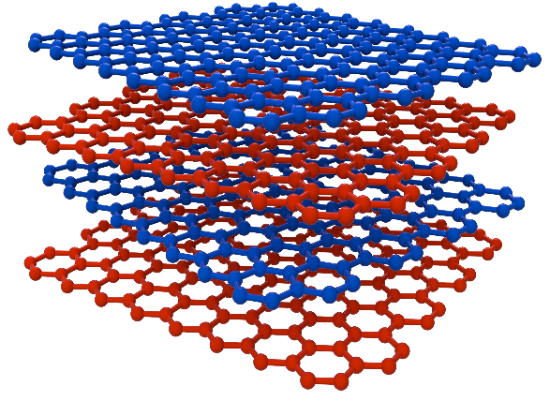

UT Austin MRSEC
DMR-1720595
Superconductivity and Correlations in Alternating Twist Quadrilayer Graphene
E. Tutuc, E. Khalaf: Univ. of Texas at Austin
Moiré materials realized by controlling the twist between different atomic layers represent an emerging family of crystals with unique electronic properties
At certain magic angles the electron velocity is greatly reduced, leading to spectacular effects like superconductivity, and magnetism
We demonstrate the emergence superconductivity, and correlated insulators in an alternating twist four-layer graphene structure
This achievement is important as it demonstrates magic angle hierarchy in graphene multilayers, achieved through accurate control of multiple twist angles in a moiré material
G. W. Burg, E. Khalaf, Y. Wang, K. Watanabe, T. Taniguchi, E. Tutuc, Nature Materials 21, 884 (2022),
θ
θ
Notes:
What Has Been Achieved: Alternating twist multilayer graphene (ATMG) has recently emerged as a family of moiré systems that share several fundamental
properties with twisted bilayer graphene, and are expected to host similarly strong electron–electron interactions near the magic angle. We study alternating twist quadrilayer graphene (ATQG) samples with twist angles of 1.96° and 1.52°. For a twist of 1.96° we find signatures of correlated insulators only when the ATQG is hole doped, and for the 1.52° twist we find evidence of superconductivity, while signs of the correlated insulators weaken. The above figure shows the schematic of the twist-controlled structures, the resistance vs density and density normalized by the Brillouin zone filling (n/ns), and differential resistance vs current measured close of -1/2 filling, illustrating superconductivity. Our results provide insight into the twist angle dependence of correlated phases in ATMG.
Importance of the Achievement: The results demonstrate magic angle hierarchy in graphene multilayers, which was possible through accurate control of multiple twist angles in a moiré material.
How is the achievement related to the IRG, and how does it help it achieve its goals? The study was supported through a UT MRSEC seed grant started in Fall 2020, and the scope and topic are related to proposed efforts in the MRSEC renewal.
Where the findings are published: “Emergence of correlations in alternating twist quadrilayer graphene”, G. William Burg, Eslam Khalaf, Yimeng Wang, Kenji Watanabe, Takashi Taniguchi, and Emanuel Tutuc, Nature Materials 21, 884 (2022), DOI: 10.1038/s41563-022-01286-2.

