Slide 1
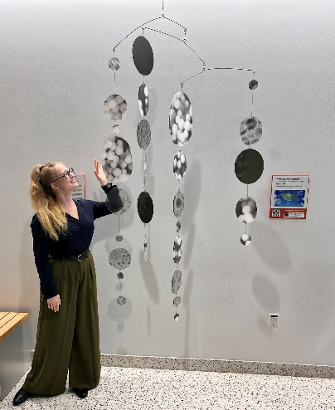
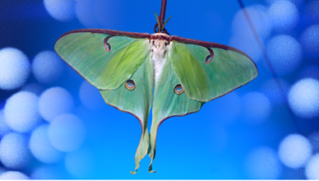
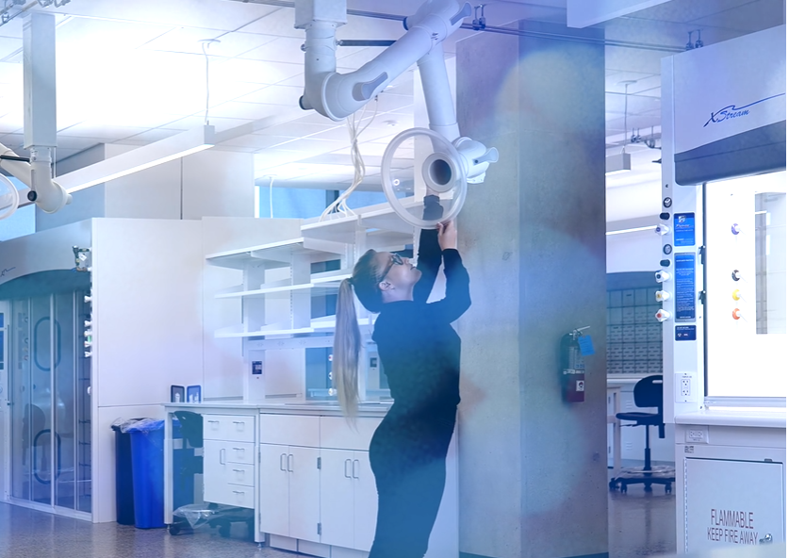
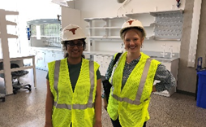
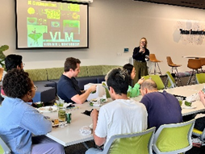
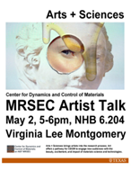
(Enter Institution) MRSEC
DMR-2308817
Arts+Sciences: A Collaborative Model
Virginia L. Montgomery, Artist in Residence & Risa Hartman, UT Austin
The artist residency program at the Center for Dynamics and Control of Materials enables artists to work with CDCM faculty to create contemporary art installations that demonstrate emerging science and technology, bringing fundamental concepts in science to the public in very tangible, engaging ways.
Virginia Lee Montgomery was funded as the CDCM Artist in Residence during 2024. She works with video, sculpture, performance, and sound and her artwork is a practice of metaphysics, latently autobiographical, often with a feminist impulse. Virginia was embedded in Prof. Brian Korgel’s lab studying quantum dots and hosted two artist talks while at CDCM. She produced a hanging mobile and video showcasing CDCM research. The mobile hangs in one of the main common areas at the Engineering Education and Research Building at the University of Texas at Austin with a QR code linked to her video that hangs beside the mobile. The video is also hosted on the CDCM website: https://mrsec.utexas.edu/education-outreach/artssciences-collaborative-model
2024 Artist in Residence – Virgina L. Montgomery’s art included a hanging mobile “Quantum Dots” and a video “Luna Moths and Quantum Dots”
Top Middle and Top Right: Still images from the art piece video “Luna Moths and Quantum Dots”
Left: Virginia Montgomery (artist) and Sejal Shah (graduate student from Prof. Brian Korgel’s lab working together in the filming of “Luna Moths and Quantum Dots”
Top Left: Virgina Montgomery and her Quantum Dots Mobile
Bottom left, Bottom center and Bottom right: Images from Virginia’s Artist Talks she gave at UT Austin while performing her residency.
Notes:
What Has Been Achieved: CDCM engaged with the Artist Virginia L Montgomery to bridge the gap between center research and the general public through the creation of a mobile and video that showcases center research in a creative and accessible way. During her residency, Virginia was embedded in a CDCM lab and interacted with faculty and graduate students to first understand some of the research and add her outside artist perspective to their work. She hosted two artist talks while at CDCM to engage the center with her work and share about the pieces she developed for CDCM Artist in Residency program.
Importance of the Achievement: The mobile and QR code for her video hangs in a highly visible and high traffic area in the flagship engineering building on the UT Austin campus. Thousands of people will walk past it each year and the mobile was designed for viewer interaction. In addition to faculty, staff and students, the Engineering Education and Research building hosts school groups and large conferences with non-science participants.
How is the achievement related to the Center, and how does it help it achieve its goals? One of the goals of CDCM is to engage a broad audience and create a community of practice whereby the general public can interact with the work of the Center. The Artist in Residence program create opportunities for the general public to interact with the research of the center in accessible and interesting ways.
Where the findings are published: The artwork hangs in the Engineering Education and Research Building on the UT Austin Campus and her work is also highlighted on the CDCM Artist in Residence webpage.

