Slide 1
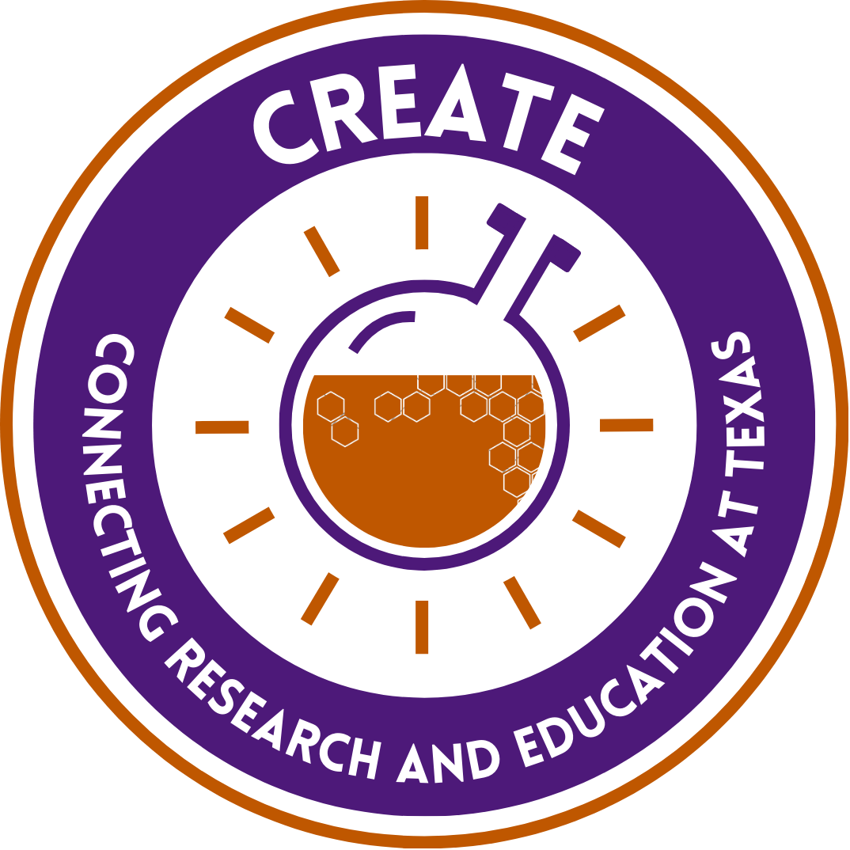
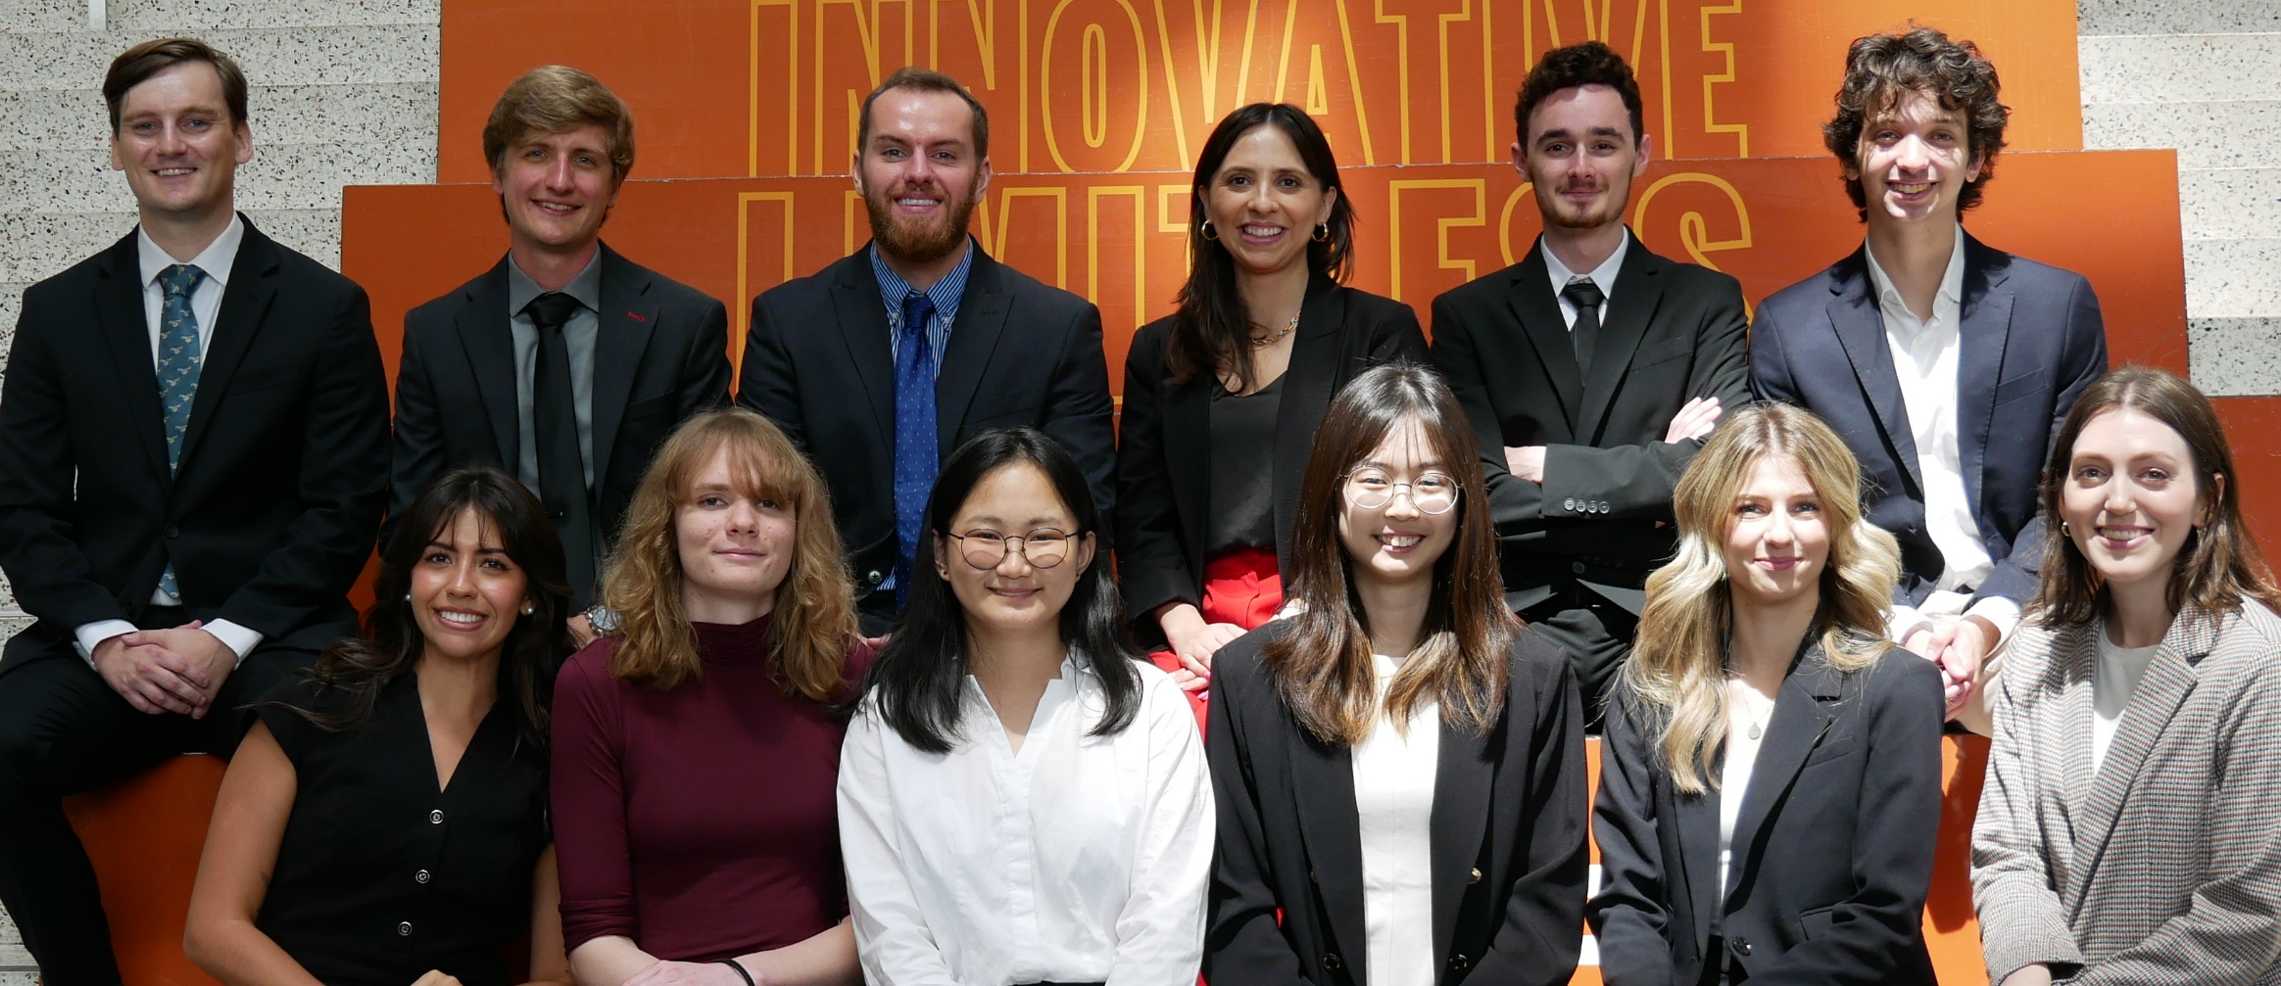
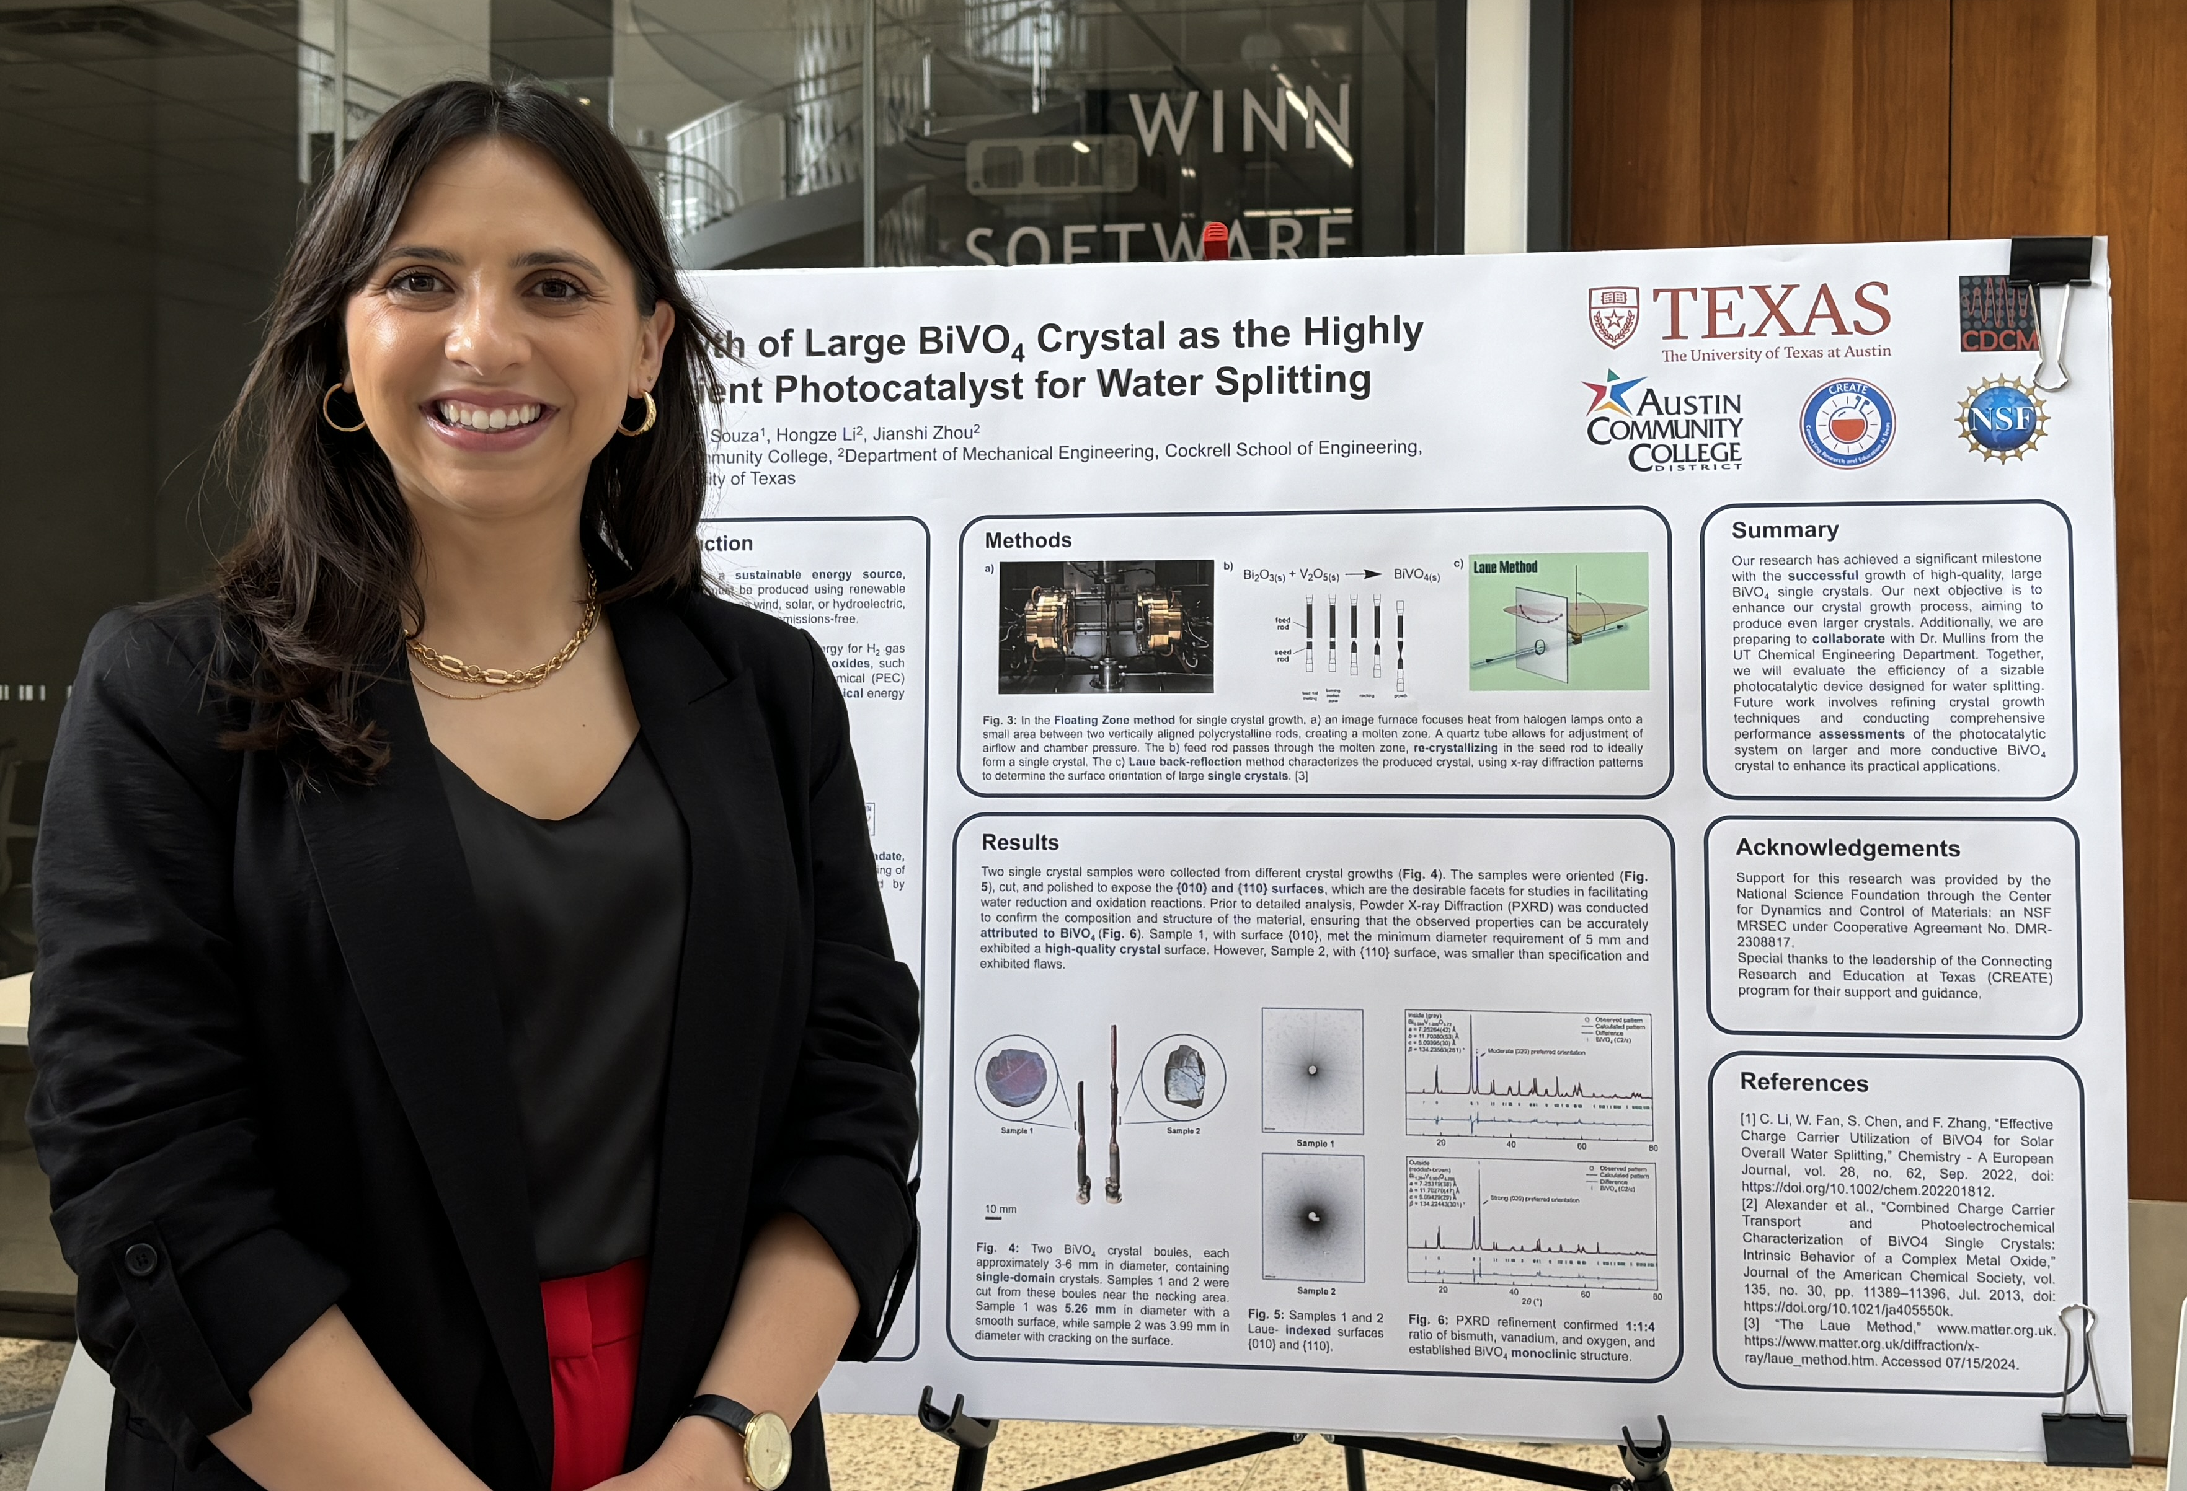
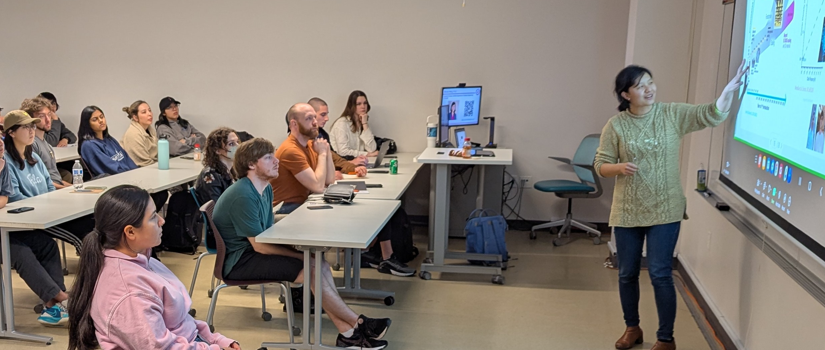

Center for Dynamics & Control of Materials, DMR-2308817
CREATE: Connecting Research and Education At TExas
Sean Roberts (UT Austin), Shawn Amorde (ACC), Purna Murthy (ACC)
Connecting Research and Education At TExas (CREATE) is a partnership program established between UT Austin and Austin Community College (ACC) whose goal is to increase retention of community college students in STEM. CREATE works to achieve this goal by building relationships between ACC students and UT Austin researchers through a fall/spring seminar series held at ACC that features UT faculty speakers and a 9-week summer research program that pairs ACC students with research mentors at UT Austin. With support from the CDCM, over the past two years CREATE has expanded into materials science, engineering, and physics, with CDCM faculty volunteering to serve as both seminar speakers and research mentors for CREATE.
CREATE has a growing track record for success. 71% of CREATE students have transferred to a 4-year university, which outstrips ACC’s baseline transfer rate of 37%. CREATE students have earned authorship on 10 research publications and alumni are enrolled in graduate programs at universities such as Penn State, UNC Chapel Hill, Pitt, and the University of Washington. CREATE was also named the 2024 recipient of the Partners in Progress & Prosperity (P3) Award given out by the ACS Southwest Region.
Top: Photo of the CREATE 2024 student cohort taken at the program’s capstone poster session in July 2024. Left: Perylenediimide dyes synthesized by CREATE student Paige Melancon. Bottom Left: CREATE seminar held in February 2025 featuring CDCM Seed investigator Wennie Wang. Bottom: CREATE student Burna Leao Souza pictured with her capstone poster.
Notes:
What Has Been Achieved: CDCM has partnered with Connecting Research and Education At TExas (CREATE), a program that seeks to expand community college engagement in the physical sciences. Through this partnership, CDCM faculty have directly interacted with Austin Community College (ACC) students, giving research seminars at ACC and serving as summer research mentors for visiting ACC students. In summer 2024, the CDCM provided financial support to 4 ACC researchers who conducted research over a 9-week period in labs associated with CDCM faculty.
Importance of the Achievement: CREATE has shown a demonstrable track record for student success. Since its inception, over 70 students have participated in CREATE’s summer research program. 71% of these students have transferred to 4-year year universities to pursue degrees in STEM. Several CREATE alumni have gone on to graduate study after completing their degrees and at least one CREATE student has been named a recipient of the NSF GRFP award.
How is the achievement related to the IRG, and how does it help it achieve its goals? One of the goals of CDCM is to engage a broad audience and create a community of practice whereby the general public can interact with the work of the Center. CREATE engages students at ACC, providing them with an opportunity to engage in research via the CDCM. The seminar series organized by CREATE at ACC is also open to the general public and local high school students as well as ACC faculty and staff regularly attend and hear about research projects that are ongoing within CDCM.
Where the findings are published: A news story featuring CREATE (“CREATE Program Brings Research Opportunities to Community College Students”) was published in March 2023. The program also received the Partners in Progress & Prosperity Award from the American Chemical Society’s Southwest Division in 2024.

