Slide 1


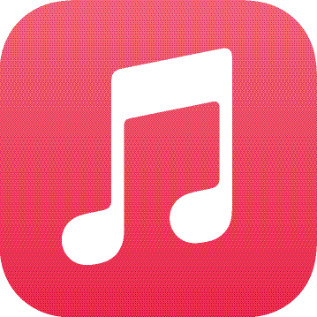



UT Austin MRSEC
DMR-2308817
The Materials Universe Podcast: Bringing Materials Research to the General Public
Risa Hartman, UT Austin
Podcasts Represent a Growing Avenue for Engaging the General Public
38% of US adults report listening to podcasts monthly in 2022 vs. 26% in 2018. This increases to 50% among 12 – 34 year olds. (Edison Research)
Science podcasts have grown exponentially, but few focus on materials science. (MacKenzie, R. Soc. Open sci. 2019)
Season 1 of The Materials Universe: 6 episodes featuring MRSEC faculty (Yu, Milliron, Roberts, Rosales, Akinwande, Li)
Geared towards an audience ages 15+
Episodes drop once a month; 4 episodes have been released
Streaming on Spotify and Apple Music, or wherever you get your podcasts
Podcast Listenership Statistics: 1,048 Total Streams, 318 Unique Listeners, 166 Followers
Streaming on Spotify and Apple Music, and all other podcasting platforms
The Materials Universe Podcast Logo
The Materials Universe Podcast will be cross-listed on these platforms
Notes:
What Has Been Achieved: CDCM has designed and launched one of the few materials science podcasts available to the public. The first season will feature 6 episodes where the podcast host, Abbey Stanzione, interviews CDCM MRSEC faculty about their educational backgrounds, pathway into academia and their cutting edge materials science research.
Importance of the Achievement: Making materials science research accessible to the general public is a focus area for the National Science Foundation and MRSEC association. Podcast listenership is a growing trend in the last 6 years and more than 38% of adults report listening to podcasts as a means of gathering information on the world at large. Currently there are very few podcasts focusing on materials science and The Materials Universe Podcast brings listeners an insider view into the fascinating world of materials science research and discoveries.
How is the achievement related to the Center, and how does it help it achieve its goals? CDCM seeks to establish a materials science community of practice and broaden participation in materials science at all levels. This podcast creates greater transparency with the research of the center and is very accessible to a diverse audience of listeners ranging from 15 – 99+. People completely unfamiliar with the materials science community can tune in and learn about exciting new discoveries, research directions, and how they pertain to their lives. Additionally, listeners from academia can also tune in and become more familiar with the landscape of research with the CDCM MRSEC. The podcast spreads awareness of the importance of this research and how it benefits society.

