Slide 1
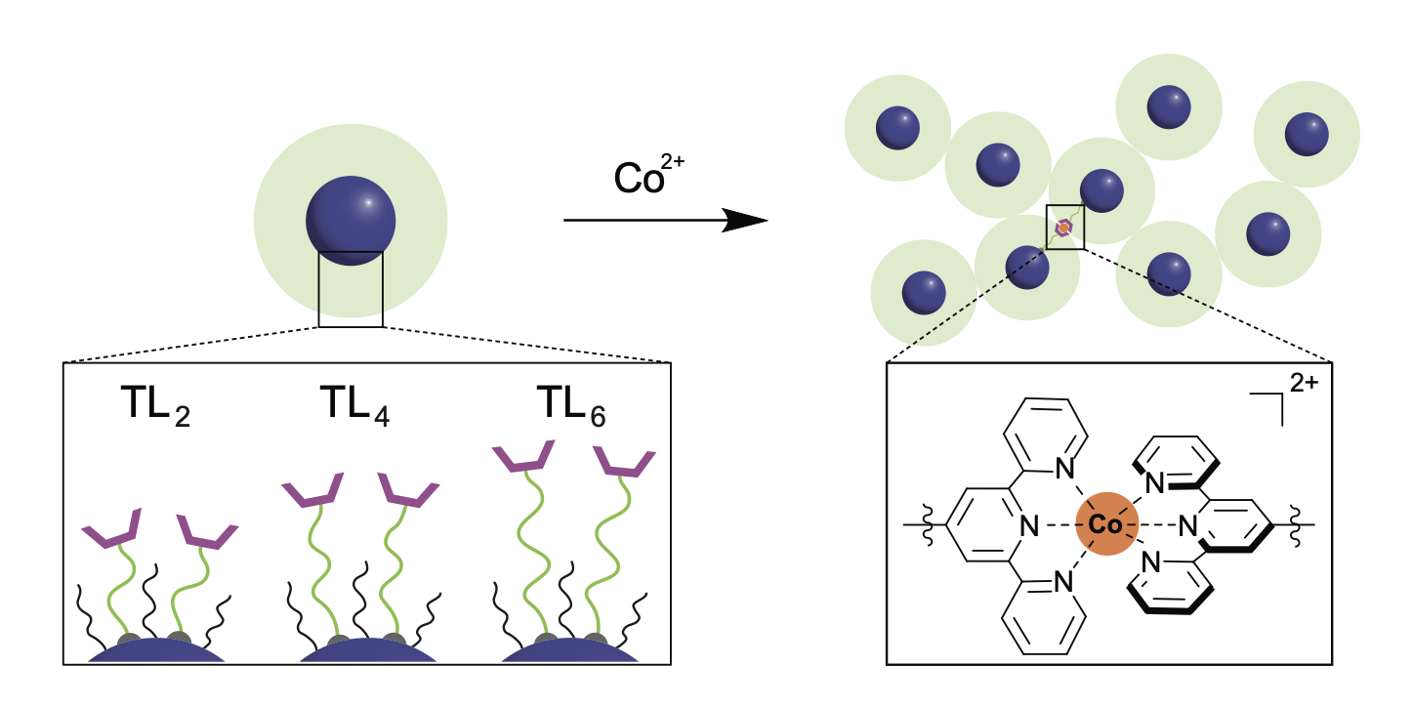
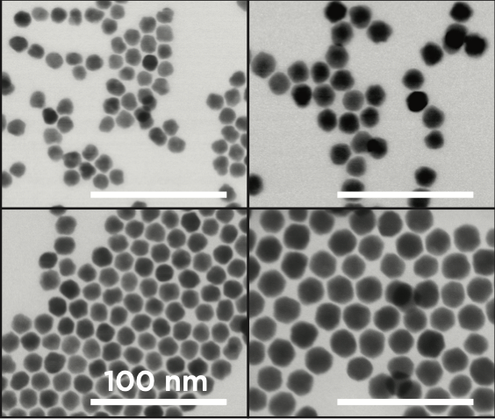
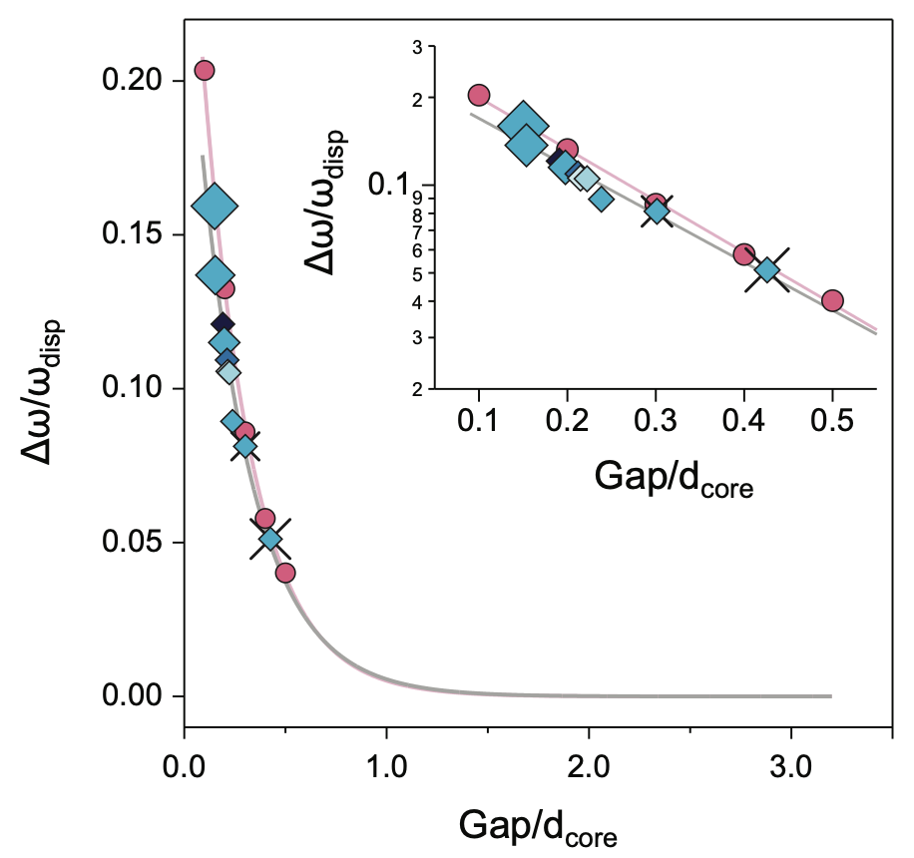
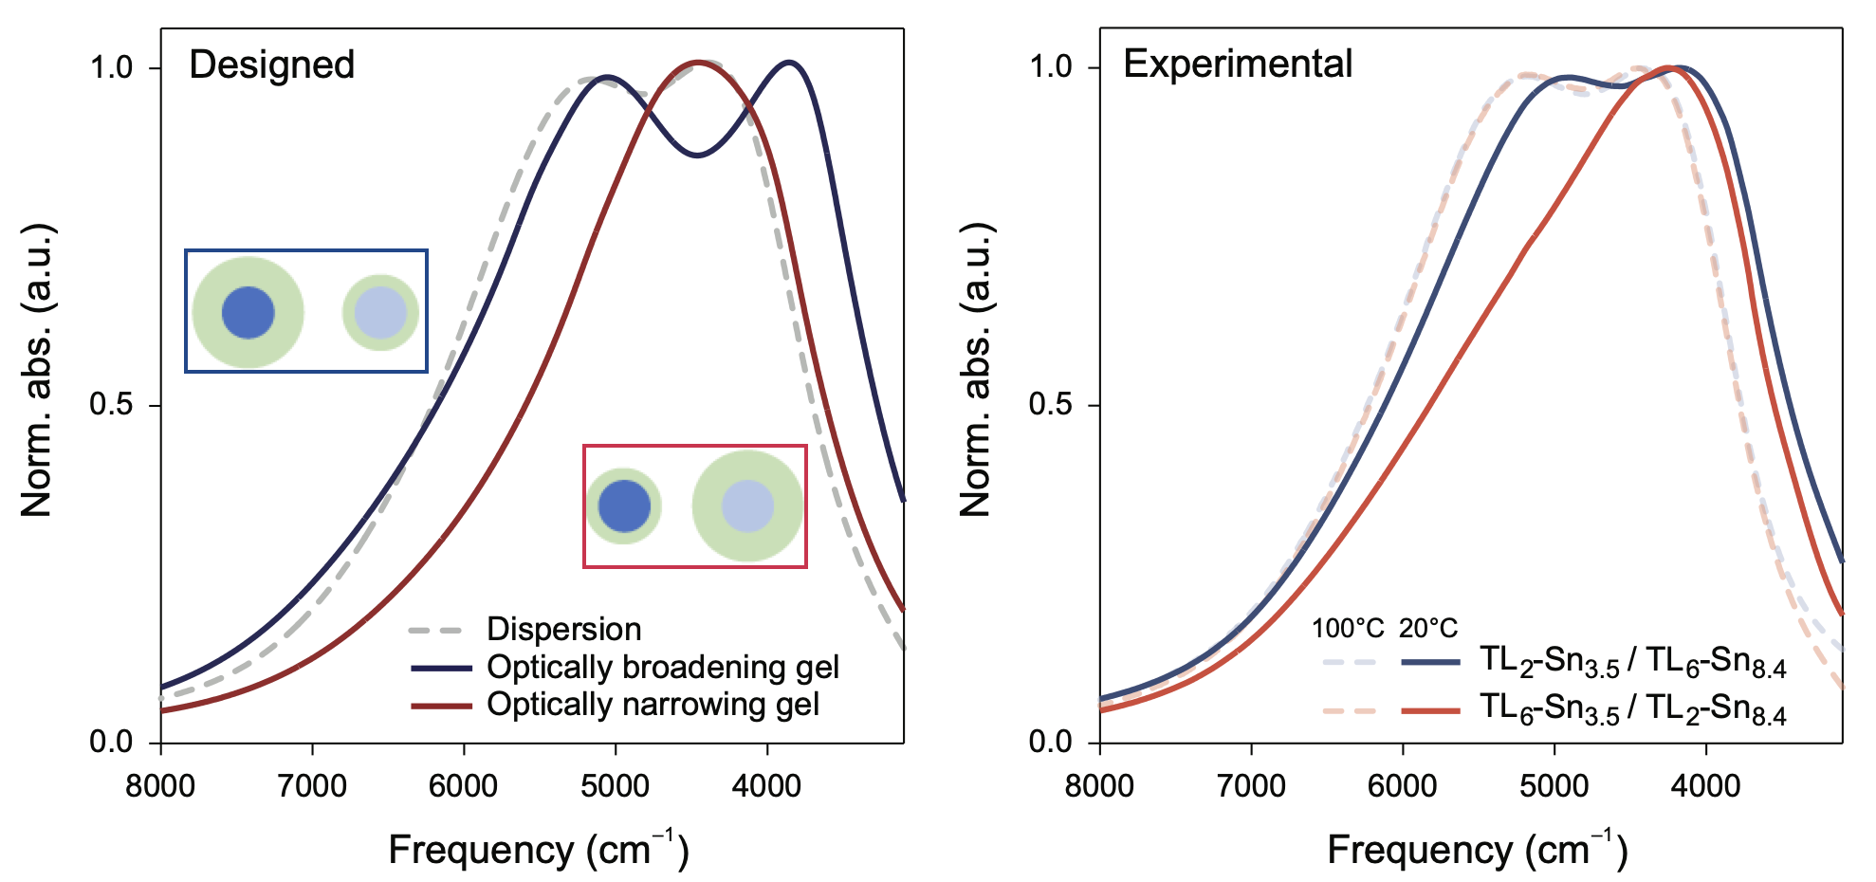
UT Austin MRSEC
(DMR-2308817)
Structure tunable optical properties in linked nanocrystal gels
Delia J. Milliron, Thomas M. Truskett, Eric V. Anslyn (UT Austin)
Controlling optical properties of disordered materials like gels is challenging because their structure is heterogeneous and strategies for tuning are few
Consistent and tunable structure ITO nanocrystal gel networks was achieved with thermoreversible metal coordination links
Small angle X-ray scattering was used to quantify changes in inter-nanocrystal spacing as the ligand length was synthetically varied
A “plasmon ruler” that was developed and theoretically verified that can predict the plasmonic optical frequency of a gel
The plasmon ruler enables design of dynamic optical response by selection of nanocrystals and ligands
Design of mixtures with optical spectra that either broaden or counterintuitively narrow upon gel formation was demonstrated
Future development of the computational design principles and dynamic linking chemistries will be used to encode time-dependent responsive optical properties in nanocrystal assemblies
Notes:
What Has Been Achieved: Optical properties of plasmonic ITO nanocrystal gels, assembled by thermoreversible cobalt terpyridine links, were tuned systematically based on the size and doping concentration of the nanocrystals and length of the custom ligand molecules. Correlation of optical shifts upon assembly with nanocrystal spacing deduced by small angle X-ray scattering was used to develop a universal structure-property relationship that was validated by large-scale optical simulations on gels made using Brownian dynamics simulations. The design rules led to the demonstration of either broadening or narrowing optical spectra upon gel formation.
Importance of the Achievement: Disordered materials can be quickly assembled and reconfigured, but rationally designing their properties is challenging. This demonstration of systematic tuning sets the stage for implementing time-dependent optical response in future IRG work.
How is the achievement related to the IRG, and how does it help it achieve its goals? Both the chemical strategies and computational methods will be a springboard for on-going efforts in the IRG to develop materials whose structure and optical properties evolve deliberately over time.
Where the findings are published: J Kang, ZM Sherman, DL Conrad, HSN Crory, MN Dominguez, SA Valenzuela, EV Anslyn, TM Truskett, DJ Milliron, ACS Nano (2023). doi:10.1021/acsnano.3c09515

