Slide 1
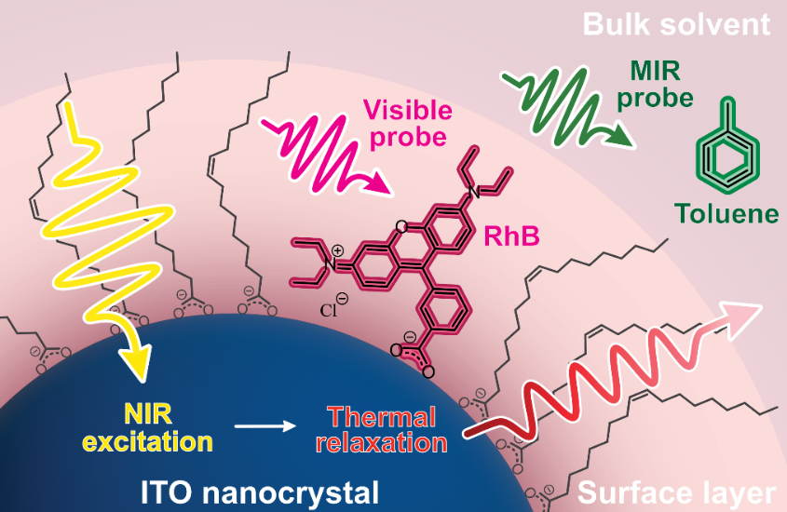

Center for Dynamics & Control of Materials, DMR-2308817
Converting Light into Heat using Plasmonic Metal Oxide Nanocrystals
Sean T. Roberts, Carlos R. Baiz, Delia J. Milliron, & Thomas M. Truskett
What Has Been Achieved: Metal Oxide nanocrystals that incorporate dopants (impurities) can display intense absorption bands known as localized surface plasmon resonances (LSPRs) that can transduce light into heat. Using a series of time-resolved measurements with femtosecond resolution together with a theoretical heat transfer model, we have quantified timescales over which tin-doped indium oxide (ITO) nanocrystals heat their environment following light absorption.
Importance of Achievement: We find heat transfer to molecules bound to the surface of ITO nanocrystals occurs rapidly, over tens of picoseconds, while heat transfer from these molecules to a surrounding solvent is slower, occurring over a few nanoseconds. This difference in timescales allows molecules at a nanocrystal’s surface to be heated significantly by light, reaching temperatures of a few hundred Kelvin above room temperature under appropriate conditions.
Relationship of Achievement to IRG: In prior work, we have established that ITO nanocrystal gels with unique optical properties can be formed by cross-linking nanocrystals to one another via thermally reversible links. By heating nanocrystals in these gels using light, we can reconfigure the gel’s structure and thereby reshape its optical and physical properties.
By exciting an ITO nanocrystal with near-infrared (NIR) light, we generate heat that can be passed from the nanocrystal to its environment. We have tracked this process using probes placed at a nanocrystal’s surface and in its surrounding solvent that show colorimetric changes on heating.
Notes:
What Has Been Achieved: While prior work has extensively investigated photothermal heat generation by plasmonic structures based on noble metals such as gold and silver, photothermal heat generation by plasmonic structures based on doped metal oxides remains underexplored. In this work, we have quantified photothermal heat generation by ITO nanocrystals that display a plasmonic resonance in the near-infrared spectral range, making them of potential utility for applications in photothermal therapy and smart window technology. We find a bottleneck exists in the dissipation of heat from nanocrystals to their environment wherein heat is initially trapped in a surface layer of molecules comprised of ligands that are directly bound to a nanocrystal’s surface as well as solvent molecules that intercalate within the ligand layer. This allows molecules in this layer to reach very high temperatures (~200 K above their starting temperature) upon illumination by near-infrared light.
Importance of the Achievement: Our work suggests ITO nanocrystals hold promise for a range of photothermal applications. By binding molecules to a nanocrystal’s surface, light can be used to heat these molecules substantially. This could lead to potential new approaches for photothermal therapy and could be used to drive photocatalysis via thermal activation of molecules by light.
How is the achievement related to the IRG, and how does it help it achieve its goals? ITO nanocrystal gels targeted by the IRG for fueled assembly are held together by tunable, orthogonal, reversible, covalent (TORC) bonds that are thermally reversible. Thus, heating ITO nanocrystals using light provides a mechanism by which these bonds can potentially be released, thereby allowing nanocrystal gels to transient reconfigure their structure. Upon the removal of light, nanocrystals are expected to reestablish TORC linkages and reform a gel. Hence, light can provide a “fuel” that can enable the disassembly of a gel. Once the fuel is removed, the nanocrystals in a sample are expected to revert to their initial state, reforming the gel.
Where the findings are published: This work is in the final stages of being prepared for publication. We anticipate a manuscript will be submitted for peer review in March 2025. Once submitted, this work will also be made available via ChemRxiv.

