Slide 1
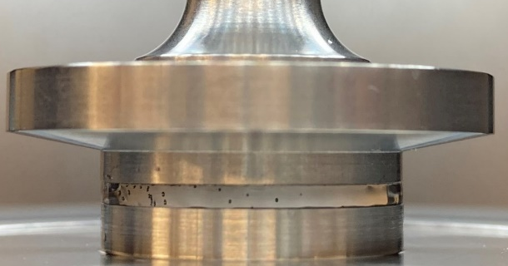
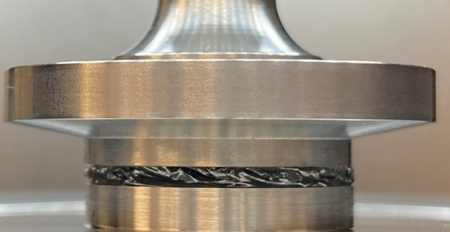
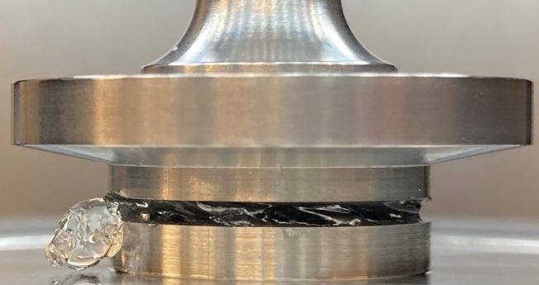

UT Austin MRSEC
DMR-1720595/2308817
Nonlinear Rheological Behavior of Dynamic Covalent Gels
Adrianne Rosales, Eric Anslyn, The University of Texas at Austin
Hydrogels with dynamic linkers have garnered intense interest for applications that require flow, including injectable delivery vehicles and 3D bioprinting inks. However, to fully enable these applications, there remains a need to understand how linking chemistry affects gelation and nonlinear rheological properties. To probe this relationship, we developed synthetic multi-arm polyethylene glycol (PEG) gels linked with dynamic covalent bonds.
Dynamic covalent hydrogels exhibit non-monotonic flow curves under steady shear, with shear thickening behavior that depends on exchange kinetics of linkers.
Transient shear measurements indicate chain stretching is responsible for shear thickening.
These results will guide hydrogel design for injectable gels and 3D bioprinting inks.
This work supports the IRG goals of developing strategies for dynamic polymeric depletants and materials with rheo-adaptive behavior.
Right: shear stress as a function of shear rate for a dynamic covalent PEG gel, showing non-monotonic flow. Bottom: images of the gel on a shear rheometer at each shear regime.
1
2
3
Shear Rate (1/s)
1
Newtonian
2
3
Flow instability
3
Material expulsion
2
Shear thickening
Notes:
What Has Been Achieved: We developed synthetic multi-arm poly(ethylene glycol) (PEG) hydrogels with three different dynamic covalent linking chemistries. They exhibit non-monotonic flow curves under steady shear, with shear thickening behavior that depends on the crosslinking bond exchange kinetics and polymer concentration. We probed the mechanism of shear thickening behavior using two techniques: transient steady shear measurements and absorbance under shear measurements. The transient steady shear measurements indicated reversible shear thickening behavior, and the absorbance under shear measurements indicated that the extent of bond formation in the hydrogel remained constant. Both results point to chain stretching as a primary driver of shear thickening behavior.
Importance of the Achievement: These results will guide hydrogel design for injectable gels and 3D bioprinting inks.
How is the achievement related to the IRG, and how does it help it achieve its goals? The dynamic control of reversible covalent bonding and generating fueling strategies for achieving non-equilibrium steady states of complex assemblies of soft materials, biomaterials, and nanocrystals are the two overarching themes of IRG1. Our research accomplishments in the area of TORC-linked polymer networks lay the groundwork for new fueling strategies, dynamic depletants, and materials with rheo-adaptive behavior, all of which are key goals of IRG 1.
Where the findings are published: Macromolecules 2023, 56, 19, 7795–7807, https://doi.org/10.1021/acs.macromol.3c00780

