Slide 1
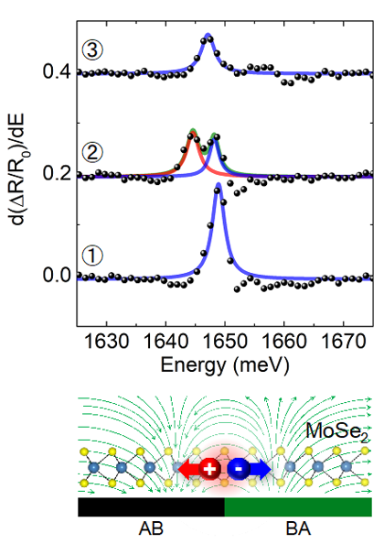
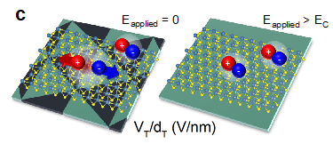
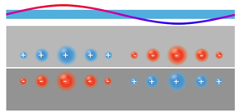
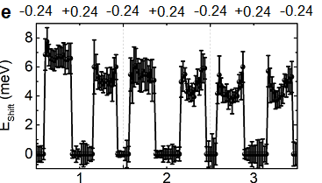
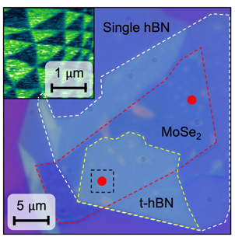
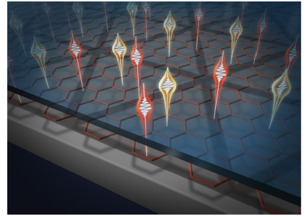

UT-Austin MRSEC
DMR- 2308817
Harnessing moiré ferroelectricity to modulate light emission from a semiconductor monolayer
Li and Shih at UT-Austin + Miyahara at Texas State Univ (PREM)
A heterostructure consisting of a twisted hBN substrate and a semiconductor functional layer has been built, combining the properties of the two components
Twisted hBN substrates leads to ferroelectric domains due to inversion symmetry breaking at the interface; the electrostatic potential on the top surface may be used to modify properties of an adjacent layer
In the plane electric field at the domain walls separate the electron-hole pair and induces Stark shifted excitons
A global gate can erase and restore ferroelectric domains, leading to hysteresis and switching in light emission.
A demonstration of using remote moiré potential to modulate a functional layer, a key goal of the IRG 2
(a)
Functional layer
(c)
(e)
(b)
Twisted hBN
(f)
(d)
(g)
(a) Illustration of how the remote potential from twisted hBN modulates a functional layer. (b) optical image of heterostructure and Kelvin probe force microscopy image of twisted hBN, (c) optical spectra taken from three locations, the middle one is taken at a domain wall; (d) in-plane E-field induces Stark shift; (e) electric gate erases and restores ferroelectric domains. (f) electric field switching of light emission; (g) illustration of spectral and spatial modulation of light emission in vdW heterostructure
Kim et.al Under review
Notes:
What Has Been Achieved: We show that ferroelectric polar domains formed in a twisted hexagonal boron nitride (t-hBN) substrate can modulate light emission from an adjacent semiconductor monolayer. The abrupt change in electrostatic potential across the domains produces an in-plane electric field (E-field) and leads to a remarkably large exciton Stark shift in the adjacent MoSe2 monolayer, previously only observable in p-n junctions created by the advanced e-beam lithography tools. Both the spectrum and spatial pattern of the light emission of the monolayer are periodically modulated by the remote moire potential imposed by the t-hBN substrate.
Importance of the Achievement: Ferroelectricity has been recently discovered in stacked or twisted van der Waals (vdW) layers. The versatility of producing a large array of size-tunable domains and integration with diverse functional materials make them an enticing platform for developing multifunctional devices. Here, we show that ferroelectric polar domains formed in a twisted hexagonal boron nitride (t-hBN) substrate can modulate light emission from an adjacent semiconductor monolayer.
How is the achievement related to the IRG, and how does it help it achieve its goals? One key goal of IRG 2 is to extend the strategy of moire engineering to a broader range of materials using the concept of remote potential engineering. This work represents the first demonstration of combining the functionality of a moire substrate and the light emission properties of a semiconductor monolayer.
Where the findings are published: Under review at Nature Nanotechnology

