Slide 1
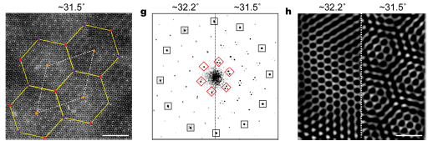
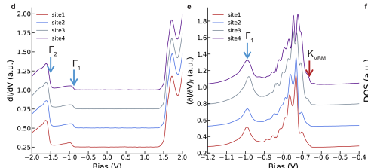

(UT-Austin) MRSEC
DMR-2308817
Novel Electronic Bands in a Supermoiré Lattice
Super-moiré patterns identified in WSe2 bilayer with large twist angles
Graphene and transition metal dichalcogenide (TMD) bilayers with a small twist angle are known to host flat bands and novel electronic states, correlated insulators, topological insulators, or superconductivity
Angle deviation near large commensurate angles (32.2) spontaneously form super-moiré;
Deviation from the commensurate angle determines the second period, directly identified from the TEM spatial images (a,c) and their Fourier transform (b).
Electronic bands from (d) a 32.2º commensurate bilayer and (e) a 31.1º bilayer.
A Super-moiré (e.g. 31.1º and 31.5º bilayer) combining the benefits of the large twisted angle (smooth moire pattern without reconstructions) and small twist angle (narrow electronic bands)
Shih, Han (Rice), Khalaf (Harvard), Giustino, Robinson (Penn State), Li
(a)
(b)
(c)
(d)
(e)
arXiv:2502.12335, Nature Physics, in press
Notes:
What Has Been Achieved: Discovered that super-moiré structure in a large-angle single twisted WSe2 bilayer, which hosts narrow electronic bands.
Importance of the Achievement: While moiré superlattices in graphene and transition metal dichalcogenide (TMD) bilayers with small twist angles are known to exhibit flat bands and host exotic correlated phases, strong lattice reconstruction in these systems poses challenges. In contrast, large-angle bilayers are structurally robust but typically considered electronically decoupled. Here, we discover robust super-moiré patterns emerging near a large commensurate angle, combining the advantages of both regimes—structural stability with flat electronic bands. This work expands moiré twistronics and flat-band quantum physics into the large twist-angle regime.
How is the achievement related to the IRG, and how does it help it achieve its goals?
Our discovery of robust super-moiré patterns at large commensurate angles directly aligns with IRG 2's goal of exploring engineered symmetries and patterns in atomically thin heterostructures. By demonstrating a structurally stable moiré system that retains flat electronic bands, our work expands the moiré twistronics platform to previously overlooked large-angle regimes and extends the scope of engineered functionality in atomically thin heterostructures, reinforcing IRG 2’s mission to explore emergent quantum phenomena in moiré systems.
Where the findings are published: arXiv:2502.12335, Nature Physics (in press)

