Slide 1

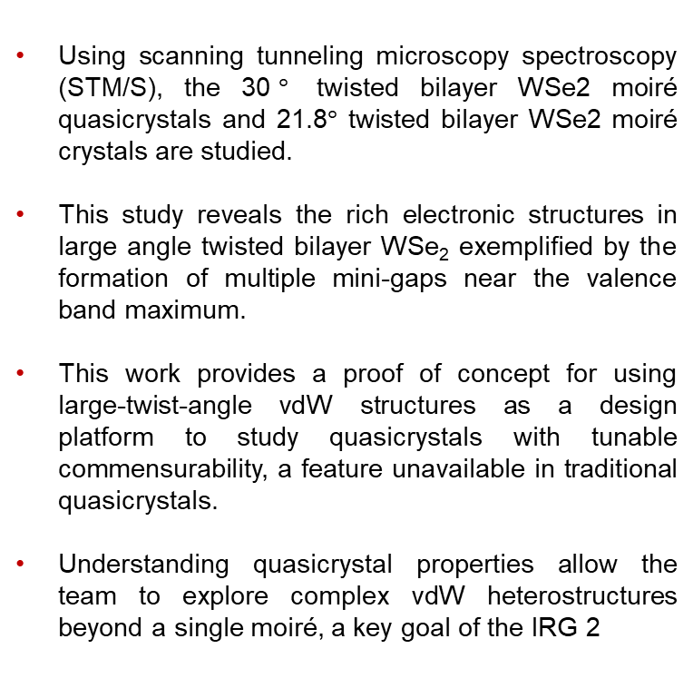
UT-Austin MRSEC
DMR- 2308817
Tuning commensurability in twisted van Der Waals (vdW) bilayers
Shih, Khalaf, Giustino, Li groups at UT-Austin
Using scanning tunneling microscopy spectroscopy (STM/S), the 30$°$ twisted bilayer WSe2 moiré quasicrystals and 21.8$°$ twisted bilayer WSe2 moiré crystals are studied.
This study reveals the rich electronic structures in large angle twisted bilayer WSe₂ exemplified by the formation of multiple mini-gaps near the valence band maximum.
This work provides a proof of concept for using large-twist-angle vdW structures as a design platform to study quasicrystals with tunable commensurability, a feature unavailable in traditional quasicrystals.
Understanding quasicrystal properties allow the team to explore complex vdW heterostructures beyond a single moiré, a key goal of the IRG 2
a, STM image of a 30° moiré quasicrystal and its diffraction pattern (inset). b, Schematic of the first three orders of Umklapp scatterings near the first Brillouin zone for the 30° quasicrystal. c, STM image of a 21.8° moiré crystal and its diffraction pattern (inset). d, Left: schematic showing the first Brillouin zones for 21.8° (38.2°) twisted WSe2 bilayer. Right: schematics showing the anti-crossing coupling at μ and the coherent coupling at κ (κ′).
Yanxing Li, Fang Zhang, et.al. Nature, 625, 494, 2024
Notes:
What Has Been Achieved: The researchers used scanning tunneling microscopy spectroscopy (STM/S) and nano-ARPES to investigate electronic structures of 30$°$ twisted bilayer WSe2 moiré quasicrystals and 21.8$°$ twisted bilayer WSe2 moiré crystals. The former featured an aperiodic long-range order that yield a dense set of diffraction spots in the k space. The VHS signatures originating from several mini-gaps in the quasiperiodic structure were observed that can be explained using a coupled K-valley model with up to third-order Umklapp scattering suggesting strong interlayer coupling. For the commensurate 21.8° (38.2°) structure, two points in the moiré Brillion zone of interest were the anti-crossing at the μ point and the coherent coupling at κ point, which were also probed by the unique technique: constant current STS. In contrast to the previously studied 30° twisted bilayer graphene, the flatter dispersion of our system leads to stronger interlayer coupling at a smaller bias voltage making it a very promising platform to study the physics of moiré quasicrystals at finite doping and gating.
Importance of the Achievement: TMD-based moiré quasicrystals is a semiconductor system with strong spin–orbit coupling that endows a rich interplay of valley and spin degrees of freedom that affect both optical and transport properties. The theoretical analysis further shows that such moiré quasicrystals can be generalized to multilayer structures with higher rotational symmetry in which the quasiperiodic interlayer coupling can be brought down in energy even further. For example, using trilayers with two consecutive 20° twists, a previously unknown type of quasicrystal with 18-fold rotational symmetry and with an even denser set of diffraction patterns in which the mini-gaps are expected to occur at smaller doping. This work provides a proof of concept for using large-twist-angle vdW structures as a design platform to explore moiré physics beyond those formed at small twist angles.
How is the achievement related to the IRG, and how does it help it achieve its goals? This study demonstrate the rich electronic structures in large angle twisted bilayer WSe₂ exemplified by the formation of multiple mini-gaps near the valence band maximum. By tuning the commensurability, the moiré material properties and functionalities can be precisely engineered. Moreover, by tailoring the band dispersion of the moiré crystals and quasicrystals at large twist angles, it paves the road for the further study of gate tunable electron correlation and photonic structures that harness the unique properties of moiré materials. This exactly matches the goal of IRG2. After this work, more related collaborations in optical and transport studies of the same systems are on going at UT Austin.
Where the findings are published: Nature volume 625, pages494–499 (2024) DOI: 10.1038/s41586-023-06904-w

