Slide 1
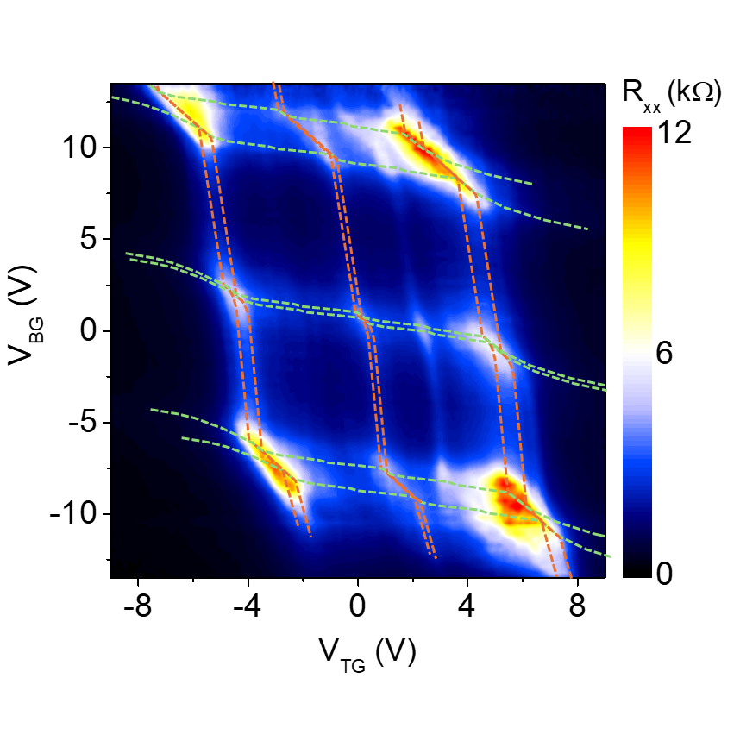
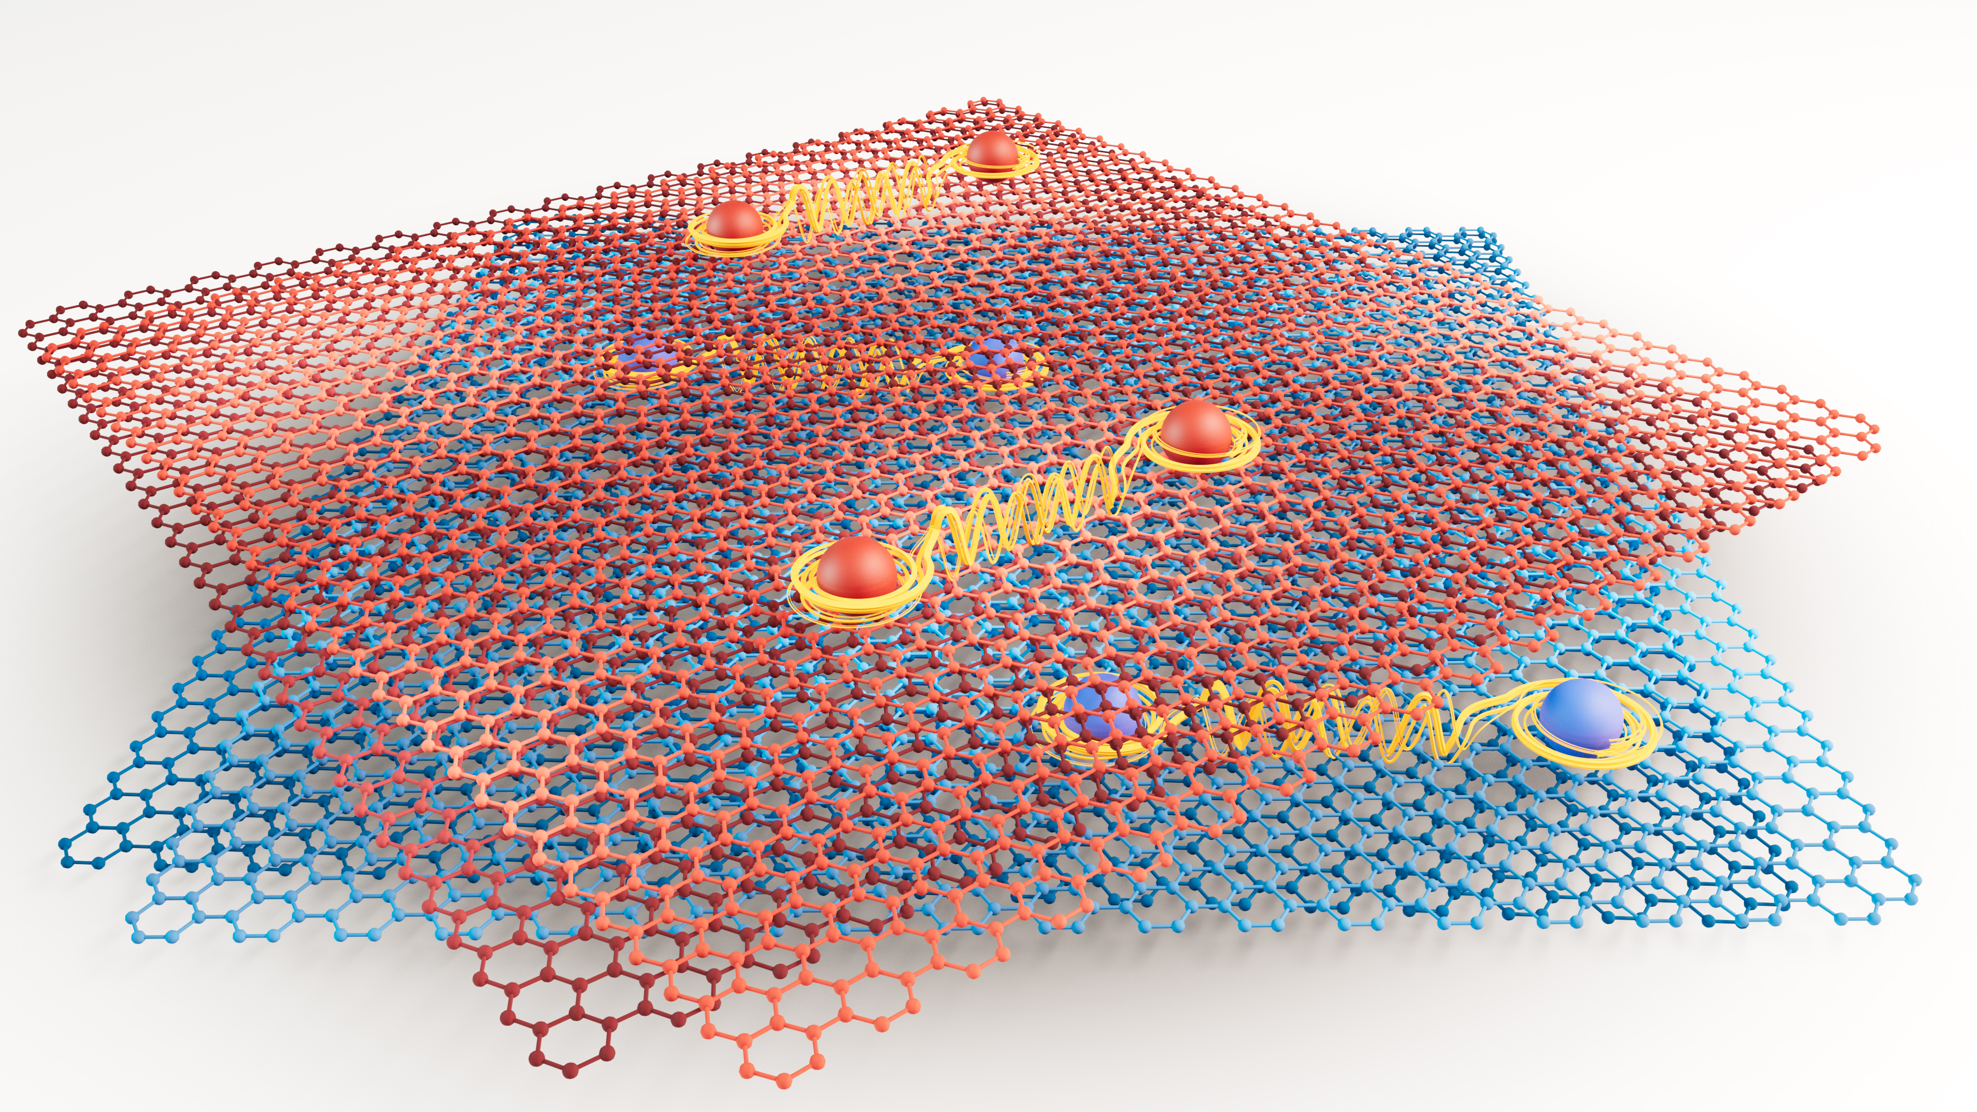
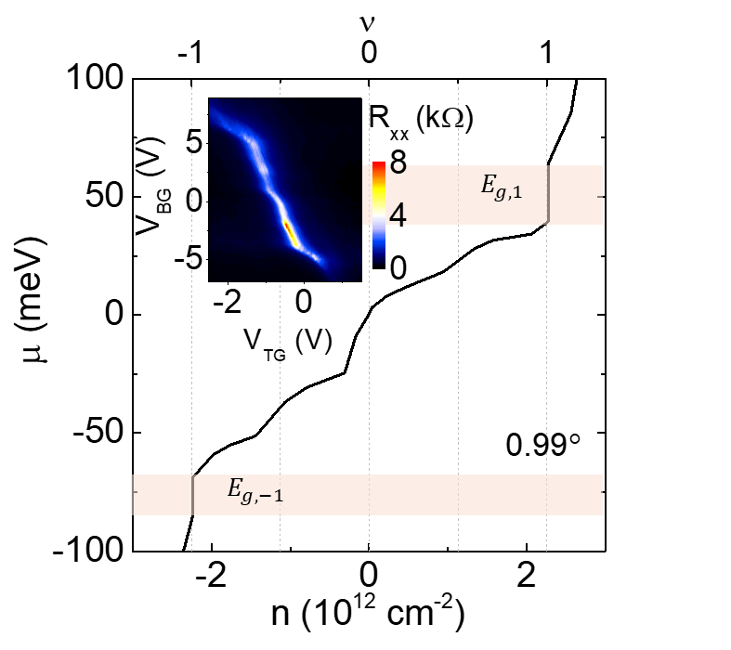
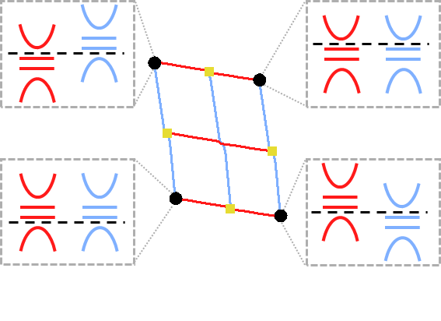
(UT-Austin) MRSEC
DMR-2308817
Independently Tunable Flat Bands and Correlations in a Graphene Double Moiré
Novel double moiré system realized in a four-layer twist- controlled graphene structure
Twisted bilayer graphene at magic angle hosts flat bands, correlated insulators and superconductivity
Spatially separated flat bands can be realized in a twist-controlled four-layer graphene structure, where the twist between layers top two and bottom two layers is small, while the twist between layers 2 and 3 is intentionally kept large
Insulators observed when the Brillouin zones of individual top or bottom moiré are filled, provides evidence for spatially separated bands
Individual moiré near magic angle show correlated insulators
An electrostatic analysis of the resistance vs top and bottom gates provides the chemical potential vs filling factor of the flat bands
Tutuc, MacDonald, Zheng, Taniguchi, Watanabe (NIMS, Japan)
Wang et al., Physical Review Letters 134, 096204 (2025)
Notes:
What Has Been Achieved: Realized a graphene double moiré structure and demonstrated independently tunable flat bands in such structure
Importance of the Achievement: These double moiré twist-controlled structure goes beyond the single moiré structures generally investigated in twisted bilayer graphene or transition metal dichalecogenides. The results show that demonstrate that electronic confinement in multilayer graphene stacks can be compactly realized by changing the twist angles, in contrast to traditional band engineering that employ dissimilar materials. Furthermore, near the magic angle the flat bands host correlated insulators, which suggests that the proximity of one flat band does not suppress the correlated insulating states in the other flat band.
How is the achievement related to the IRG, and how does it help it achieve its goals?
Our realization of graphene double moiré systems aligns with IRG 2's goal of exploring engineered patterns and symmetries in atomically thin heterostructures. Our work expands twistronics techniques, goes beyond the single moiré, and sheds light on the role of electron-electron interaction in complex twist-controlled structures, reinforcing IRG 2’s mission to explore emergent quantum phenomena in moiré systems.
Where the findings are published: Physical Review Letters 134, 096204 (2025)

