Slide 1
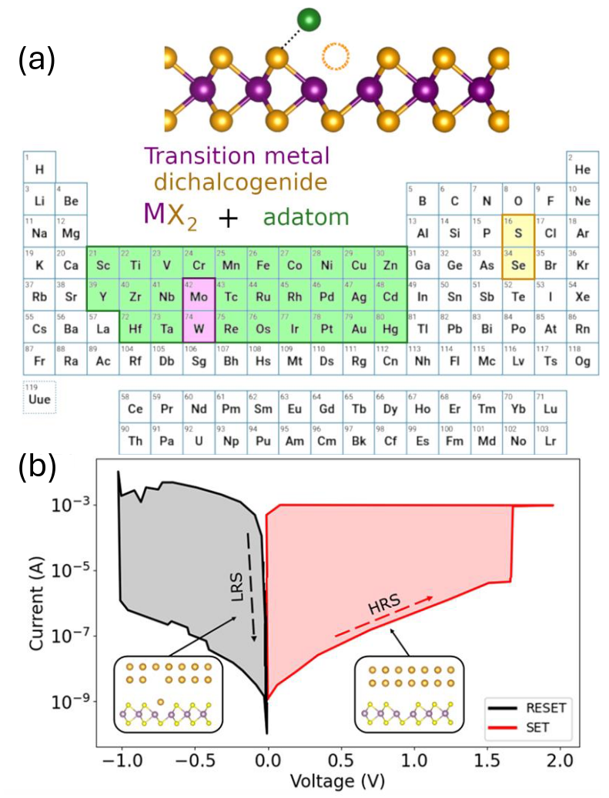
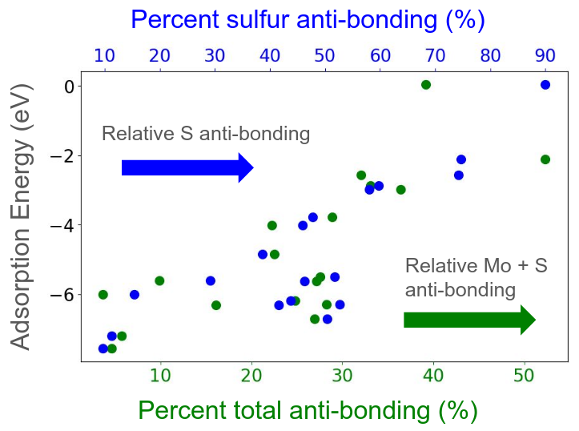
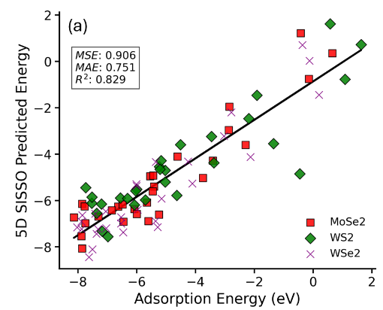
(UT Austin) MRSEC
DMR-2308817
Understanding & Predicting Trends in Defect Energetics
in Monolayer Transition Metal Dichalcogenides
Brian H. Lee, Jameela Fatheema, Deji Akinwande, Wennie Wang
What has been achieved?
Developed models that predict and explain trends in the defect adsorption energetics for metal adatom adsorption in monolayer TMDs.
These models are based on an understanding of changes in bonding character, hybridization, and electronic structure (e.g., d-band center).
Our simpler and interpretable models perform comparably well to more complex machine learning studies.
Why is this achievement important?
Demonstrate that materials trends exist in the defect energetics and hence switching energetics in resistive switching applications.
Insights provide rational materials selection rules for materials in the active switching layer and the electrodes.
How is the achievement related to the IRG/MRSEC, and how does it help it achieve its goals?
Provides framework for identifying materials trends at defective interfaces in heterostructures involving 2D materials
Understanding defects in 2D materials is critical to their use and operation in electronic devices
(c)
(d)
Figure: (a) Materials trends in the energetics of defect complexes involving a metal adatom (from an electrode) adsorbed on a chalcogen vacancy are studied. (b) These defects are present in many monolayer systems and are relevant to resistive switching applications. (c) We reveal chemical bonding principles that explain trends in defect energetics, and (d) develop models based on electronic structure to predict energetics.
Notes:
What Has Been Achieved: Two-dimensional (2D) transition metal dichalcogenides (TMDs) have recently been shown to demonstrate non-volatile resistive switching (NVRS), offering significant advantages such as high-density integration and low energy consumption due to their atomic-scale thinness. In this study,we focus on the adsorption and desorption of metal adatoms, which can modulate the electrical resistivity by several orders of magnitude. We develop material-based relationships of the adsorp-tion energy with electronic and atomic structure descriptors by examining the effects of various transition-metal adsorbates on the surface of TMDs. Our results reveal that adsorption energies of transition metals exhibit consistent trends across different TMDs (MoS2, MoSe2, WS2, WSe2)and can be explained using simple descriptors of the atomic and electronic structure. We propose several models to describe this adsorption process, providing a deeper understanding of a crucial step in the resistive switching mechanism based on the formation and dissolution of point defects. Finally, we connect our computed adsorption energies to the switching energy.
Importance of the Achievement: Our study demonstrates that materials trends exist in the defect energetics and hence switching energetics in resistive switching applications. These findings will help guide rational materials selection for the development of NVRS devices using 2D TMDs. Our models show linear correlations with R^2 ranging between 0.6 to 0.9 depending on the descriptor and complexity of the models used.
How is the achievement related to the IRG, and how does it help it achieve its goals? Our study paves the way for understanding the impact of defects in the electronic structure and properties of 2D systems. This study forms the foundation to future studies in rationalizing materials trends and identifying engineering strategies for heterostructures and electronic devices involving 2D materials.
Where the findings are published: B.H. Lee, J. Fatheema, D. Akinwande, W. Wang. “Understanding and predicting trends in adsorption energetics on monolayer transition metal dichalcogenides” Under revision at npj 2D Materials and Applications (as of 04/03/2025). pre-print: https://www.researchsquare.com/article/rs-6117205/v1

