Slide 1
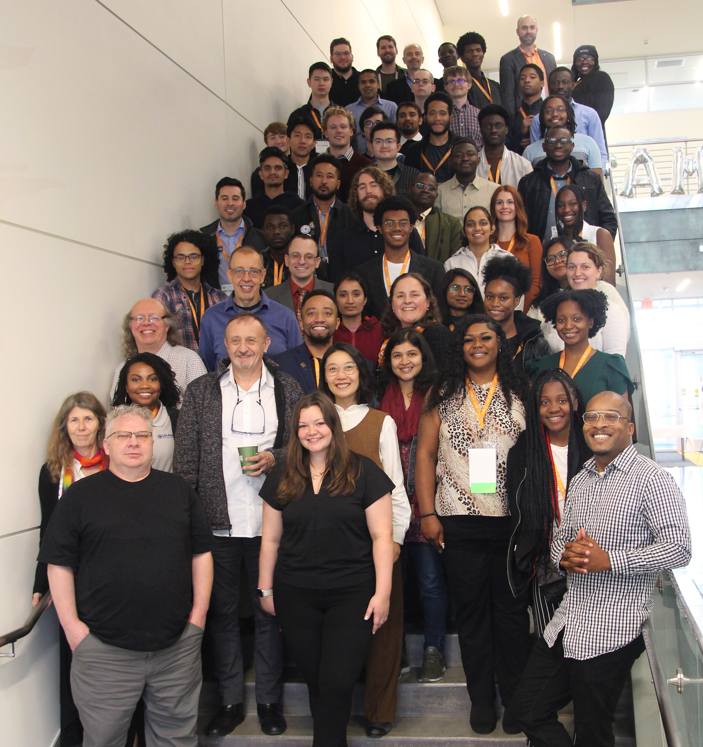
UTK Knoxville MRSEC Partners with the National Society of Black Physicists to Bring Conference into the Laboratories
MRSEC award number 2309083
2023
Center for Advanced Materials and Manufacturing (CAMM) University of Tennessee, Knoxville (UTK)
The National Society of Black Physicists (NSBP) held their Annual Conference, the largest academic meeting of minority physicists in the US in Knoxville, Tennessee November 9-12th. On Friday November 10th participants visited the University of Tennessee, Knoxville’s (UTK) Institute of Advanced Materials and Manufacturing (IAMM). CAMM hosted an event featuring laboratory tours and informational tables from Engineering Diversity, the Bredesen Graduate Center, the Department of Materials Science and Engineering, and UTK MRSEC. The University of Tennessee is waiving student application fees for all students that attended the NSBP Annual Conference in Knoxville

