Slide 1
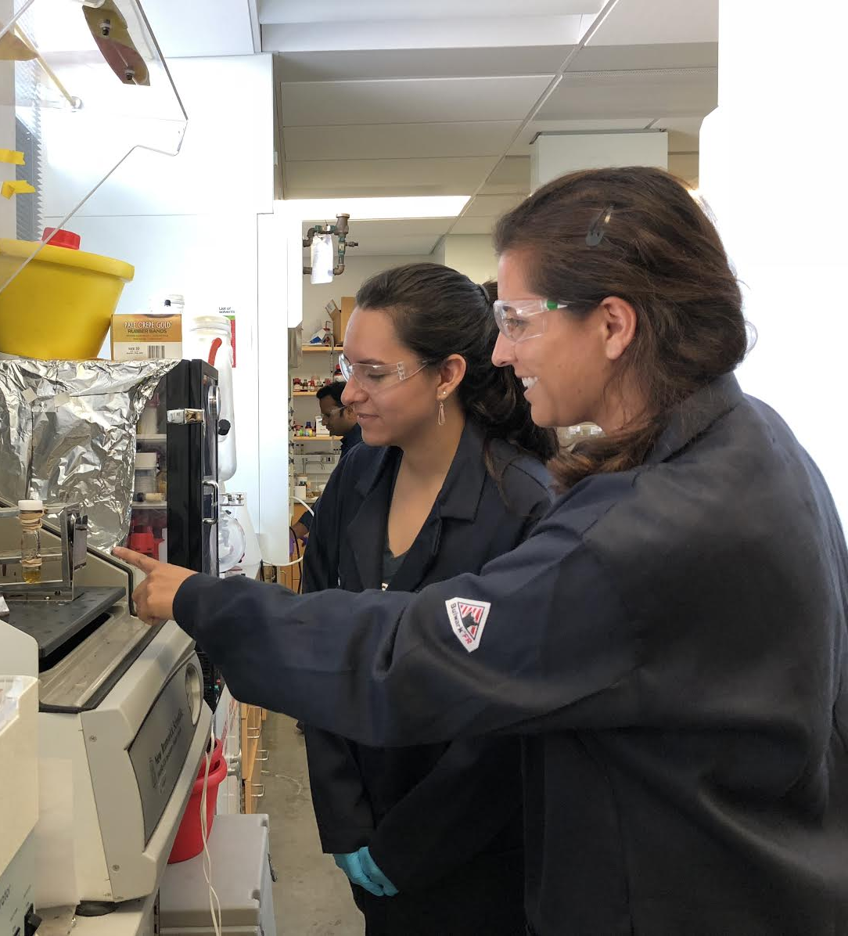
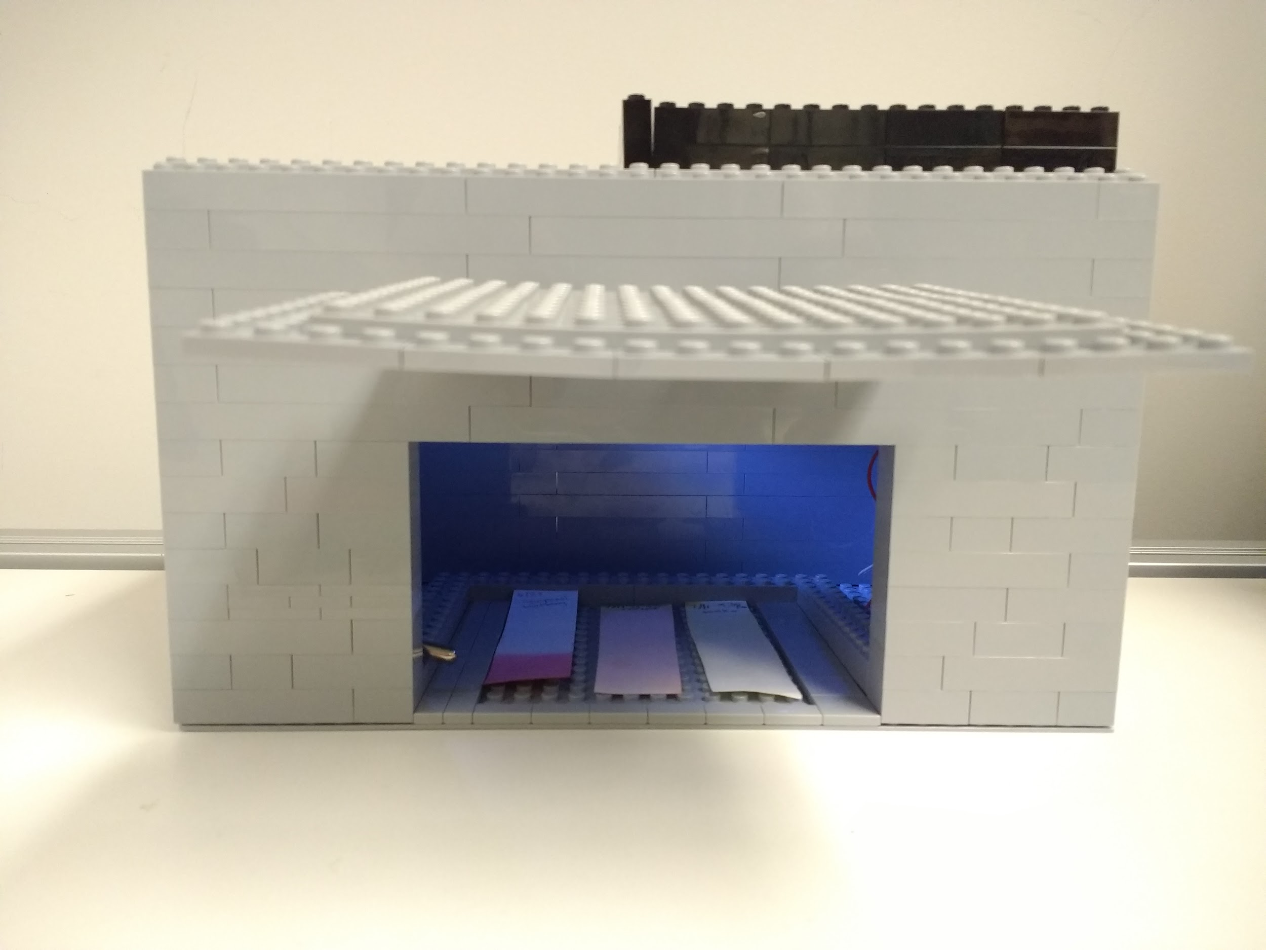
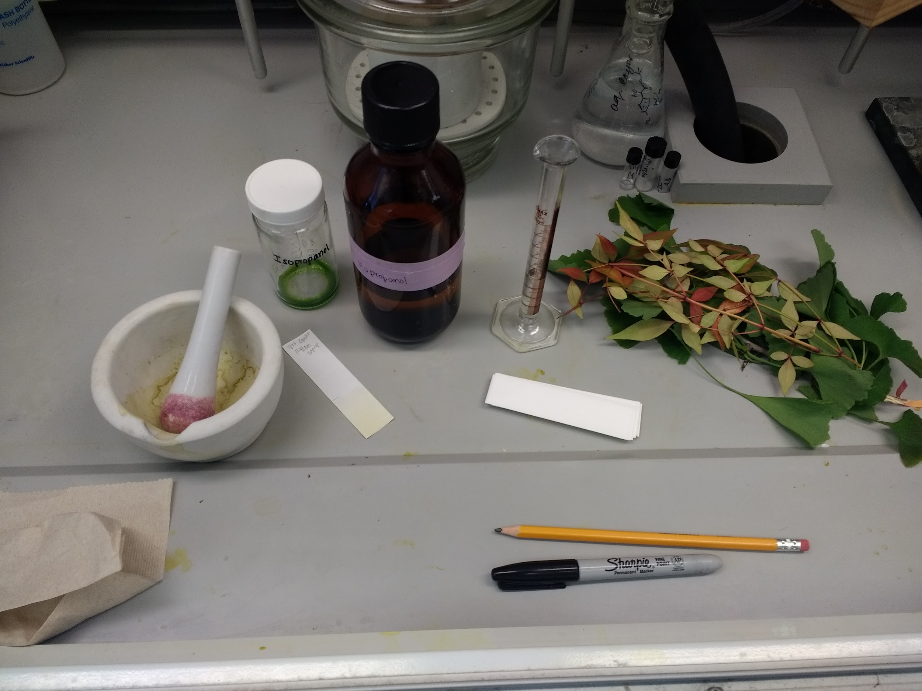
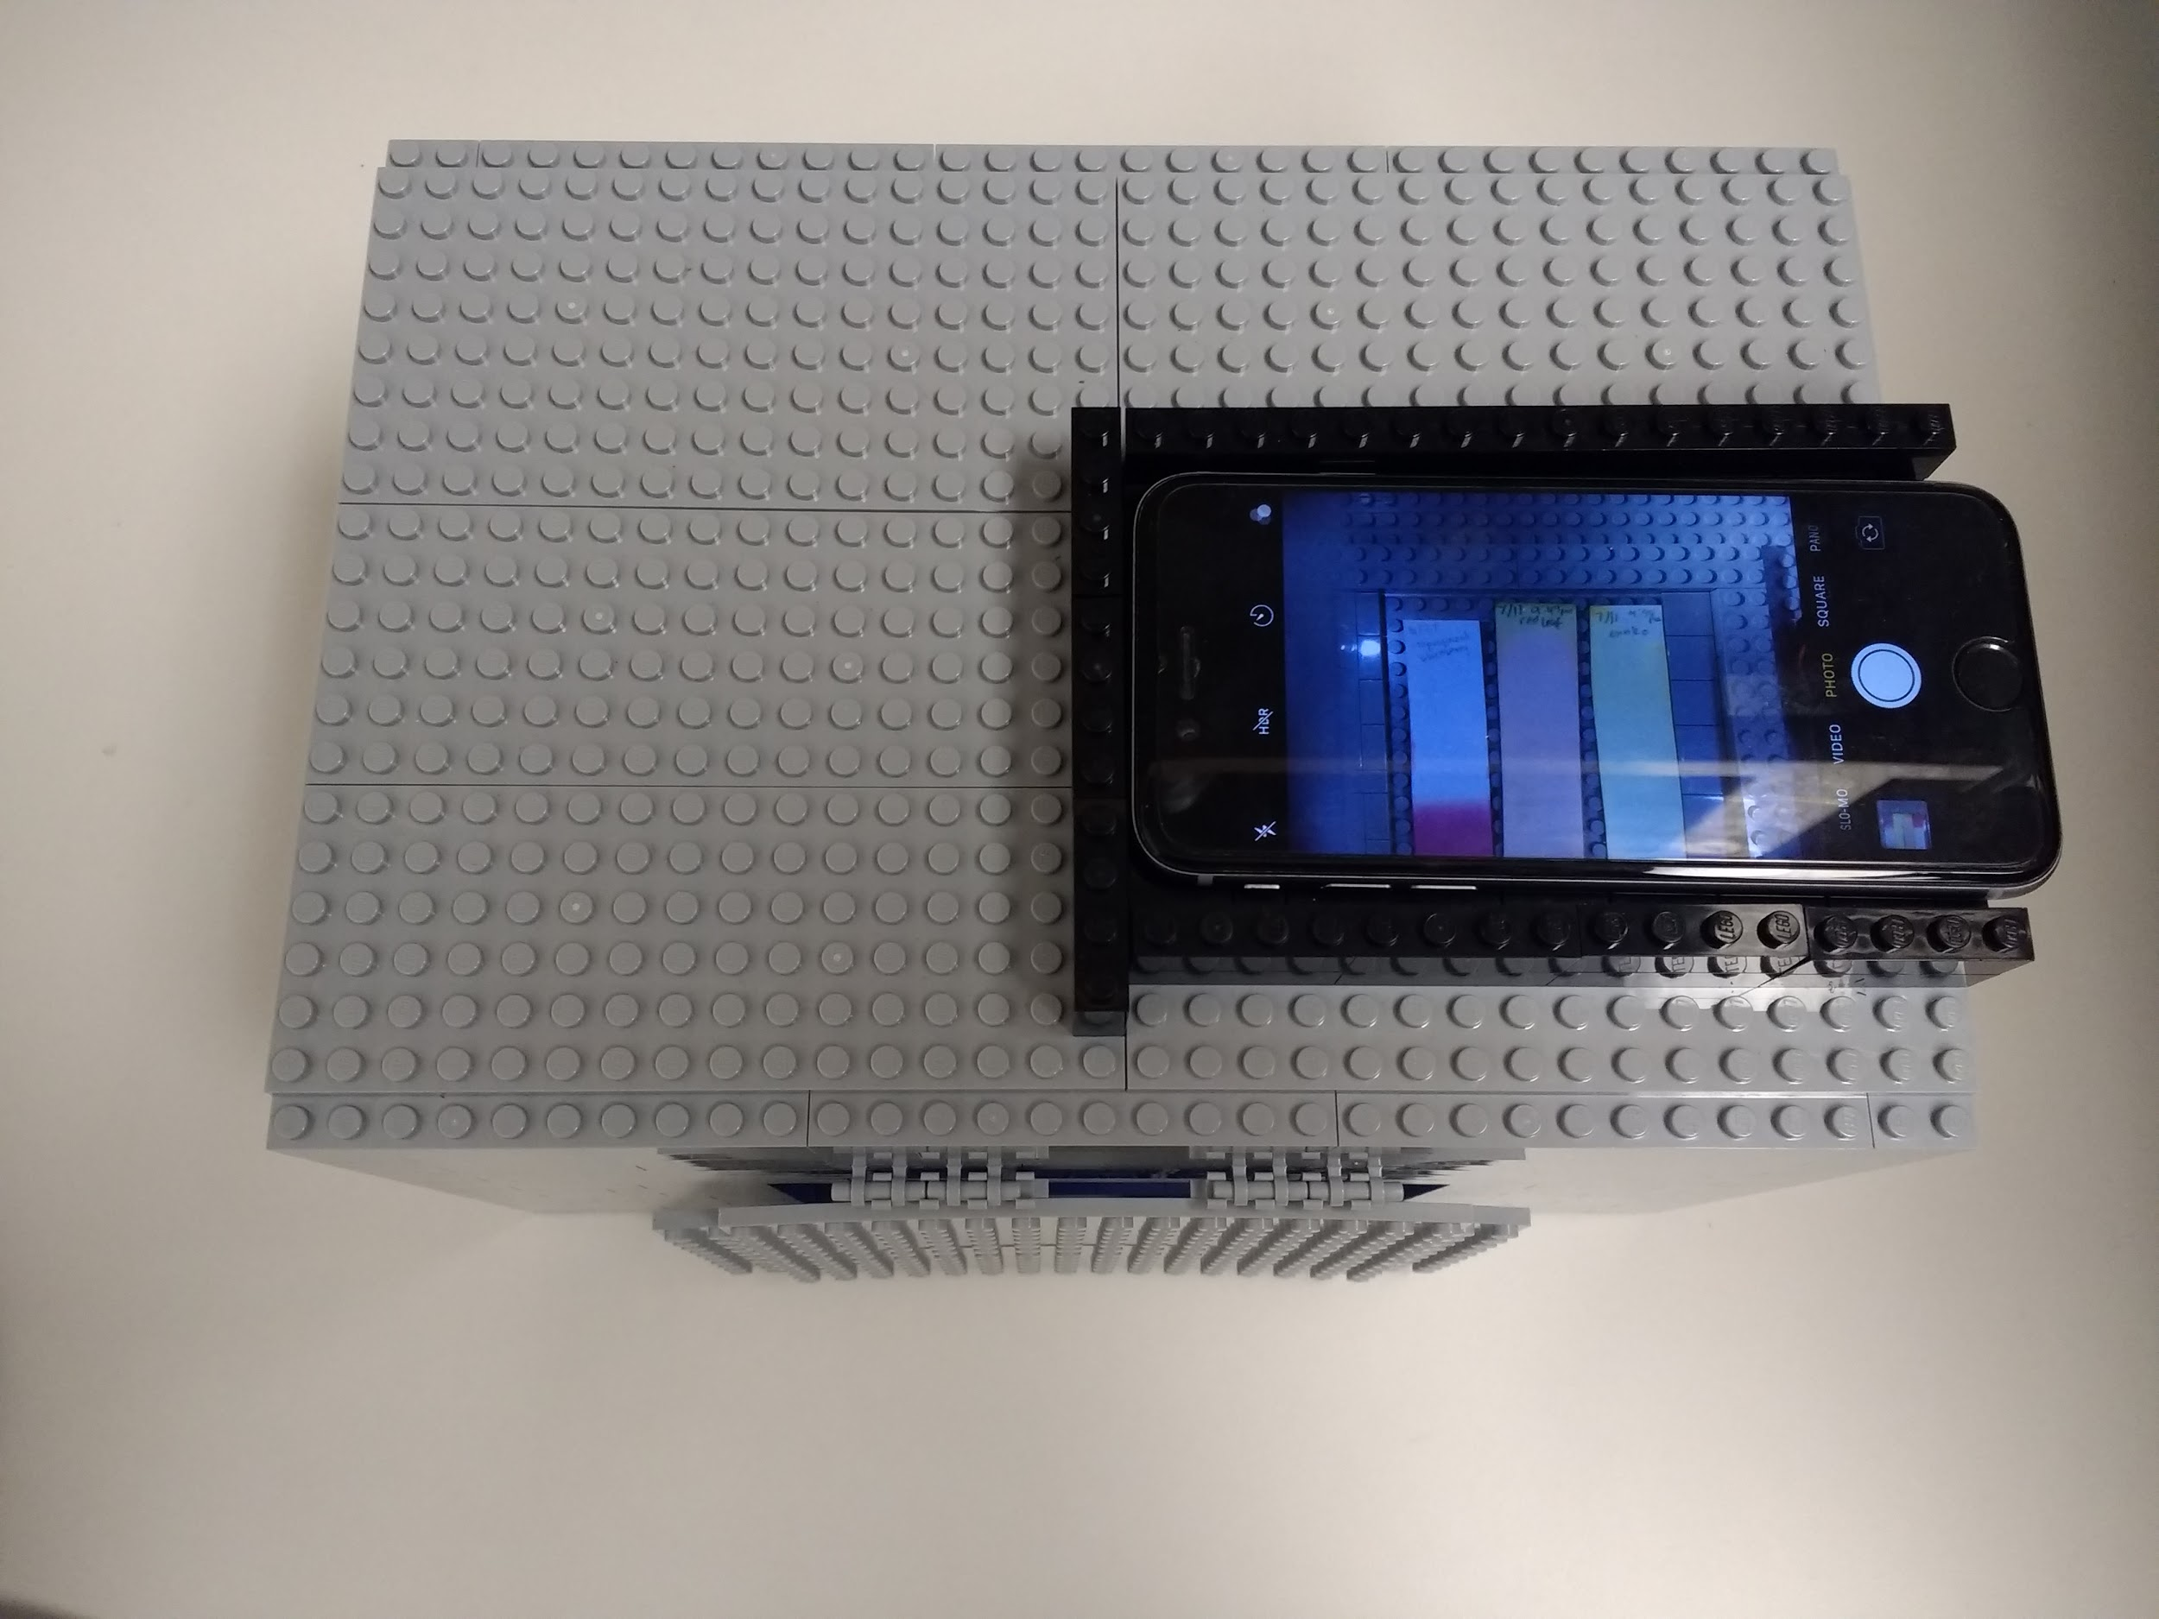
CDCM K-5 Research Experience for Teachers is Forging Direct Links between Elementary Classrooms & University Labs, Mentors, & Facilities
MRSEC: DMR- 1720595
2019
CDCM MRSEC – University of Texas at Austin
The CDCM RET program is unique in that it is designed specifically for K-5 teachers, with the intended purpose of engaging and sustaining student interest in STEM at a young age. In summer 2018, CDCM launched its inaugural program with 4 teachers participating, spanning grades 1st – 5th . In addition to the 7 week summer research program and curriculum development activities, RETs participate in extensive follow-up activities throughout the academic year to better support the integration of RET educational objectives with their classroom teaching & aid in the dissemination of teaching modules they develop. Examples include: faculty/graduate student visits to their classrooms; K-5 classroom tours of CDCM labs and UT campus; leading professional development workshops within their schools, districts and at local/national conferences. CDCM endeavors to meet the needs of each RET, their students and schools as completely as possible. A 2018 RET shared the need for an afterschool coding club at her school and CDCM stepped in to not only work with her in the development of the curriculum but has also facilitated each of sessions with Center volunteers.
CDCM offers a full spectrum of support for its RET’s
RET, Ms. Saldaña, receiving training, support and guidance through research (far left), the creation of her 4th grade chromatography lab (middle) and Lego sample analyzer tool (top/bottom right).
Teaching module to be submitted to Chemistry Education journal.
Follow-up Academic year activities with Ms. Saldaña and her class. Graduate student mentor, Stephanie Valenzuela, visits classroom one of many times to speak to students about what scientists are, and do in the lab (left), Ms. Saldaña’s class with Prof. Eric Anslyn on a lab tour.

