Slide 1
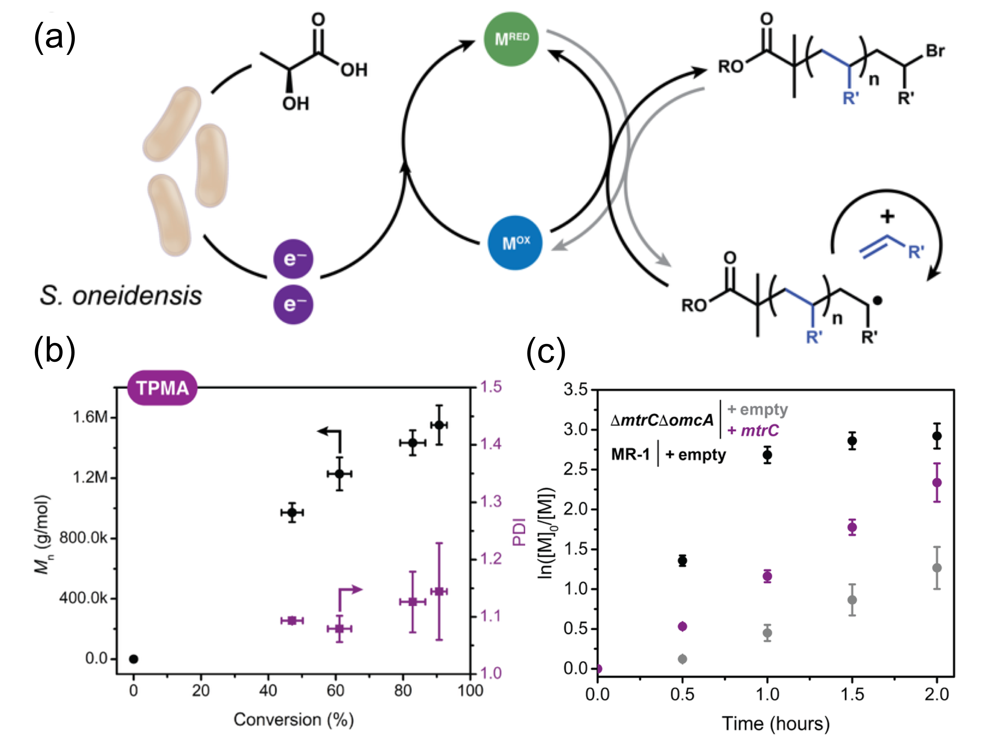
Shewanella oneidensis as a Living Electrode for Controlled Radical Polymerization
MRSEC: DMR-1720595
2018
N. A. Lynd, B. K. Keitz: University of Texas at Austin
Metabolic engineering produces fuels, pharmaceuticals, and materials using microbial catalysts. We sought to expand the power of these catalysts by redirecting respiratory electron flux from Shewanella oneidensis to a metal polymerization catalyst.
Our microbial polymerization features characteristics of controlled radical polymerization such as first-order kinetics, narrow molecular weight distributions and block-copolymer synthesis. Catalyst performance and polymer microstructure were a strong function of bacterial metabolism, specific electron transport proteins, and catalyst design.
Overall, our results suggest that manipulating biological electron transport pathways may be a general strategy for allowing bacteria to produce or communicate with synthetic materials.
Scheme 1. (a) Electron equivalents generated from S. oneidensis MR-1 reduce a metal catalyst from an inactive state (M^{OX}) to an active state (M^{RED}) to enable ATRP, (b) molecular weight and polydispersity of poly(OEOMA₅₀₀) as a function of monomer conversion, (c) rescue of normal polymerization activity via knockout complementation with a plasmid encoding MtrC.
G. Fan, C. M. Dundas, A. J. Graham, N. A. Lynd, and B. K. Keitz, PNAS DOI:10.1073/pnas.1800869115 (2018).

