Slide 1
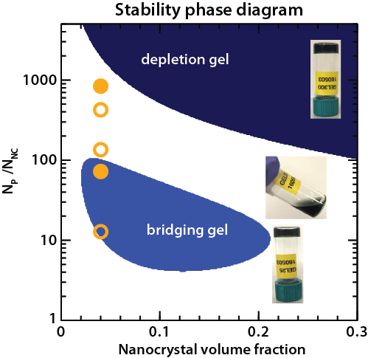
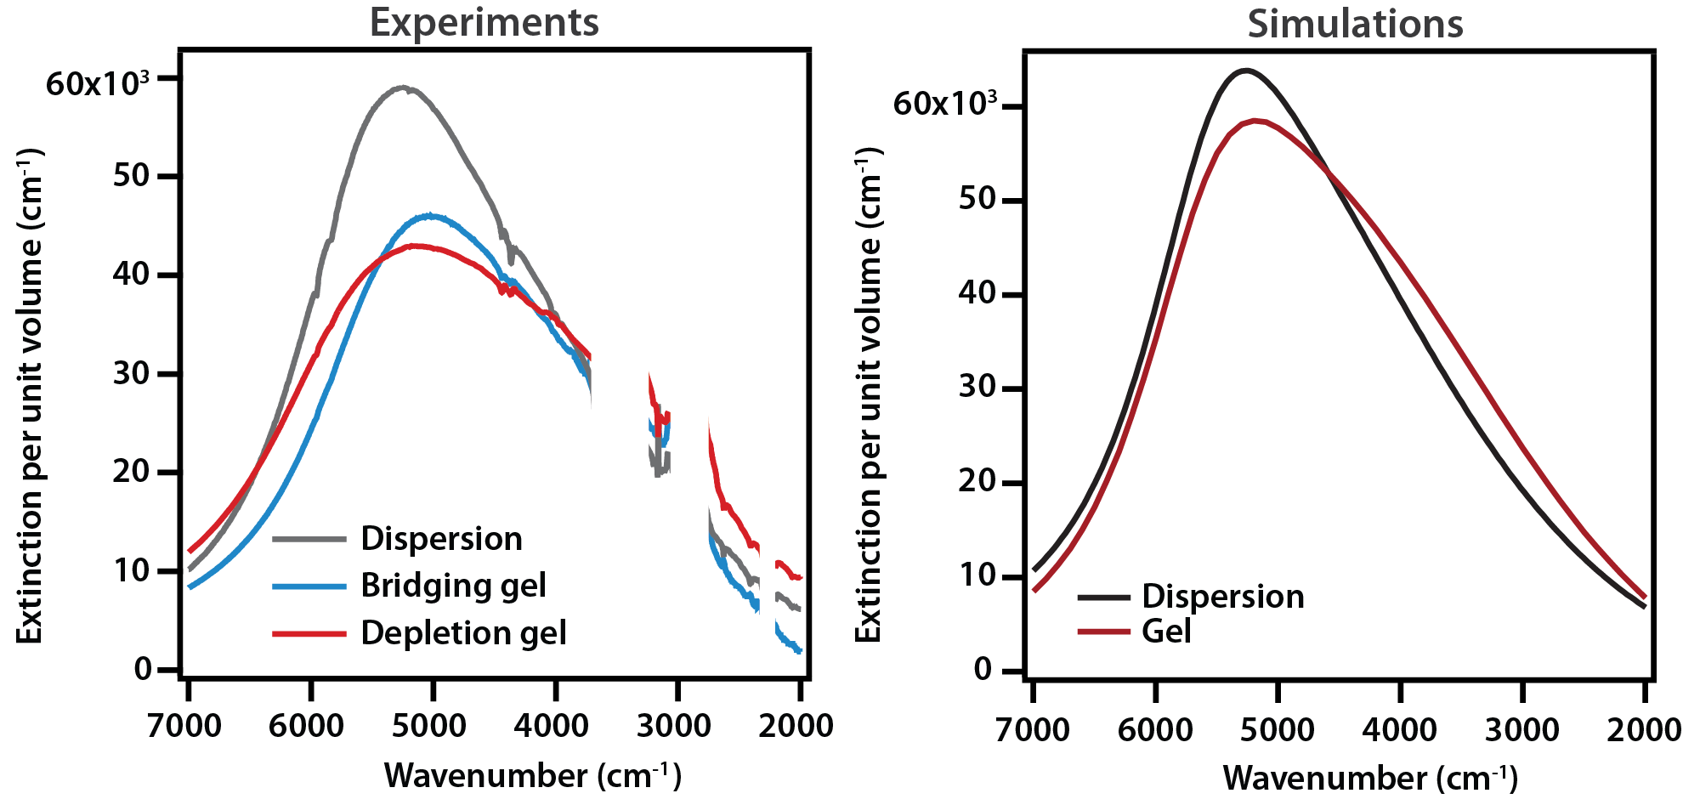
Gelation of plasmonic metal oxide nanocrystals by polymer-induced depletion attractions
MRSEC: DMR- 1720595
2019
Nanocrystal gelation is a strategy to translate exceptional properties inherent to nanoscale building blocks into multiscale architectures and devices. However, available gelation methods are not easily adaptable across broad classes of nanocrystal systems since assembly is strongly reliant on specific surface chemistries.
T. M. Truskett, D.J. Milliron: University of Texas at Austin
a
b
We designed an alternate gelation approach based on physical interactions instead of specific chemical linkages: depletion attractions balanced by electrostatic repulsions. We demonstrate its feasibility by assembling charge-stabilized tin-doped indium oxide nanocrystals in the presence of polyethylene glycol. Increasing the polymer-to-nanocrystal ratio and thereby the strength of attraction results in a phase behavior featuring two favorable gelation windows that are preceded by a fluid regime. Bridging effects dominate at low polymer concentration while depletion attractions drive gelation at higher concentration according to predictions from our unified theoretical model. Because our approach prevents nanocrystal fusion during assembly, we achieve gels that strongly absorb in the infrared with an optical response characteristic of both the discrete building blocks and the network architecture.
c
Saez Cabezas, C.A., Ong, G.K, Jadrich, R.B., Lindquist, B.A., Agrawal, A., Truskett, T.M., and Milliron, D.J., Gelation of plasmonic metal oxide nanocrystals by polymer-induced depletion attractions, Proc. Natl. Acad. Sci. U.S.A., 2018, 115 (36) 8925-8930; DOI:10.1073/pnas.1806927115
Notes:
Authors and Affiliations: Camila A. Saez Cabezas, Gary K. Ong, Ryan B. Jadrich, Beth A. Lindquist, Ankit Agrawal, Thomas M. Truskett, and Delia J. Milliron. GKO is affiliated to the department of Materials Science and Engineering at the University of California Berkeley. All other authors are affiliated to the McKetta Department of Chemical Engineering at the University of Texas at Austin.
Figure caption: a) Photograph of highly transparent nanocrystal depletion gel under natural lighting against the University of Texas Tower, b) theoretical phase diagram obtained from our unified free energy model for polymer bridging and depletion effects. Np/N_{NC} denotes the ratio of number of polymers per nanocrystal. For comparison, experimental results are overlaid on the phase diagram: open circles represent flowing dispersions and closed circles represent gels, and c) experimental optical properties (left panel) of charge stabilized tin-doped indium oxide nanocrystals (grey), bridging gel (blue), and depletion gel (red) compared to simulations (right panel) to support internanocrystal coupling effects in the gel.
Technical description of the work: We demonstrate a nanocrystal gelation method that leverages physical bonds formed by balancing long-range electrostatic repulsions due to surface charge and short-range attractions induced by depletants (polyethylene glycol), aiming to create stable open, arrested, and percolated networks. We investigated conditions to induce gelation by varying the depletant concentration at a fixed nanocrystal volume fraction. Experimentally, as the depletant concentration increased, we observed that the system transitioned from a fluid regime to a first gelation threshold followed by a second fluid regime (reentrancy) and gelation threshold. The structure of each regime was probed by small-angle x-ray scattering (SAXS) and the observed phase behavior as a function of depletant concentration was compared to predictions from a thermodynamic phase diagram obtained from a unified theoretical model formulated to capture bridging and depletion attractions effects. Because the nanocrystals remained discrete (non-fused) within the gel network, based on X-ray diffraction and high-resolution transmission electron microscopy, we achieved optically actives gels with a response reminiscent of the optical properties of dispersed (non-assembled) nanocrystals in solution. In addition, the extinction spectra of the gels were also slightly broadened and shifted liked due to the internanocrystal coupling effects arising from the influence of the network structure, which we explored by perform far-field and near-field electromagnetic simulations.

