Slide 1
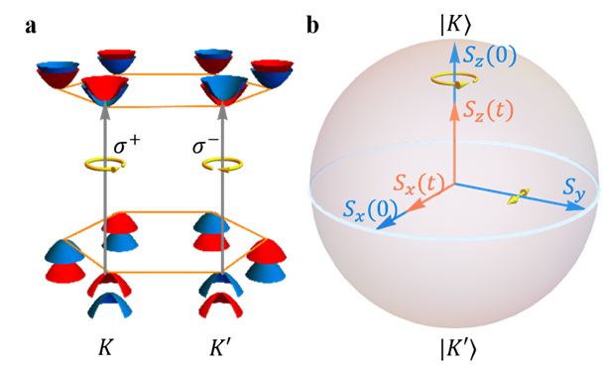
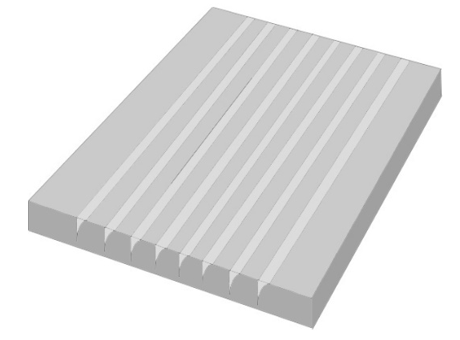
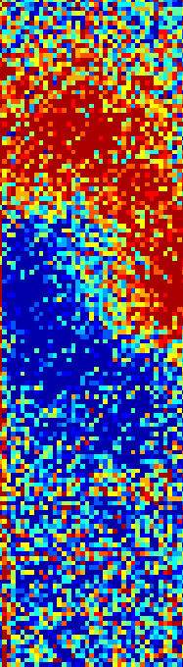
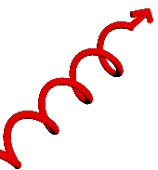
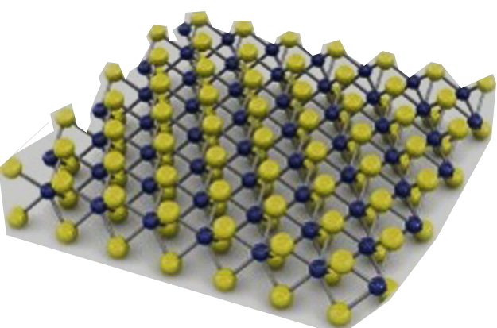
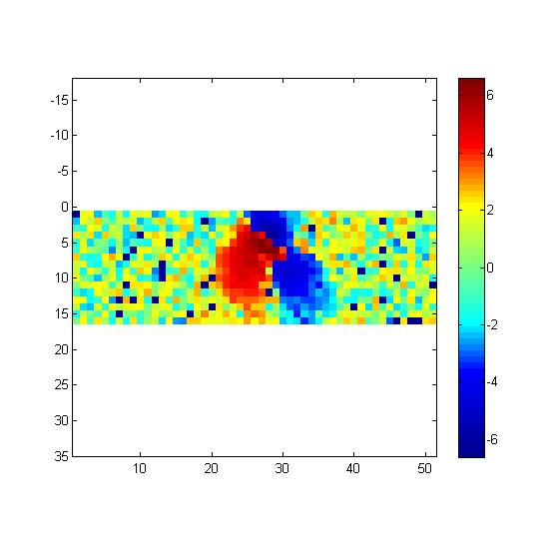
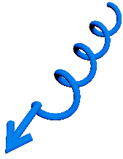
Routing Valley Excitons with a Metasurface
MRSEC: DMR-1720595
2018
The search for new quantum degrees of freedom has the potential for transformative impact on information processing technology. Currently, transistors or other switches in all electronic information processing devices rely on moving a puddle of electrons.
Valleys – extreme points in the energy band structure of periodic crystals – have been proposed as a new information carrier. In most materials, the valley degree of freedom does not couple to any external field. A unique situation in monolayer semiconductors has been discovered: light with opposite helicity may be used to control valley occupation.
We have discovered a new method to separate valley index using a designed metasurface. Excitons that carry different valley index are routed toward different directions in real space and momentum space, and photons emitted go to different directions according to their helicity.
X. Li, A. Alu, C. K. Shih: University of Texas at Austin
c
d
e
σ⁺
σ⁻
L. Sun, C. Wang, A. Krasnok, J. Choi, J. Shi, J. Gomez-Diaz, A. Zepeda, S. Gwo, C.-K. Shih, A. Alu, and X. Li, arxiv.org/abs/1801.06543 (2018).
Notes:
In transition metal dichalcogenides (TMDC) monolayers, there are two inequivalent valleys (energy extrema points in the band structure) related by time-reversal symmetry. Fundamental optical excitations, or excitons (bound electron-hole pairs) are formed at these valleys. The large spin orbit interaction in these materials leads to large energy splitting between the spin up and down states and valley contrasting optical selection rules. To utilize valley as a new information carrier, a simple method to separate this degree of freedom at room temperature is required.

