Slide 1
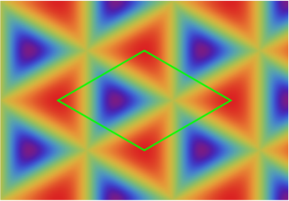
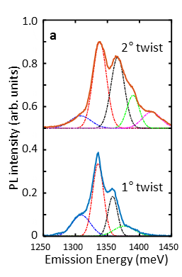

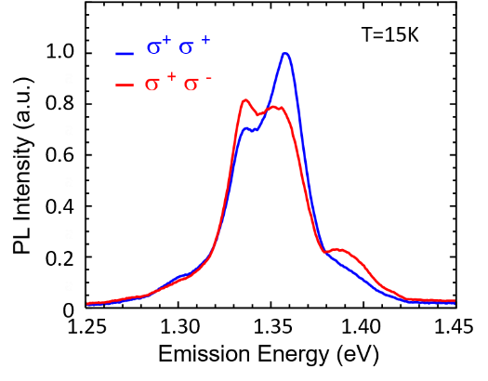
Optical Excited States in a Moiré Crystal
MRSEC: DMR-1720595
2019
Both intra- and interlayer excitons form in a TMD heterostructure because of the type-II band alignment
Interlayer excitons are localized in a moiré crystal with a period of ~ 20 nm
As the twist angle increases, the quantum box (moiré supercell) reduces in size, leading to larger energy spacing between resonances
The optical selection rules are spatially dependent as shown theoretically
Multiple interlayer excitons are observed with alternating circular emission
First evidence of localized excitons in a moiré crystal
Potential applications as a regular array of quantum dots as single photon emitters
X. Li, A. H. MacDonald: University of Texas at Austin
MoSe₂
Degree of circular polarization
e
e
h
h
WSe₂
1
-1
K. Tran, …, A. H. MacDonald, and X. Li, Nature 567, 71 (2019).
Notes:
Citation: Tran, K; Moody, G; Wu, FC; Lu, XB; Choi, J; Kim, K; Rai, A; Sanchez, DA; Quan, JM; Singh, A; Embley, J; Zepeda, A; Campbell, M; Autry, T; Taniguchi, T; Watanabe, K; Lu, NS; Banerjee, SK; Silverman, KL; Kim, S; Tutuc, E; Yang, L; MacDonald, AH; Li, XQ. Evidence for moire excitons in van der Waals heterostructures. Nature 2019, 567(7746), 71+ DOI:10.1038/s41586-019-0975-z
Figure Caption: Upper left: schematic illustration of direct and indirect exciton (electron-hole pair) formation in MoSe2/WSe2 van der Waals heterostructure. Upper right: computed map of distribution of circular polarization of emitted light from different regions of a moire superlattice formed by slight rotational misalignment between the MoSe2 and WSe2 layers in the van der Waals heterostructure. Lower left: Measured photoluminescence (PL) intensity as a function of “twist” angle between the lattice structures of the MoSe2 and WSe2 layers, showing change in exciton emission energy, and hence quantum confinement energy, with twist angle. Lower right: Measured PL intensity for different circular polarizations.
Technical Description of Work: In transition metal dichalcogenides (TMDC) monolayers, there are two inequivalent valleys (energy extrema points in the band structure) related by time-reversal symmetry. Fundamental optical excitations, or excitons (bound electron-hole pairs) are formed at these valleys. The large spin orbit interaction in these materials leads to large energy splitting between the spin up and down states and valley contrasting optical selection rules. To utilize valley as a new information carrier, a simple method to separate this degree of freedom at room temperature is required.

