Slide 1
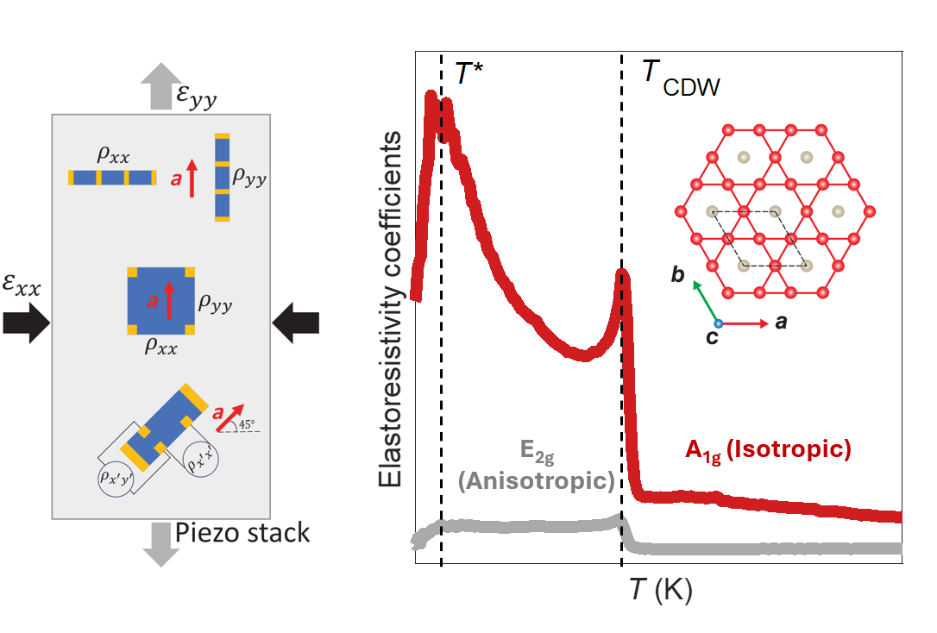
U. Washington MRSEC
DMR-2308979
MEM-C IRG-2: Absence of E_{2g} Nematic Instability and Dominant A_{1g} Response in Kagome Metal CsV₃Sb₅
Jihui Yang, Xiaodong Xu, Jiun-Haw Chu
Electronic nematicity, the spontaneous breaking of crystalline rotational symmetry, has been discovered in several strongly correlated electronic systems, including high Tc superconductors. Recently, several studies have suggested that the charge density wave in the kagome superconductor CsV₃Sb₅ breaks rotational symmetry—an intriguing possibility, as it would be a rare example of “three-state Potts nematicity,” in which there are three possible orientations in a hexagonal lattice. Here, we report that CsV₃Sb₅ is probably not nematic, but it is very sensitive to isotropic strain. To reach this conclusion, we performed comprehensive elastoresistivity measurements using three different techniques. We also performed an elastocaloric measurement that measures the change of the sample temperature due to the applied strain. Our findings suggest that CsV₃Sb₅ displays a weak, temperature-independent anisotropic response. It also shows a diverging response to the in-plane isotropic component of the strain. The previously reported diverging nematic susceptibility was probably due to contamination from this response. This new picture of the symmetry-breaking states in CsV₃Sb₅ provides clarity on past misconceptions and offers strong constraints on the symmetry of its charge density wave and the normal state of its superconductivity.
(Left) Schematic of three different elastoresistivity techniques. (Right) The temperature dependence of the elastoresistivity coefficients of CsV₃Sb₅. The A_{1g} isotropic coefficient shows a diverging response, whereas the E_{2g} anisotropic coefficient shows a weak and temperature independent response.
Notes:
What Has Been Achieved: Recent studies claimed the existence of nematicity within the charge density wave phase of CsV3Sb5. A follow up work further suggests a nematic quantum critical point within the superconducting dome of Ti doped CsV3Sb5. These experiments are based on an outdated differential elastoresistivity technique, which suffers from cross-symmetry contamination that leads to false nematic response. Using a combination of three different elastoresistivity techniques that eliminate contamination, we determined that there is no nematic instability in CsV₃Sb₅.
Importance of the Achievement: CsV₃Sb₅ is the first superconducting kagome material, offering a unique platform to explore strongly correlated topological phases due to its exotic band structure. The nature of its charge density wave and superconducting states remains highly debated. Our work resolves key questions about the symmetry of electronic order in this remarkable system.
How is the achievement related to the IRG, and how does it help it achieve its goals? The discovering of diverging isotropic strain response in CsV₃Sb₅ aligns with the IRG goal of developing highly strain tunable quantum materials.
Where the findings are published: Liu, Z. et al. Absence of E_{2g} Nematic Instability and Dominant A_{1g} Response in the Kagome Metal CsV₃Sb₅. Phys. Rev. X 14, 031015 (2024). https://doi.org/10.1103/PhysRevX.14.031015

