Slide 1
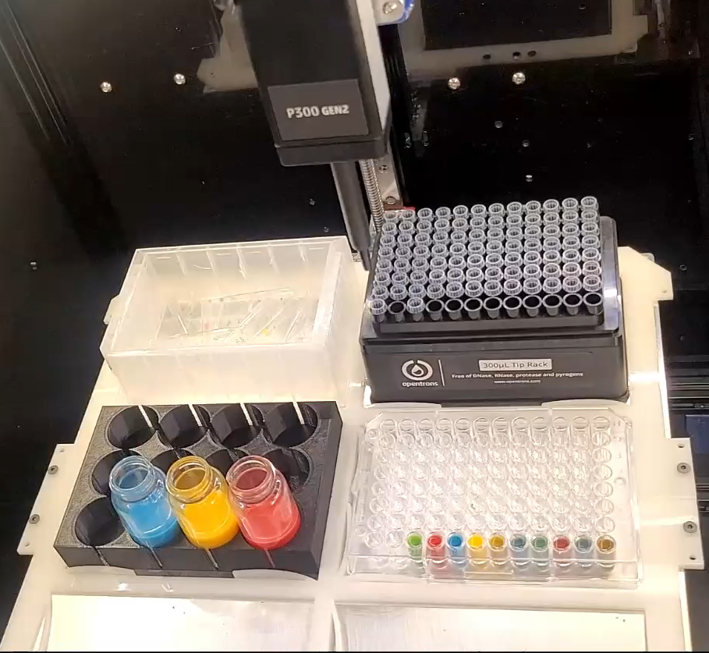
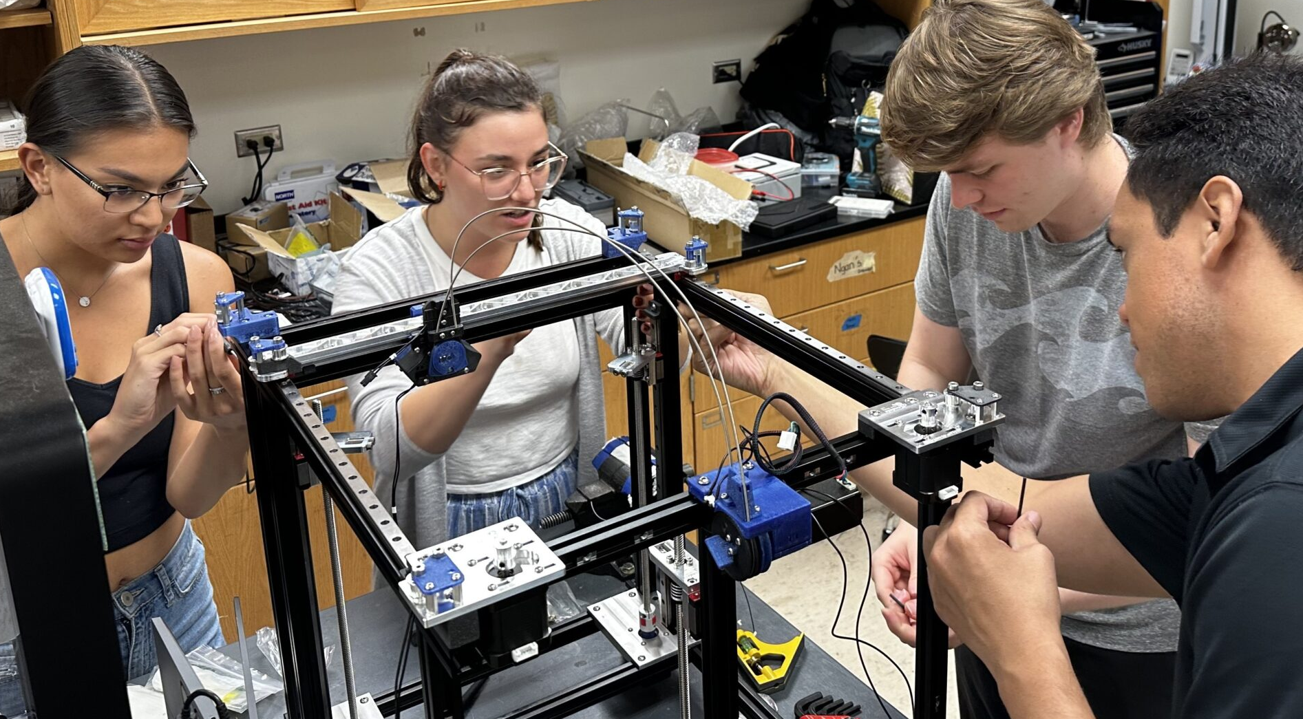
U. Washington MRSEC
DMR-2308979
MEM-C SEED: Expanding Data Automation Using a Jubilee Robotic Platform
Lilo Pozzo, Nadya Peek (UW), Joseph Brown (UH), Godwin Severa (UH)
UW Chemical Engineering Prof. Lilo Pozzo’s ‘23/’24 Seed project aims to serve the materials community by advancing AI-driven experimentation and analysis for broad adoption and acceleration of materials research. Pozzo has engaged in highly collaborative projects to advance self-driving laboratory (SDL) technologies and to help others adopt them for their own workflows. In this project, Pozzo worked with UW Human Centered Design and Engineering (HCDE) Asst. Prof. Nadya Peek to advance the creation of an essential tool library for employing the Jubilee robotic platform in wide ranging workflows. These efforts were further expanded to include collaborative work with MEM-C’s PREM partners from the University of Hawai’i (UH), particularly in the exfoliation of nano TiB₂ for hydrogen sorption (UH, Severa), gas sensing tests (UH, Brown), and materials education (Brown).
Pozzo and graduate student, Maria Polti, traveled to UH in October 2023 to work with Brown and his students in building a Jubilee tool at UH. 7 UH students (5 undergrads, 2 grad students, of whom 2 identify as Native Hawaiian and 3 as women) were engaged in the project and have continued using the Jubilee system. Two of the participating UH students had conducted summer'23 research with MEM-C and one of the students will be at UW in Pozzo’s lab for summer'24.
Lilo’s vision of automation for research acceleration, and open-source hardware as a pathway towards global equity in research activity is compelling and resonates broadly.—Prof. Joseph Brown, UH
(left) Self-driving laboratory collaboratively developed by Pozzo and Peek based on the open-sourced Jubilee platform. Jubilee systems have been developed to demonstrate AI-driven algorithms for the synthesis of CdSe, TiB₂ (Severa), and other nanocrystals and in self-driving color-matching demonstrations (Brown).
(right) In Brown’s lab at UH in October 2023, MEM-C PhD student Polti trains UH students Costa, Abella, and Dodge in the Jubilee system setup.
Notes:
What Has Been Achieved:
UW ChemE Prof. Lilo Pozzo’s ‘23/’24 Seed project aims to serve the materials community by advancing AI-driven experimentation and analysis for broad adoption and acceleration of materials research. Pozzo has engaged in highly collaborative projects to advance self-driving laboratory (SDL) technologies and to help others adopt them for their own workflows. Pozzo worked with UH Human Centered Design and Engineering (HCDE) Asst. Prof. Nadya Peek to advance the creation of an essential tool library for the use of the Jubilee robotic platform in wide ranging workflows that have recently been expanded to include collaborative work with MEM-C’s PREM partners from the University of Hawai’i, particularly in the exfoliation of nano TiB₂ for hydrogen sorption (UH, Severa), gas sensing tests (UH, Brown), in materials education (Brown). In October 2023, Pozzo and MEM-C PhD graduate student Maria Polit traveled to MEM-C’s University of Hawai’i MRE-C PREM partners to set-up a Jubilee system at Brown’s lab. Maria trained a UH undergrad student team in setting up the Jubilee platform. Four UH undergrad students (Jade Lopes, Garett Costa, Cecilia Abella, Michael Dodge) were trained on the Jubilee system as part of the UH ME491 course. Garett and Cecilia worked at UW last summer. Additionally, undergrad student (Duke Vierra) is working on the system as a project in the Brown lab, UH PhD student Matthew Nakamura is mentoring all these students, and UH MS student Kaitlyn Matsunaga will also be working with system automation (Total: 5 undergrads and 2 grad students, of whom 2 identify as Native Hawaiian and 3 of whom identify as women). Additionally, during the visit, Pozzo met with UH faculty and gave a lecture.
Importance of the Achievement:
Jubilee is now recognized as a leading platform for the adoption of SDLs for materials research in universities and laboratories across the world. Quote from Brown about the visit in October 2023: “Seeing the system that Maria and Lilo brought to UH in operation helped the students better envision what was possible. Working with Maria and learning about open-source collaboration tools from Dr. Pozzo helped my graduate students envision some pathways for sharing and getting recognition for the other automated instrumentation systems that we have been working on in our group. I plan to continue to use it as an experimentation and teaching tool for engaging undergrads into thinking about robotics applications and process workflows. In the short term in the spring 2024semester, one of the undergrad students in my group (Duke Vierra) will be building a gripper system for use in the jubilee platform, in order to enable automation of dip coating processes.”
How is the achievement related to the Seed, and how does it help it achieve its goals?
These activities serve MEM-C’s unique AI-Core mission of elevating and accelerating the use of advanced AI and ML approaches throughout the materials community. This project is engaging MEM-C IRG investigators, current and past MEM-C seed grantees (Peek), MEM-C's UH PREM partners (Severa and Brown), student participants. It also advances the visibility of the center as a leader in integration of AI into materials research. Quote from Brown about the Jubilee platform built during the 2023 visit: “My group had an ongoing theme of building tools for automated data acquisition using low-cost hardware, including sensor modules we attached to quadcopter drones, automated thermal conductivity measurement, and most recently automated process control for thermodynamic property measurements. My students had also been quite skilled at creative uses for the automated mechanical test frame we have. The jubilee platform resonates and expands on our goal of data automation by providing a more explicit platform for actuation in 3D. It becomes another tool for helping students learn programming, process planning, mechanical design. Importantly, this tool, and engagement with UW, has helped us to really understand better that there are opportunities for research output in the area of research automation generally, rather than focusing on impacts in specific applications.”
Where the findings are published: N/A

