Slide 1
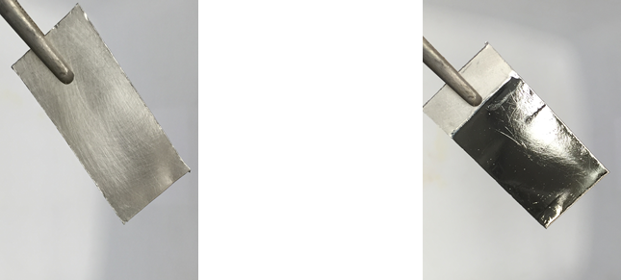
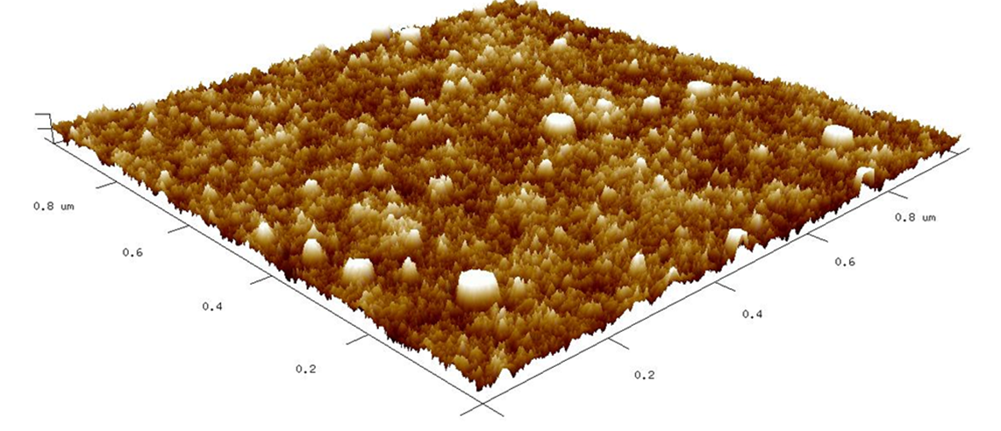
Surface-Enhanced Fluorescence of Pyrene on Nanostructured Aluminum
MRSEC at the University of Utah;
DMR 1121252
2017
Danielle Montanari, Joel Harris, Steve Blair; University of Utah
Objective: To generate enhanced absorption and emission of light in the ultraviolet (UV) region by structuring an aluminum by electrolysis (passing electrical current for polishing by controlled corrosion).
Approach: Benchtop electro-polishing is used to produce aluminum with nanoscale roughness, which can enhance the UV absorption and emission by molecules on its metal surface. The aluminum is treated with a surfactant which attracts polycyclic aromatic hydrocarbon (PAH) compounds from water to the aluminum surface.
Results and Significance: Both the absorption and emission of ultraviolet light by pyrene (PAH compound) are enhanced by more than 30-fold on nanostructured aluminum, compared to an equivalent control sample on sapphire (aluminum oxide). Such surfaces are shown to be important for sensitive environmental sensing of various molecular compounds.
Electro-polish
3-D image of features on electro-polished aluminum. The maximum roughness is 1/50,000th the thickness of typical human hair.
Images of raw aluminum prior to polishing (left) compared with electropolished aluminum (right).
Absorption of UV light by pyrene on electro-polished aluminum (black) versus sapphire (red).
Emission of UV light by pyrene on electro-polished aluminum (black) vs. sapphire (red).
Notes:
We develop substrates capable of enhancing excitation and emission of ultraviolet (UV) chromophores, by electro-polishing aluminum to produce a nanostructured surface. The resulting material has nanometer-scale surface features (see atomic force microscopy results) that enhance electric fields of incident and emitted UV radiation through local surface plasmons.
The influence of these surfaces on the absorption and emission of UV light was tested by measuring the response of a polycyclic aromatic hydrocarbon (pyrene) on the aluminum surface. Because the electropolished aluminum has a thin oxide layer on its surface, a control experiment and comparison is carried out on sapphire, which is pure aluminum oxide and has the same surface chemistry. Both nanostructured aluminum (oxide) and sapphire surfaces were functionalized with alkyl chains using octadecyl-phosphonic acid, to produce a hydrophobic boundary layer that can attract pyrene from aqueous solutions to deposit on the two surfaces. Wash-off experiments confirm that the concentrations of pyrene on the two surfaces are equivalent, corresponding to a fraction of a monolayer coverage.
From these experiments, we observe a 30-fold enhancement of both the reflectance change (absorption of radiation) and fluorescence, from the submonolayer population of pyrene on nanostructured aluminum compared to a sapphire surface. Because the enhancements are comparable for absorption and emission, these results indicate that the fluorescence enhancement on nanostructured aluminum arises primarily through enhanced excitation rather than enhanced emission.

