Slide 1
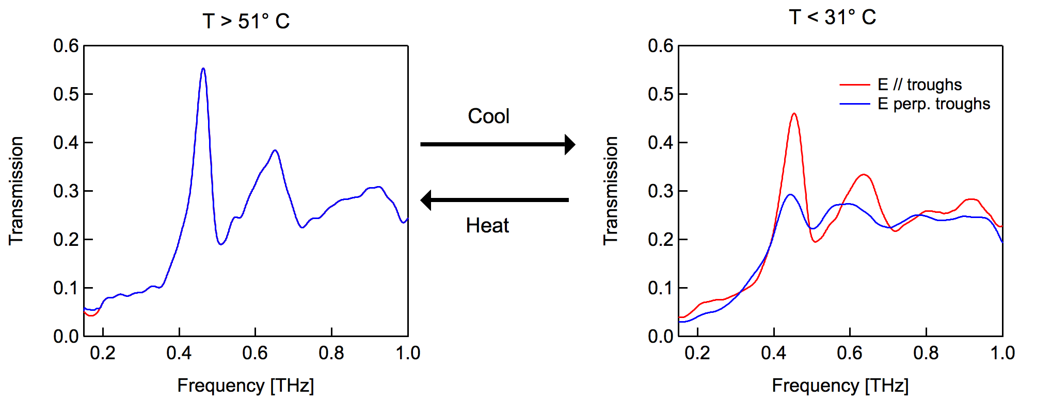
Using Shape Memory Alloys for Active Terahertz Plasmonic Devices
MRSEC at the University of Utah;
DMR 1121252
2017
Barun Gupta, Shashank Pandey, Anjali Nahata, Ting Zhang, Sivaraman Guruswamy and Ajay Nahata; University of Utah
Objective: To develop active devices in which the terahertz (THz) response can be switched by simply changing the temperature of the device.
Approach: Shape memory alloys composed of nickel and titanium were trained to thermally switch between two different physical geometries. A modest 20°C change in temperature causes the alloy to change its crystal structure resulting in physical deformation of the foil.
Results and Significance: We show the first demonstration of shape memory alloys being used for active THz devices. The metal foil was found to reproducibly cycle between the two geometries over 100 times. Other alloys have been shown to switch over 10⁶ times without fatigue. Work is ongoing to show that such switching can be accomplished electrically.
Cool
Heat
Figure 1. Thermal switching of a 5 cm x 5 cm x 127 µm thick free-standing shape memory alloy (Nitinol) foil. When heated above 51°C, the structured metal foil is flat, When cooled below 31°C, the metal foil switches to a corrugated geometry. The structure in the foil consists of a periodic array of apertures with 300 µm diameter circular holes spaced by 600 µm. For the corrugation, h varied from 0.5 mm to 6 mm, while the periodicity, p, was kept constant at 10 mm.
Figure 2. THz transmission properties for a foil with h = 0.5 mm for incident radiation that is polarized parallel and perpendicular to the foil corrugation troughs upon heating and cooling of the foil (both experimental traces in the graph on left overlap).
B. Gupta, S. Pandey, A. Nahata, T. Zhang, and A. Nahata, Adv. Opt. Mater. (2017).
DOI: 10.1002/adom.201601008
Notes:
Shape memory alloy foils that are appropriately patterned are cycled between two different metal foil geometries resulting in two different terahertz (THz) plasmonic responses. This is accomplished by using patterned foils of a nickel-titanium alloy (Nitinol) that switches between the martensite phase below 31° C, yielding one physical geometry, and the austenite phase, when the foil is heated above 51° C, yielding a second physical geometry. In order to enable this reproducible switching, the sample is initially put through a two-way training procedure, through which the two different desired physical geometries are imprinted. Specifically, the metal foils are trained to switch between a sinusoidal corrugation, either one-dimensional (1D) or two-dimensional (2D), at close to room temperature and a flat metal sheet above the austenite phase transition temperature. The foils are found to switch reproducibly between geometries over at least 100 thermal cycles. Using THz time-domain spectroscopy, the transmission properties of the foils are measured as a function of incident polarization and foil geometry. The changes in spectrum are explained qualitatively and through numerical simulation.

