Slide 1
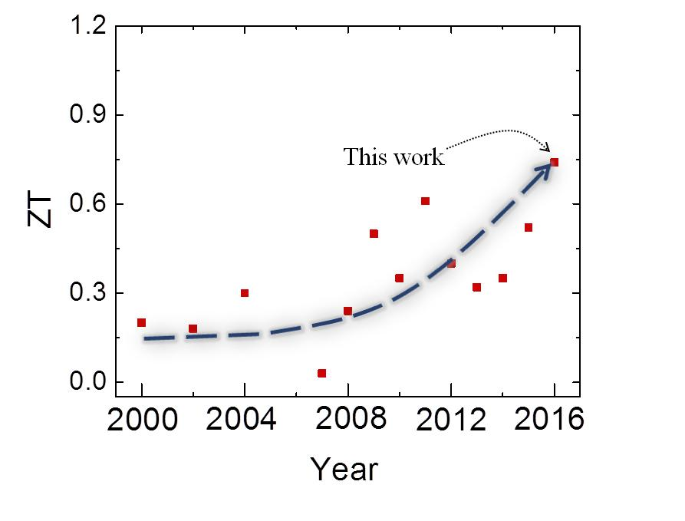
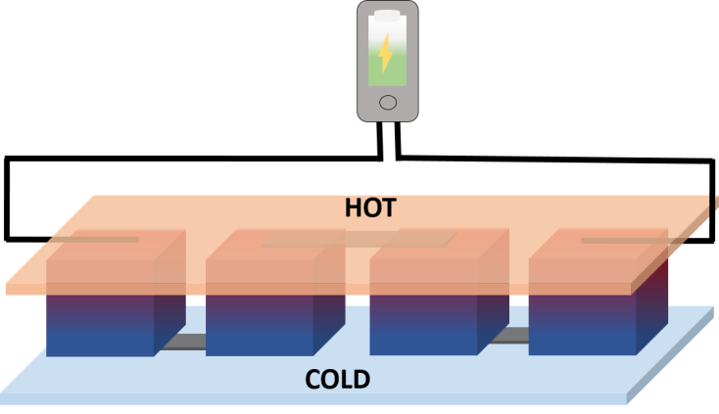
Terbium Ion Doping in Ca₃Co₄O₉: A Step Towards High-Performance Thermoelectric Materials
NSF DMR #11-21252
2017
Shrikant Saini, Yinong Yin, Ashutosh Tiwari; University of Utah
Objective: To discover thermoelectric materials that are environmentally friendly and exhibit high value for ZT, the standard figure of merit used for thermoelectrics. Oxide materials are considered ideal for such applications.
Approach: Our approach is based on the fact that Tb (terbium) doping causes a reduction in the relative concentration of Co⁴⁺ (cobalt) ions, which leads to a decrease in the concentration of holes in the material. A reduction in the hole concentration gives rise to a larger Seebeck coefficient (the thermoelectric sensitivity of the material) and a lower thermal conductivity, corresponding to a higher ZT value.
Results and Significance: We have achieved the enhanced thermoelectric response in polycrystalline Ca₃Co₄O₉ on doping Tb ions in the material. Specifically, a high figure of merit (ZT) of 0.74 at 800 K was observed for Ca_{2.5}Tb_{0.5}Co₄O₉.
(a)
(b)
(a) Performance of Ca₃Co₄O₉ based thermoelectric material over two decades and the performance achieved in our present work. (b) Schematic of thermoelectric module based on oxide thermoelectric material.
S. Saini, H. Yaddanapudi, K. Tian, Y. Yin, D. Magginetti, A. Tiwari, Sci. Rep. 7, 44621 (2017). doi:10.1038/srep44621
Notes:
The ability of thermoelectric materials to generate electricity from the waste heat can play a vital role in achieving a global sustainable energy future. To move in this direction, it is essential to have thermoelectric materials that are environmentally friendly and exhibit high figure of merit, ZT. Oxide thermoelectric materials are considered ideal for such applications. High thermoelectric performance has been observed in single crystals of Ca3Co4O9. However, for large scale applications single crystals are not suitable and it is necessary to develop high-performance polycrystalline thermoelectric materials. But in polycrystalline form, Ca3Co4O9 is known to exhibit much weaker thermoelectric response than in single crystal form. We observed enhanced thermoelectric response in polycrystalline Ca3Co4O9 by doping Tb ions in the material. A record ZT of 0.74 at 800 K was observed for Tb doped Ca3Co4O9, which is the highest value observed in any polycrystalline sample of this system.

