Slide 1
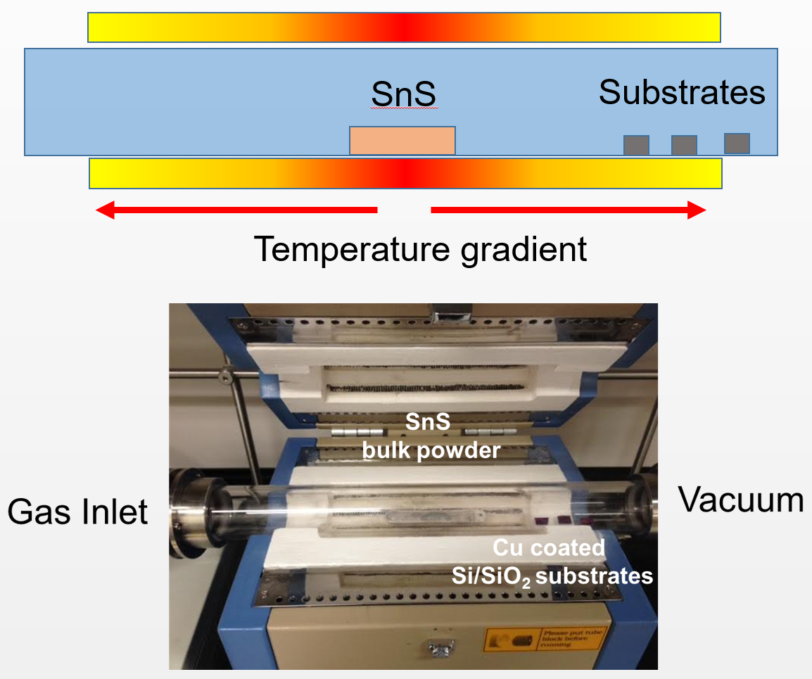
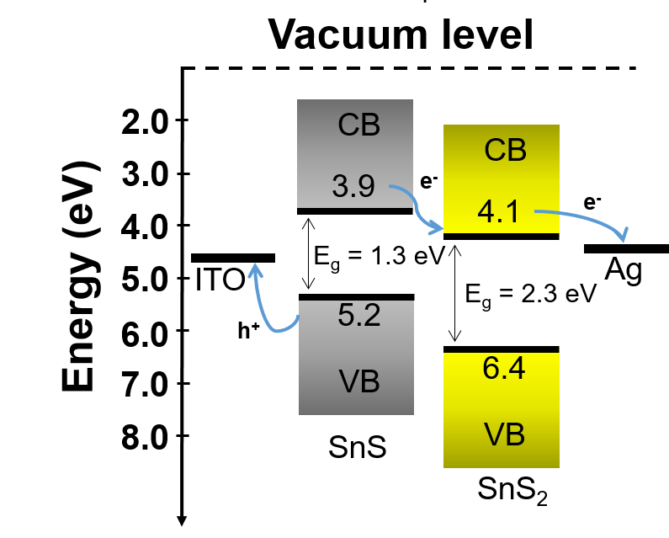
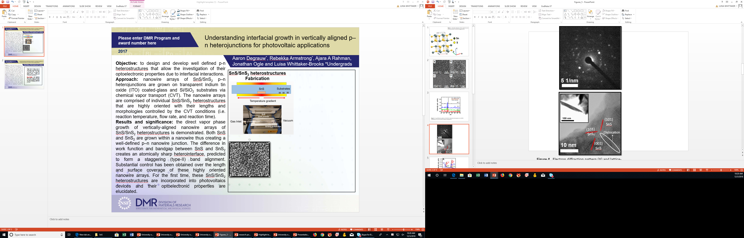
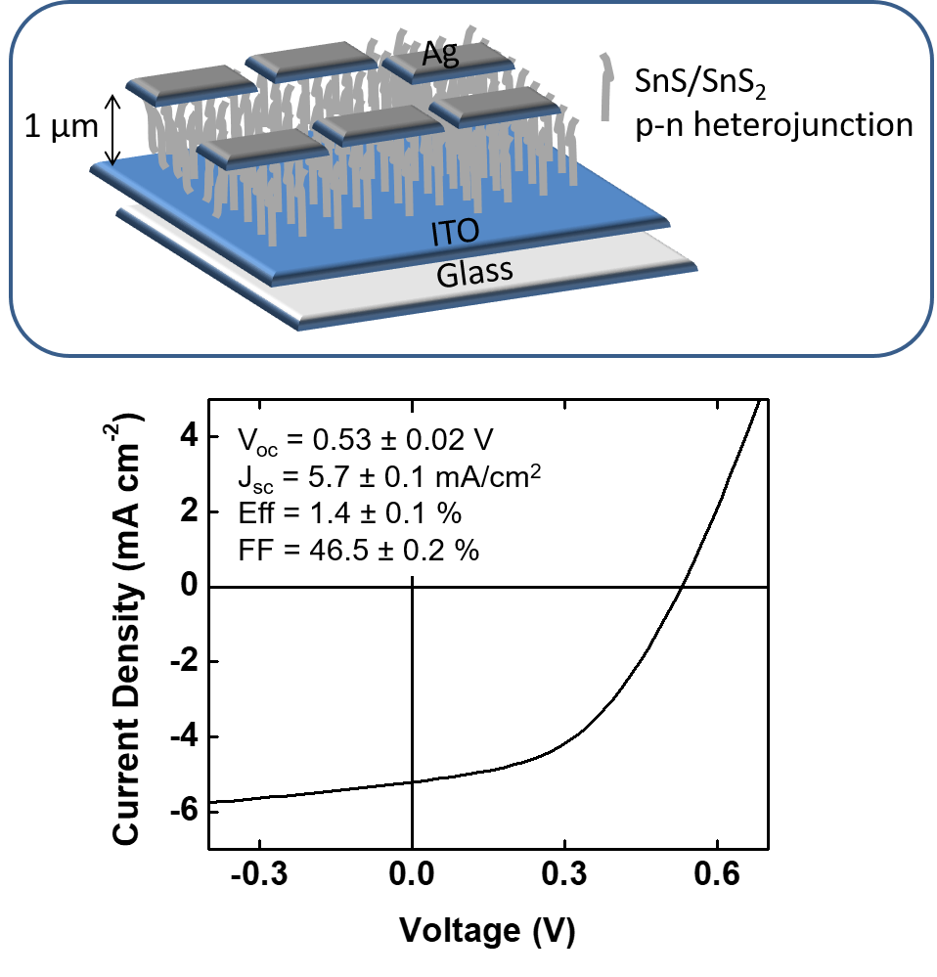
Understanding interfacial growth in vertically aligned p–n heterojunctions for photovoltaic applications
Please enter DMR Program and award number here
2017
Aaron Degrauw*, Rebekka Armstrong*, Ajara A Rahman, Jonathan Ogle and Luisa Whittaker-Brooks *Undergrads
Objective: to design and develop well defined p-n heterostructures that allow the investigation of their optoelectronic properties due to interfacial interactions.
Approach: nanowire arrays of SnS/SnS₂ p–n heterojunctions are grown on transparent indium tin oxide (ITO) coated-glass and Si/SiO₂ substrates via chemical vapor transport (CVT). The nanowire arrays are comprised of individual SnS/SnS₂ heterostructures that are highly oriented with their lengths and morphologies controlled by the CVT conditions (i.e. reaction temperature, flow rate, and reaction time).
Results and significance: the direct vapor phase growth of vertically-aligned nanowire arrays of SnS/SnS₂ heterostructures is demonstrated. Both SnS and SnS₂ are grown within a nanowire thus creating a well-defined p–n nanowire junction. The difference in work function and bandgap between SnS and SnS₂ creates an atomically sharp heterointerface, predicted to form a staggering (type-II) band alignment. Substantial control has been obtained over the length and surface coverage of these highly oriented nanowire arrays. For the first time, these SnS/SnS₂ heterostructures are incorporated into photovoltaics devices and their optoelectronic properties are elucidated.
Fabrication of SnS/SnS₂ heterostructures
Energy level diagram for SnS/SnS₂ p-n heterojunctions. This diagram is derived from UPS and UV-vis-NIR studies.
SEM
TEM
J-V curves for solar cells comprising nanowire arrays of SnS/SnS₂ p-n heterojunctions.
Device architecture
Degrauw, A.; Armstrong, R.; Rahman, A. A.; Ogle, J.; Whittaker-Brooks, L., Catalytic growth of vertically aligned SnS/SnS₂ p–n heterojunctions. Mater. Res. Express 2017, 4, 094002.
Notes:
A p–n heterojunction, specifically in solar cells, is normally comprised of a light absorber (p-type semiconductor) and an electron transport material (n-type semiconductor). The choice of p- and n-type semiconductor is governed by the effective electronic energy band alignment at the interfaces to ensure that charges (electron and holes) are successfully generated and transported to the electrodes for current generation. Besides the rational design of materials with compatible properties that can be engineered into highly efficient p–n heterojunctions, one has to consider several limitations arising from the relatively narrow light absorption range and serious electron–hole recombination at the p–n heterojunction interface. Particularly, in solar cell devices, vertically-aligned 1D nanostructures are preferred over their disordered counterparts to facilitate anisotropic charge transport to the electrodes. While many thin film p–n heterostructures and superlattices may be fabricated via molecular beam epitaxy, atomic layer deposition, pulsed laser ablation and/or vapor deposition techniques, there is no specific synthetic scheme where 1D p–n heterojunctions with well-defined interfaces may be fabricated. This fabrication limitation is due to the lack of control over materials' phase and stoichiometry, grain size and grain boundary defects, and energy level alignment. Thus, the growth and optoelectronic characterization of well defined and well controlled all inorganic p–n heterostructures will pave the way for the fabrication of highly efficient solar cell devices.

