Slide 1
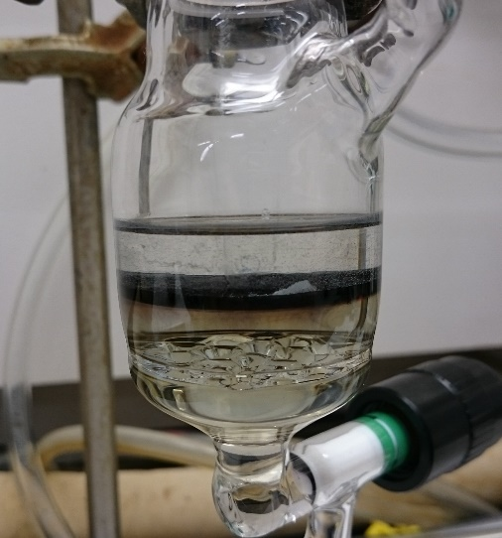
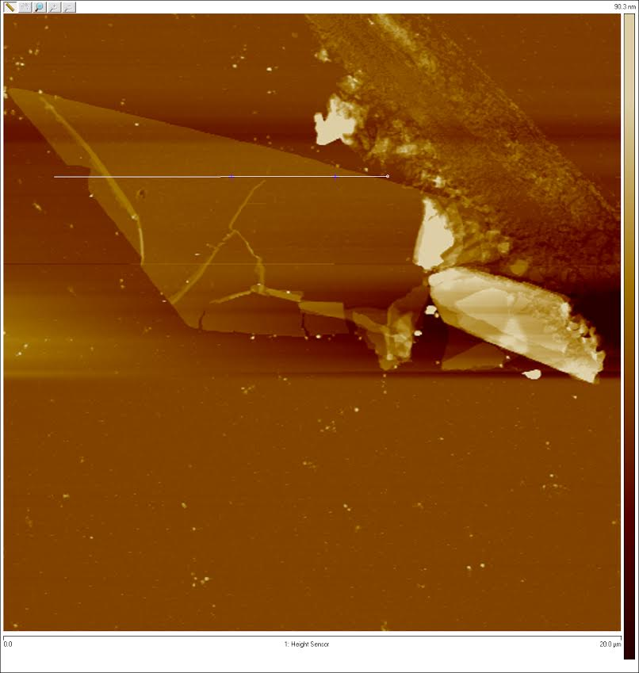
Synthesis of a Family of 2D Coordination Polymers using Hexaaminobenzene as the Building Block
MRSEC at the University of Utah;
DMR 1121252
2017
Nabajit Lahiri, Neda Lotfizadeh, Ryuichi Tsuchikawa, Vikram Deshpande and Janis Louie; University of Utah
Since the discovery of Graphene, there has been a significant interest in the search of new 2D materials which would show similar interesting properties such as electrical and thermal conductivity, superconductivity , topological gap, etc. In this regard, a ‘bottom-up’ synthesis or a synthesis which involves generating the polymer from its constituents, is of particular interest since it could give access to a library of 2D materials.
In this work, we have used a ‘bottom-up’ interfacial synthetic strategy to develop a family of hexaaminobenzene based 2D materials using several different metal ion linkers.
The materials were characterized using various surface analysis techniques and was found not only to be ultrathin (ca. 10nm) and crystalline abut also posses a smooth and flat topography. Conductivity studies also revealed that the materials were weakly conducting in nature.
Figure 1: General Synthetic Scheme of 2D Coordination Polymers. Hexaaminobenzene in water is layered with a solution of metal(II) acetylacetonates in ethyl acetate to generate the 2D polymer at the interface.
Figure 2: (left) Photograph showing the liquid-liquid interfacial synthesis of the material. The material can be seen as a black film at the interface of water and ethyl acetate. (right) Atomic Force Microscope (AFM) image showing the topography of the Ni-Hexaaminobenzene polymer. The flat and ultrathin nature of the material can be easily observed.
Lahiri, N; Lotfizadeh, N; Tsuchikawa, R; Deshpande, V.V.; Louie, J. J. Am. Chem. Soc. 2017, 139. 19-22
Notes:
A family of 2D coordination polymers were successfully synthesized through “bottom-up” techniques using Ni²⁺, Cu²⁺, Co²⁺, and hexaaminobenzene. Liquid–liquid and air–liquid interfacial reactions were used to realize thick (∼1–2 μm) and thin (<10 nm) stacked layers of nanosheet, respectively. Atomic-force microscopy and scanning electron microscopy both revealed the smooth and flat nature of the nanosheets. Selected area diffraction was used to elucidate the hexagonal crystal structure of the framework. Electronic devices were fabricated on thin samples of the Ni analogue and they were found to be mildly conducting and also showed back gate dependent conductance.

