Slide 1
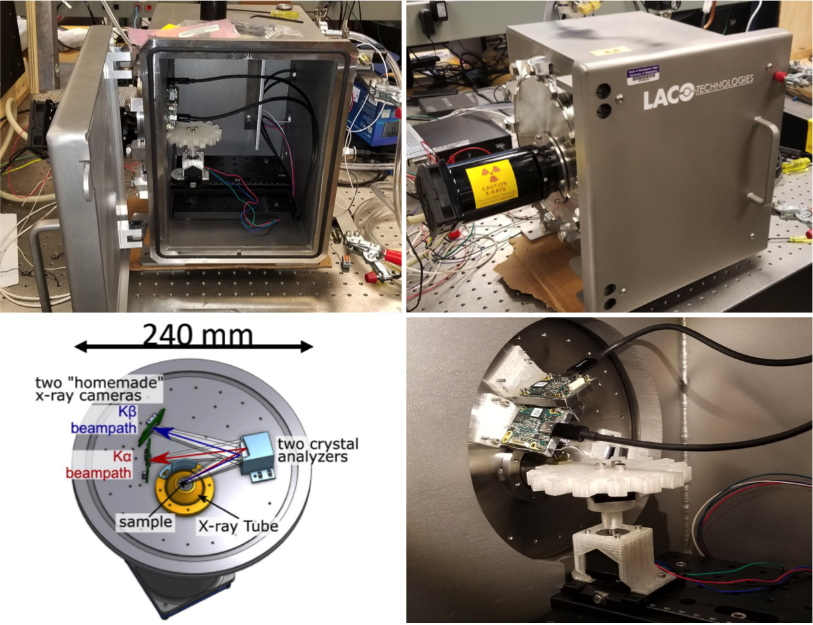
Unique Facilities: Benchtop X-ray Spectrometer for Accelerating Discovery and Characterization of Novel Phosphorous-Rich Materials
Materials Research Science and Engineering Center
DMR- 1719797
2020
Gerald Seidler, easyXAFS LLC, and MEM-C Shared Facilities
Molecular Engineering Materials Center (MEM-C)
University of Washington, Seattle
MEM-C has developed a unique high-resolution x-ray emission spectrometer for studying phosphorus-rich, air-sensitive materials. Building upon Seidler's pioneering instrument-development work, a collaboration with local start-up company easyXAFS, and MEM-Seed funding, the MEM-C "phosphortron" is based on a dispersive refocusing Rowland geometry and consists of two parallel spectrometers that simultaneously capture core-to-core Kα and valence-to-core Kβ x-ray fluorescence. It is housed within a temperature-regulated double glovebox in the MEM-C Shared Facilities space. The phosphortron allows automated, unattended measurement of up to 15 samples following a single round of sample mounting. Partnership with easyXAFS aided instrument development through sharing of control software. easyXAFS also benefited from MEM-C student training by hiring a recent MEM-C PhD graduate into a full-time position. This instrument offers users a unique and powerful probe for characterizing P-rich materials.
Photos of MEM-C's "phosphortron" benchtop x-ray emission spectrometer in its helium/radiation enclosure. The schematic illustrates the dual-spectrometer design. The entire unit is housed in a temperature-controlled inert-atmosphere glove box in MEM-C Shared Facilities.
Holden, et al., “An X-ray Emission Spectrometer for Electronic Structure of Air-Sensitive Phosphorus-rich Materials,” in prep. (2020).

