Slide 1

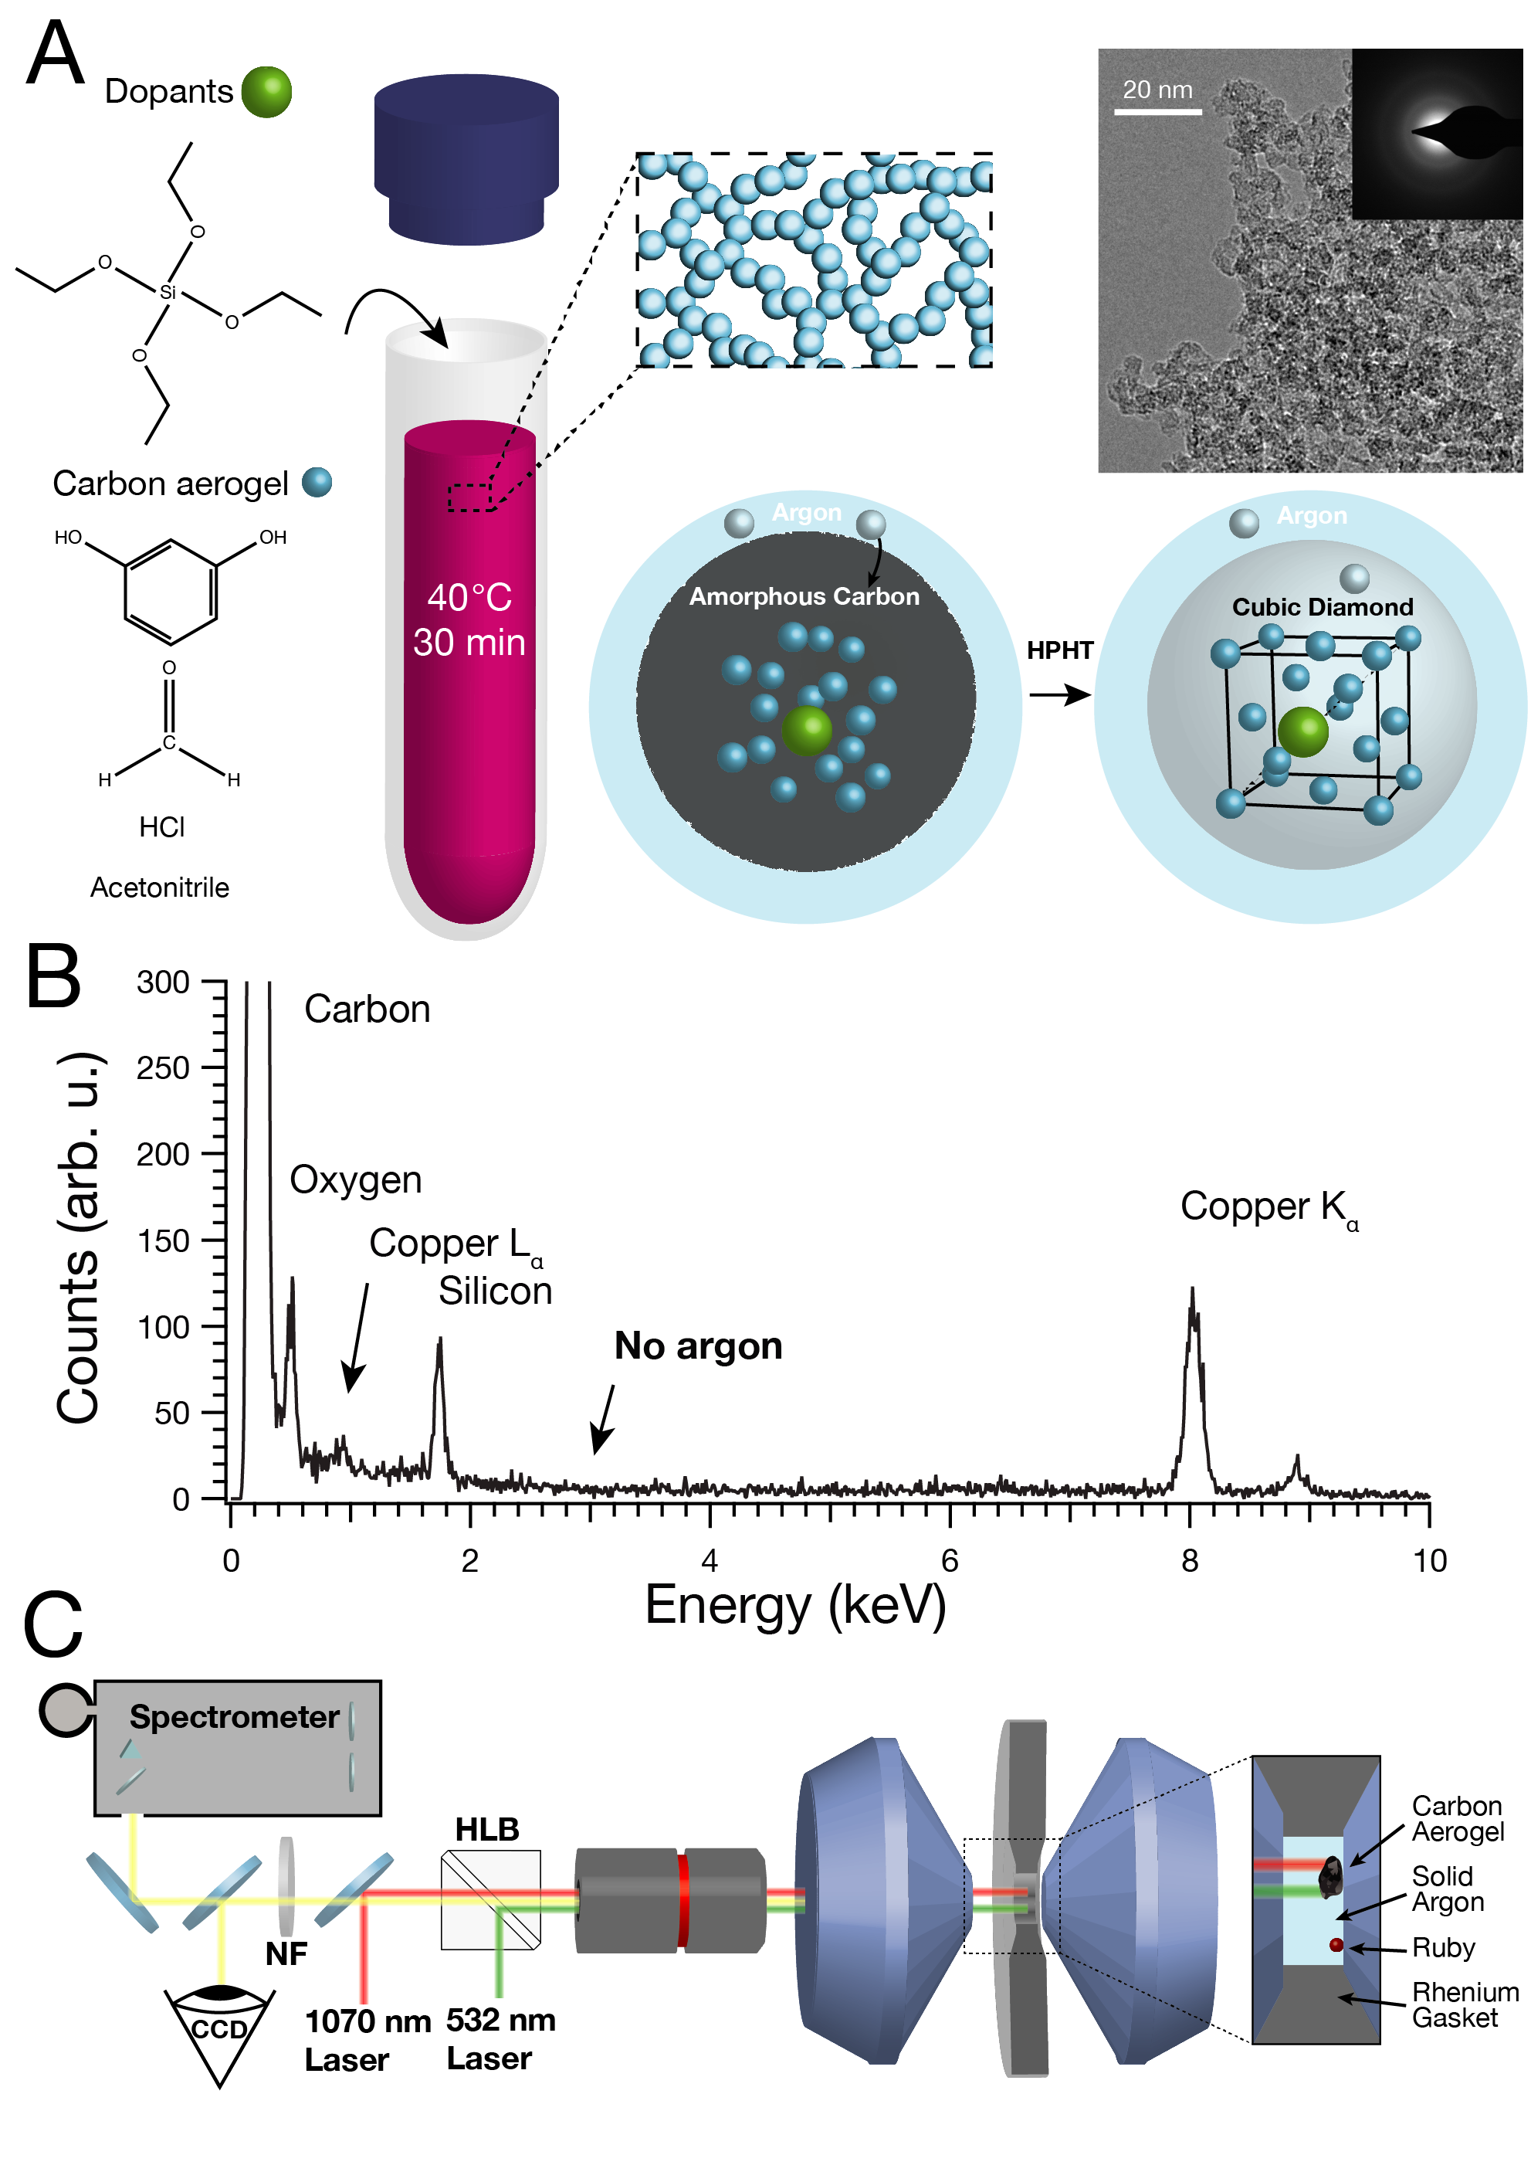
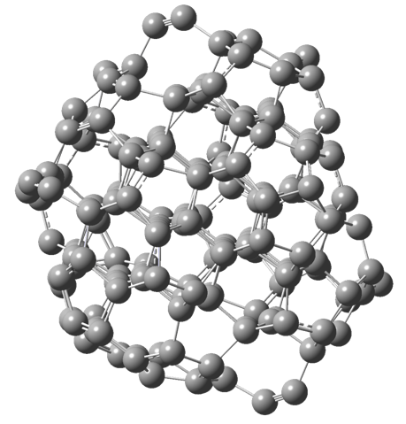
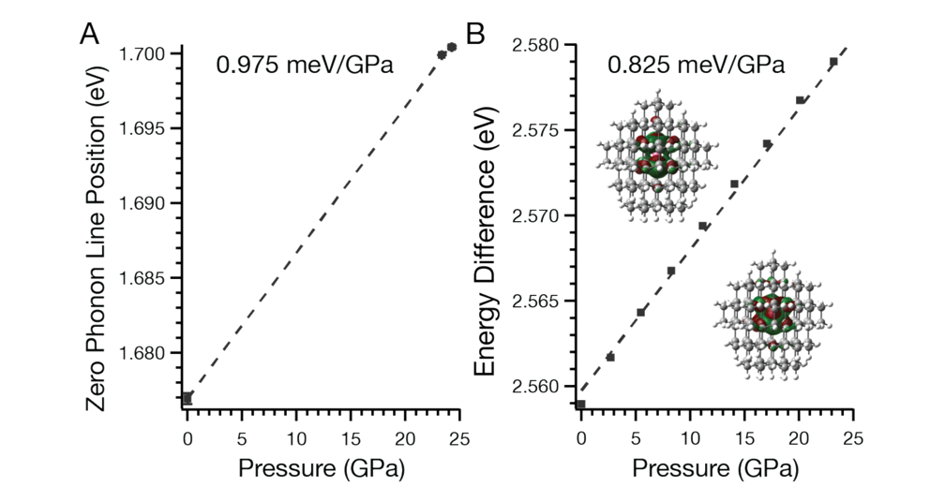
Silicon vacancy color center in nanodiamonds for high pressure temperature sensing and quantum cryptography.
Materials Research Science and Engineering Center
DMR-1719797
2018
Xiaosong Li and Peter Pauzauskie
Molecular Engineering Materials Center (MEM-C)
University of Washington, Seattle
The presence of isolated defects in the lattice of large band-gap semiconductors can introduce colored centers, by altering their electronic properties giving rise to transitions within the visible region. Diamond has a rigid and dense lattice preventing defect diffusion and phase transitions under high pressure and temperature settings. Upon approaching the nanoscale doped diamonds can be used for applications such as quantum computing, sensing, and cryptography, and as such much interest has been garnered to make and characterize these systems. Investigation of the rearrangement of the surfaces of the nanodiamond, including the effects on the X-ray absorption spectrum, have been theoretically investigated, and the contributions of the surface rearrangement to previously debated pre-edge features has been shown. In addition, we developed a versatile method to dope diamond for quantum applications by first synthesizing a doped, nanostructured amorphous carbon precursor and then transforming it to nanodiamond at high pressure, high temperature conditions. Specifically, we incorporated silicon atoms in the form of the split silicon vacancy color center. The origin of the pressure dependence of this site as well as X-ray and vibrational signatures of the negatively charged silicon split vacancy were investigated experimentally and computationally.
Si Dopant
High pressure, high temperature conditions
Carbon atoms
Fig. 2: A schematic of the high pressure molecular doping process. Silicon atoms molecularly doped into precursor and noble gas atoms from the pressure medium both form dopants in the recovered nanodiamond.
Experimental
Theoretical
Fig. 1: Top - Ball and stick model of the split silicon (pink) vacancy (light blue) in diamond lattice (gray). Bottom – A nanodiamond showing the appearance of surface defects.
Fig. 3: Experimental (left) and theoretical (right) optical response of the negatively charged split silicon vacancy center (Fig. 1) visible spectrum to hydrostatic pressure. The molecular orbitals responsible for the transition are shown inset on the theoretical plot.
Beck, R.A., et al. J. Phys. Chem. C. 2018. 10.1021/acs.jpcc.8b00354
Crane, M.J., et al. arXiv:1804.00350 2018
Petrone A., et al. Submitted 2018
Notes:
Synthesis of the nanodiamonds was achieved through synthesizing a nanostructured carbon aerogel precursor with a controlled chemical composition, and subjecting it to HPHT conditions in a laser-heated diamond anvil cell with an argon pressure medium. Bright-field transmission electron microscopy and selected area electron diffraction demonstrated that the aerogel consists of 6.8± 1.9 nm radius amorphous carbon grains. We tuned the chemical composition of the aerogel grains by adding tetraethylorthosilicate molecules directly to the mixture as it gelled. Energy dispersive X-ray spectroscopy confirmed that silicon dopants were incorporated throughout the carbon precursor material. To synthesize diamond, we placed the doped carbon precursor into a diamond anvil cell and condensed solid argon within the high-pressure chamber to infiltrate the microstructure of the aerogel and subsequently pressurized the cell above 20 GPa to thermodynamically favor diamond formation and drive grain growth through heating above 2000 K with a near-infrared, continuous laser.
Theoretical investigations of the nanodiamonds were performed by constructing nearly spherical diamond quantum dots of three sizes (0.8, 1.2, 1.4, 2.1 nm in diameter) with the bulk face-centered cubic lattice parameter of 0.357 nm. Hydrogen atoms were used to passivate the surface carbon dangling bonds. The sizes generated are similar in size to those that are able to be produced experimentally. These quantum dots exhibit quantum confinement effects as the Bohr excitonic radius for diamond is ~1.6 nm. To model the surface reorganization models were fully optimized with various degrees of surface hydrogen present (0%, where all hydrogens are removed; 50%, where half of the hydrogen is removed; and 100%, where none of the hydrogen is removed) using density functional theory (DFT) at a B3LYP/6-31G* level of theory with the Gaussian electronic structure software package. To verify that the structures returned from the optimization were true minima, and to compute the vibrational frequencies, the second derivates of the energy with respect to the nuclear coordinates were calculated using harmonic treatment. The X-ray absorbance spectrum (XAS) was then computed using time-dependant (TD) DFT within the linear response framework and its energy specific implementation for high energy states. The silicon split vacancy was constructed to have a D3d symmetry before optimization by removing two carbons along the <1,1,1> axis of the models, and positioning the Si atom into the center of the resulting divacancy. To examine the pressure dependence of the system the crystallographic constant was shrunk resulting in an approximate hydrostatic application of pressure on the system. The model was then treated through DFT at a B3LYP/6-31G* level of theory and the response to the pressure measured by examining the difference in the band gap for the orbitals involved in the first bright transition from TD-DFT within the linear response framework. The electronic structures of the excited states were also calculated using TD-DFT within the linear response framework. The vibrational spectra for the Si systems were calculated using the harmonic treatment, and the XAS for the Si doped nanodiamonds was calculated using TD-DFT within the linear response framework and its energy specific implementation for high energy states.

