Slide 1
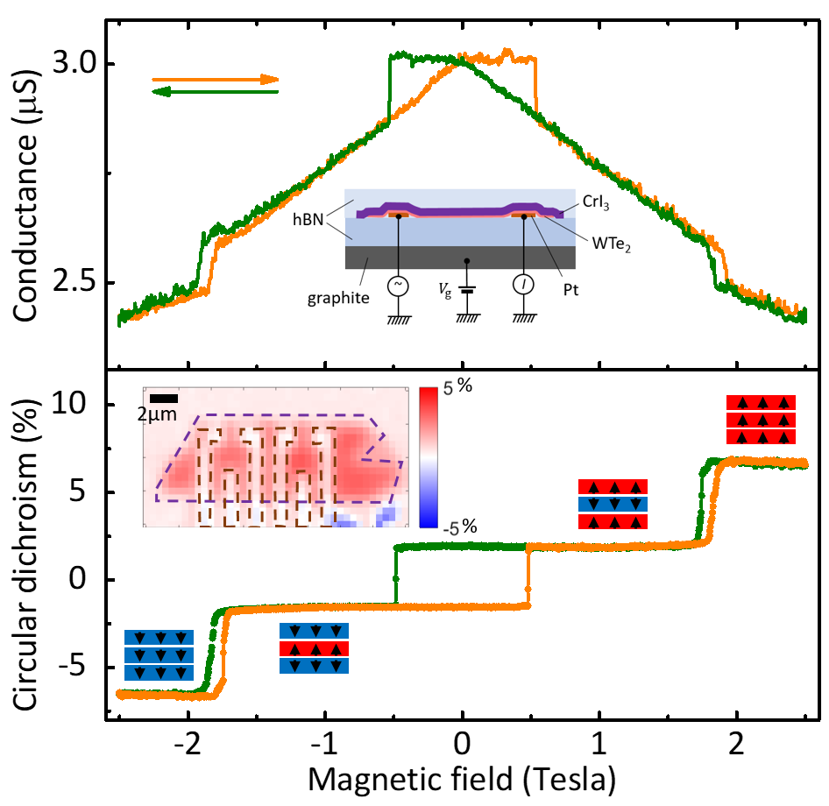
MEM-C IRG-2: Coupling a Monolayer Magnet to a Monolayer Quantum Spin Hall Insulator
Materials Research Science and Engineering Center
DMR-1719797
2019
David Cobden, Jiun-Haw Chu and Xiaodong Xu
Molecular Engineering Materials Center (MEM-C)
University of Washington, Seattle
Monolayer WTe₂ is a quantum spin Hall insulator at temperatures below 100 K. This means that the current is carried by helical conducting edge modes and is spin polarized. CrI₃ is a layered antiferromagnet below about 45 K, with the magnetization of each layer out of plane and opposite to that of the adjacent layers. The magnetization of the CrI₃ is therefore expected to affect the spin-polarized current in the WTe₂ edge if the two are coupled.
We have made devices incorporating bi- and tri-layer CrI₃ on top of monolayer WTe₂. We found that when the magnetization pattern of the layers changes in an applied magnetic field, the conductance of the WTe₂ edge changes. The magnitude of the effect can be interpreted in terms of a perpendicular exchange field acting on the WTe₂ of ~3 T from the adjacent CrI₃ monolayer, consistent with magnetic inception of backscattering within the edge.
Figure 1. The conductance (top) of a device containing trilayer CrI₃ overlaying monolayer WTe₂ encapsulated in hBN, shows steps and hysteresis as a function of perpendicular magnetic field. The steps occur when the magnetization of the CrI₃ rearranges, as detected by circular dichroism (bottom) which measures the total magnetization.
Reference: Wenjin Zhao*, Zaiyao Fei*, Tiancheng Song, Han Kyou Choi, Tauno Palomaki, Bosong Sun*, Paul Malinowski*, Jiun-Haw Chu*, Xiaodong Xu*, & David H. Cobden*, preprint. *MEM-C participants
Notes:
We have made devices incorporating bi- and tri-layer CrI₃ on top of monolayer WTe₂. We found that when the magnetization pattern of the layers changes in an applied magnetic field, the conductance of the WTe₂ edge changes. The magnitude of the effect can be interpreted in terms of a perpendicular exchange field acting on the WTe₂ of ~3 T from the adjacent CrI₃ monolayer, consistent with magnetic inception of backscattering within the edge.

