Slide 1
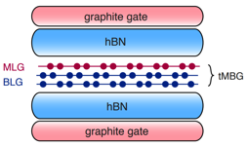
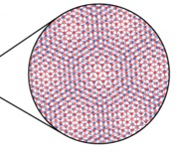
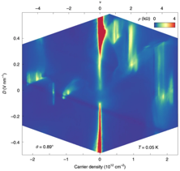
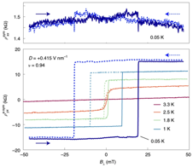
MEM-C IRG-2: Tunable Correlated and Topological States in Twisted Graphene Multilayers
Materials Research Science and Engineering Center
DMR-1719797
2021
David Cobden, Xiaodong Xu and Matthew Yankowitz
Molecular Engineering Materials Center (MEM-C)
University of Washington, Seattle
Stacking various atomically-thin crystals on top of one another can strongly modify their overall properties. When two materials are stacked with a twist angle, a geometric interference pattern (a moiré pattern) emerges. At special twist angles, the moiré pattern can result in new electronic states dominated by strong correlations between electrons.
We have made devices in which a monolayer and a bilayer graphene sheet are stacked and twisted by around 1 degree. We found that strongly correlated states emerge in these devices, and can be controlled by applying an electric field. Additionally, we discovered a unique type of ferromagnetism known as “orbital magnetism” in these devices. Combined with nontrivial band topology, this results in a large anomalous Hall effect that is nearly quantized. These highly tunable correlated and topological states are promising for the development of future quantum technologies.
(a)
(c)
(b)
Figure 1. (a) Schematic of a tMBG device, showing a moiré interference
pattern arising owing to an interlayer twist angle. (b) Device resistivity at
low temperature, exhibiting various correlated insulating and metallic
phases tunable with displacement field. (c) Measurements of the longitudinal and Hall resistivities as the magnetic field is swept back and forth. The large hysteresis loop indicates the formation of a topological orbital ferromagnet.
He, Li, Cai, Liu, Watanabe, Taniguchi, Xu, Yankowitz, Nature Physics, 17, 26 (2020)
Chen, He, Zhang, Hsieh, Fei, Watanabe, Taniguchi, Cobden, Xu, Dean, Yankowitz, Nature Physics, 17, 374 (2021)
Notes:
Numerous heterostructures comprising van der Waals materials with an interfacial twist angle have recently been identified to host flat electronic bands. Electronic ground states in these materials are dominated by Coulomb interactions between charge carriers owing to the quenched kinetic energy, leading to the emergence of a variety of novel correlated electronic states. Heterostructures constructed with one or more components of Bernal-stacked bilayer graphene exhibit correlated states that can additionally be tuned with an applied electric field perpendicular to the sheets. The Yankowitz, Xu, and Cobden groups investigated the transport properties of the emergent correlated states in twisted double bilayer graphene (tDBG) and twisted monolayer-bilayer graphene (tMBG). The work in tMBG was the first to report the discovery of correlated insulating and metallic states in this platform. Owing to the low crystal symmetry of tMBG, the correlated phase diagram differs substantially depending on whether an external electric field is applied towards the monolayer or bilayer graphene component. In a device with twist angle of 0.89°, intrinsic orbital magnetism was discovered. Owing to the nontrivial topology of the bands, this magnetism was accompanied by a large anomalous Hall effect that appears likely to reach quantization to h/e² in a sufficiently clean sample. In devices with slightly larger twist angles, orbital magnetism was found to be abundant within the correlated phase diagram. Detailed transport measurements uncovered a potential exotic intervalley coherent ground state ordering with broken time reversal symmetry at one-quarter filling of the lowest moiré conduction band over a small range of twist angles.

