Slide 1
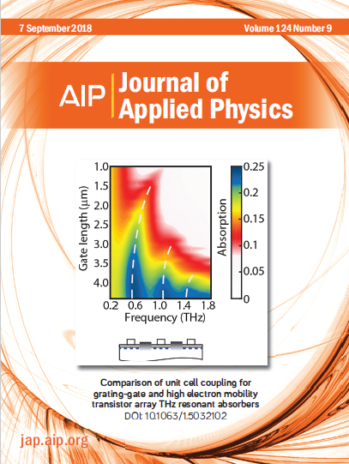
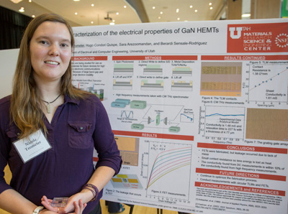
Synchronized terahertz plasmons in ultra-thin membrane GaN HEMT arrays
MRSEC at the University of Utah;
DMR 1121252
2018
J. Encomendero, M. Zhu, Debdeep Jena & Grace Xing; Cornell. M. Trometer; University of Florida. H. Condori, A. Chanana, A. Nahata & B. Sensale-Rodriguez; University of Utah
Promising a myriad of transformative applications in various fields such as communications, security, chemical & biological sensing, and astronomy, terahertz (THz) technology is a very promising technological field.
In order to realize efficient THz systems, development of active devices, such as detectors and emitters is required. In this context, promising large scale integration, spatial uniformity, and low cost, field effect transistor (FET) -based THz detection has turned into a de-facto technological goal.
THz electromagnetic waves can interact with 2DEGs, such as the channel in a FET, strongly due to the match between the wave frequency and electron scattering time. In our work we try to answer a fundamental question: should you design a coupled or a synchronized 2DEG oscillator so to maximize THz coupling into these devices?
Our work demonstrates that synchronized resonators can provide a superior coupling and therefore a superior detector response.
Notes:
We report experimental studies on the excitation of synchronized plasmon resonances in AlGaN/GaN High Electron Mobility Transistor (HEMT) arrays. In contrast to the commonly employed grating-gate configurations, the analyzed structure contains periodically patterned ohmic contacts to the two-dimensional electron gas, which are laid-out parallel to the gate fingers. In this structure, the terahertz to plasmon coupling mechanism is fundamentally different from that in grating-gate configurations. Whereas the grating-gate configuration constitutes a coupled resonant system in which the resonance frequency depends on the grating periodicity, when periodical ohmic contacts are incorporated, the system behaves as a synchronized resonant system in which each unit cell is effectively independent. As a result, in a HEMT-array, the resonance is no longer set by the periodicity but rather by the gate and the ungated region length. Experimental results of fabricated samples compare well with numerical simulations and theoretical expectations. Our work demonstrates that the proposed approach allows: (i) more efficient excitation of high order plasmon modes and (ii) superior overall terahertz to plasmon coupling, even in configurations having less number of devices per unit area. From this perspective, our results reveal a simple way to enhance the terahertz to plasmon coupling and thus improve the performance of electron plasma wave-based devices; this effect can be exploited, for example, to improve the response of HEMT-based terahertz detectors.

