Slide 1
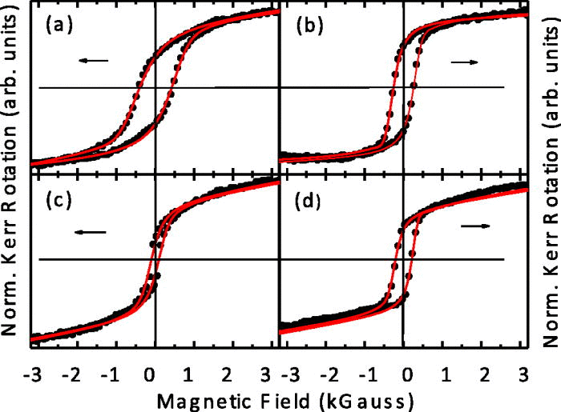
Magnetic properties of periodically organized cobalt frameworks
Golda Hukic-Markosian, Yaxin Zhai, Danielle E. Montanari, Steven Ott,
Adriane Braun, Dali Sun, Zeev V. Vardeny, and Michael H. Bartl
Discovery: Magnetic properties of cobalt films can be optimized through nanoscale structuring and thermal annealing.
Approach & Results: Periodically organized cobalt structures were fabricated by self-assembly and electrochemical deposition. Magnetic properties of these structures were revealed by magneto-optical Kerr effect studies and a magnetic pinning-site model.
Significance: This nanoscale fabrication approach is the first step towards 3D magnonic crystals, a new type of magnetic metamaterial with potential to control spin-wave propagation and spin density of states.
Scanning electron micrograph of a ferromagnetic, ordered cobalt nanostructure.
Magnetic hysteresis of nanostructured cobalt without heat treatment (a), annealed at 350 ºC (b), 440 ºC (c), and 500 ºC (d).
Journal of Applied Physics 116, 013906 (2014)

