Slide 1
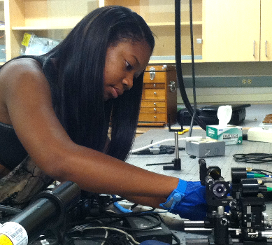
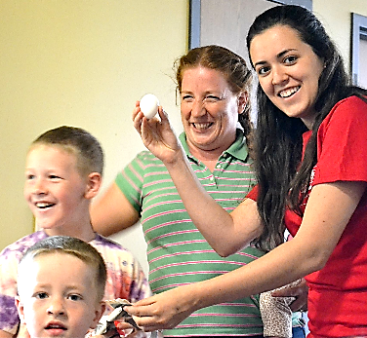
2014 Research Experience for Undergraduates
Summer Program
Approach: Recruited nine highly-talented students (four female, two from underrepresented minorities) to work on Utah MRSEC research in engineering, physics and chemistry. REU students attended professional development and academic seminars, and led outreach activities at a local children’s museum.
Impact: Three of the 2014 REU cohort intend to apply to graduate school at the University of Utah, and four will submit abstracts on their research to the National Conference for Undergraduate Research (NCUR). Utah MRSEC will fund those chosen to present at NCUR.
Feedback from 2014 REU students:
“I really appreciated that the research I was participating in was on the frontier of science.”
“I found every aspect of the research experience of great value to my future, not only as a student, but a member of the scientific community.”

