Slide 1
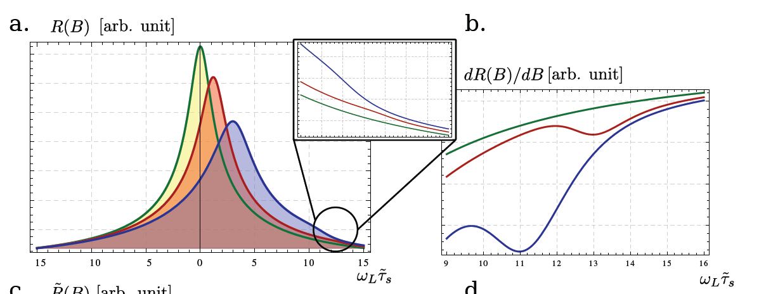
Manipulation of the Hanle curve contour for spin-transport structures in the presence of an ac drive R. C. Roundy, M. C. Prestgard, A. Tiwari, and M. E. Raikh
Effect: We have demonstrated that the shape of the Hanle curve (non-local resistance versus applied magnetic field) can be manipulated using an ac drive.
Finding: The application of a circularly polarized ac drive modifies the shape of the Hanle curve by breaking its symmetry. Surprisingly, we find that a magnetic resonance manifests itself as a feature in the Hanle curve.
Significance: Application of an ac drive reveals delicate features of the spin-transport and allows for in depth tests of the “drift-diffusion” description of spin-transport.
Top: Schematic diagram of a spin-transport device under an ac drive. Bottom: Evolution of the Hanle curve with intensity of a circularly polarized ac drive. Inset and derivative (right panel) show the signature of magnetic resonance.
arXiv:1407.6440 [cond-mat.mes-hall]

