Slide 1
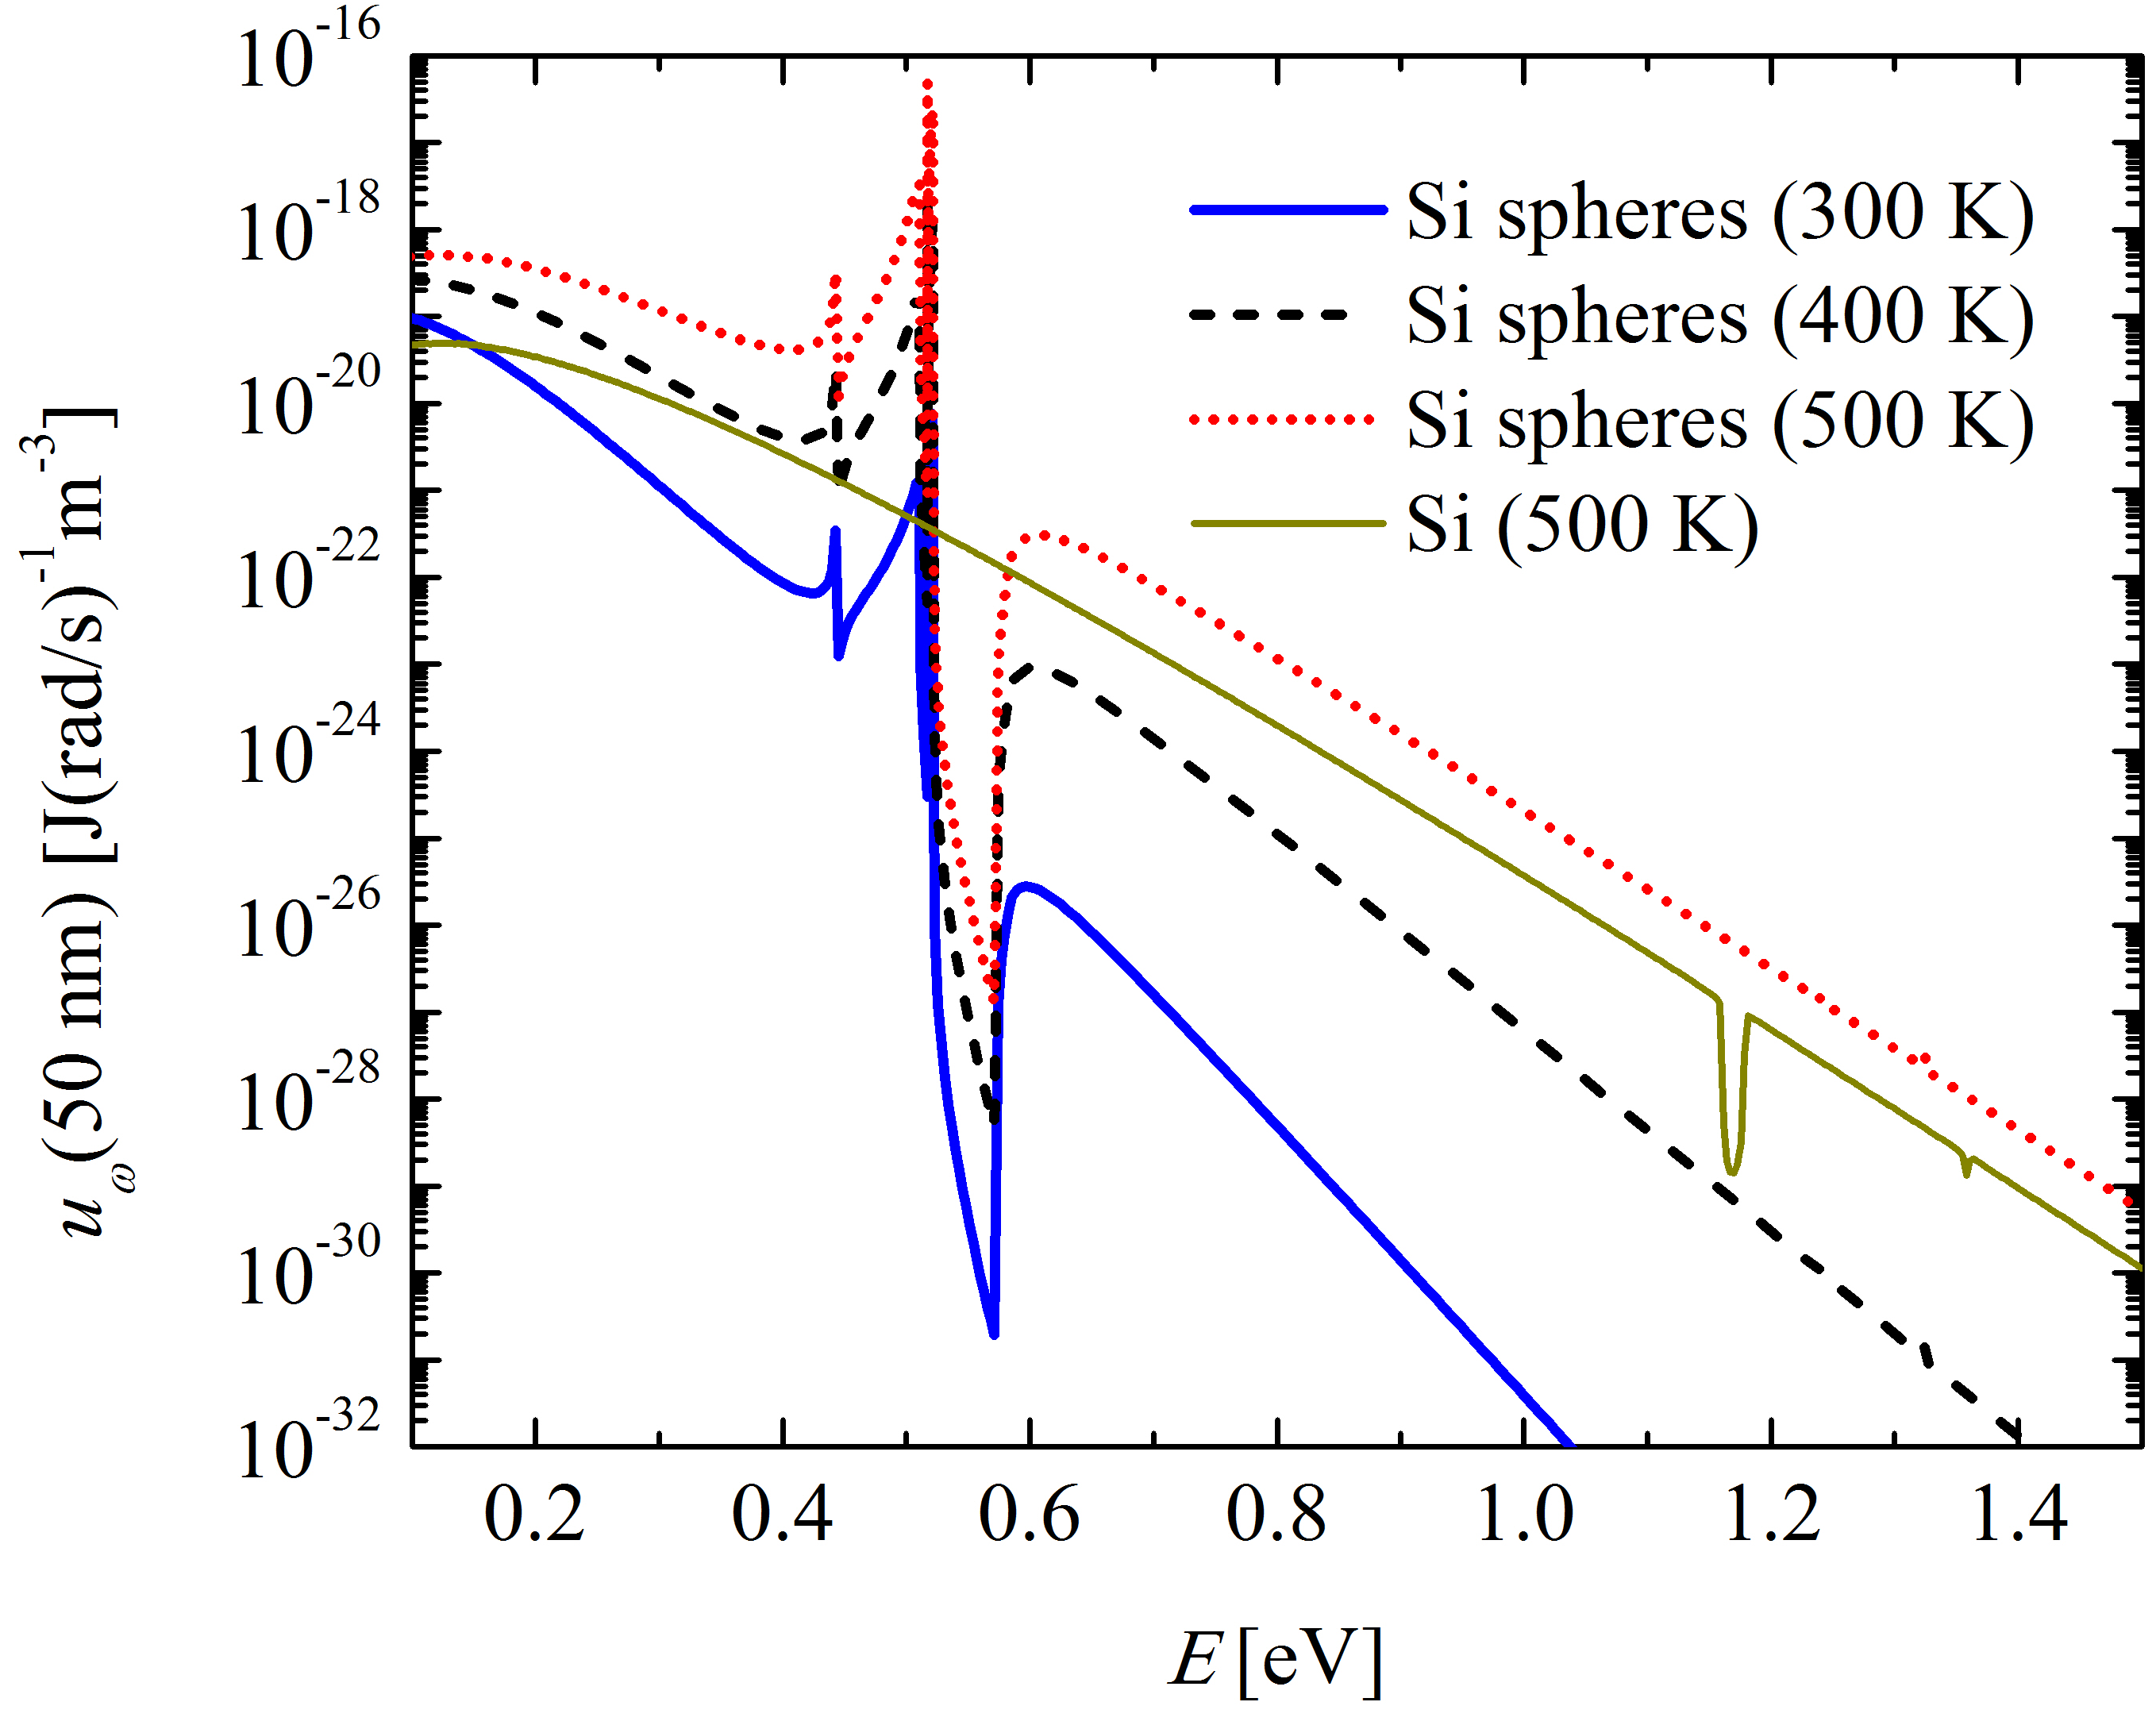
Design, fabrication and characterization of Mie resonance-based three-dimensional metamaterials for tuning thermal radiative properties
Spencer J. Petersen, Bart Raeymaekers and Mathieu Francoeur
Objective: Demonstrate that Mie resonance-based metamaterials with isotropic electromagnetic responses can be used for tuning thermal radiative properties.
Approach: Near-field energy density u_{ω} calculation performed by combining the effective medium theory with fluctuational electrodynamics.
Results and Significance: Silicon-based metamaterials lead to resonance of the thermal near field in the near infrared at low temperature. These metamaterials will impact significantly low-grade waste heat recovery via thermophotovoltaic power generators.
Energy density 50 nm above a Mie resonance-based metamaterial made of 100 nm Si spherical inclusions.
Journal of Quantitative Spectroscopy and Radiative Transfer 129, 277 (2013)

