Slide 1
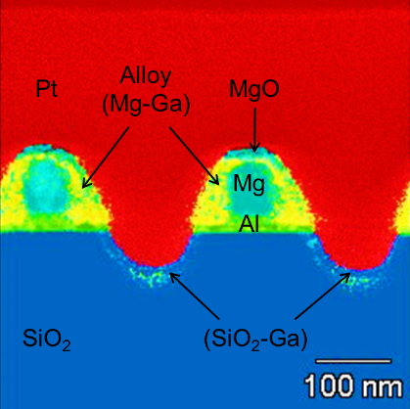
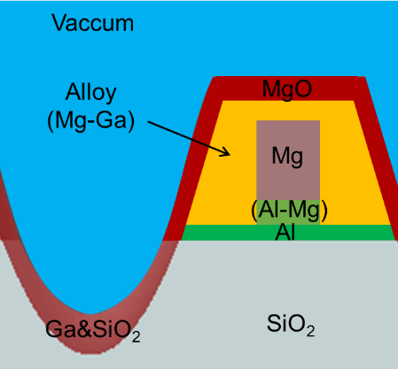
Modeling the UV Electromagnetic Response of Al and Mg Plasmonic Nanostructures
Steve Blair and Sivaraman Guruswamy
Objective: Compare the UV plasmonic response of Al and Mg nanostructures. Light transmission through sub-wavelength aperture arrays shows significant differences between the two metals that cannot be explained using simple simulations.
Approach: Detailed S/TEM cross-section analysis of samples was performed to determine nanostructure geometry and elemental composition. Because of significant alloying at the interfaces and Ga implantation near the surfaces from FIB milling, simulation models were updated with geometric and composition information.
Results and Significance: Updated simulation models accurately predict light transmission through aperture arrays of both materials. This methodology provides a path for predicting near-field and far-field optical properties of complex plasmonic nanostructures.
Array of sub-wavelength apertures in Mg film, pitch = 260nm.
Composite S/TEM elemental mapping in cross-section for a Mg aperture array sample.
Updated simulation model showing geometry and material composition.
Comparison of experimental and simulated light transmission measurements for Al and Mg samples.

