Slide 1
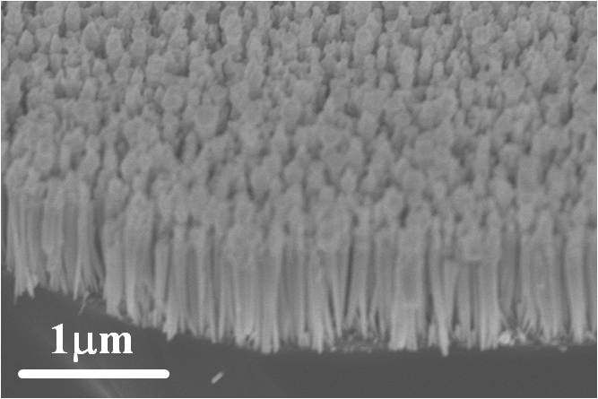
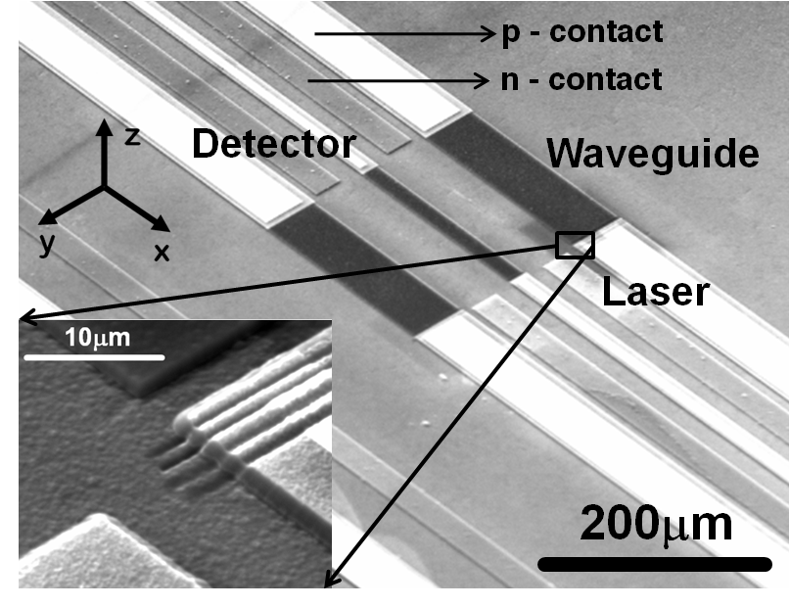
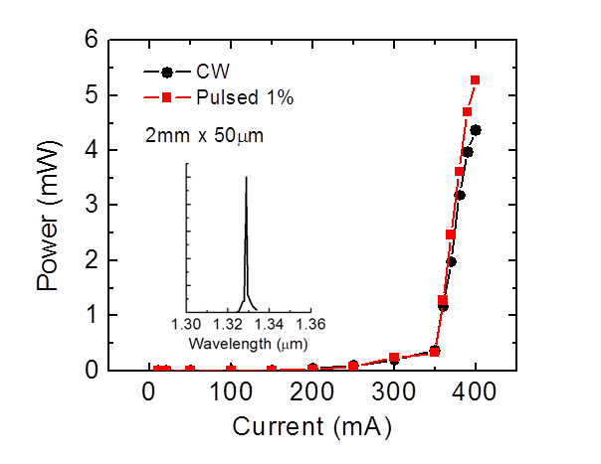
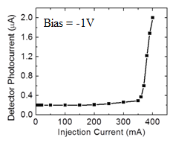
1.3µm Optical Interconnect on Silicon: A Monolithic III-Nitride Nanowire Array Photonic Integrated Circuit
MRSEC Program; DMR - 1120923
2017
A feasible optical interconnect on a silicon complementary metal-oxide-semiconductor chip demands epitaxial growth and monolithic integration of diode lasers and optical detectors with guided wave components on a (001) Si wafer, with all the components preferably operating in the wavelength range of 1.3–1.55 μm at room temperature.
The work demonstrates a novel monolithic optical interconnect on a (001)Si substrate consisting of a III-nitride dot-in-nanowire array edge emitting diode laser and guided wave photodiode, with a planar SiO₂/Si₃N₄ dielectric waveguide in between. The active devices are realized with the same nanowire heterostructure by one-step epitaxy. The structural and optical characteristics of the nanowires have been investigated. The laser, emitting at the desired wavelength of 1.3 μm, with threshold current ∼350 mA, has been characterized in detail. The detector exhibits a responsivity of ∼0.1 A/W at 1.3 μm.
Prof. Pallab Bhattacharya, University of Michigan, Ann Arbor
(a)
(b)
(c)
(a) SEM image of a nanowire array. (b) SEM image of the fabricated photonic integrated circuit. (c) TEM images of single nanowires showing the formation of quantum dot-like nanostructures in the InN disk regions.
Arnab Hazari, Lifan Yan, Joanna M. Millunchick, Pallab Bhattacharya
University of Michigan
Work performed at Michigan Center for Materials Characterization and Lurie Nanofabrication Facility
(a)
(b)
(a) Output light-current characteristics of InN/InGaN/GaN dot-in-nanowire diode laser. Inset shows the spectral output with peak at 1.3μm. (b) Photocurrent of nanowire photodiode in photonic integrated circuit in response to injection current applied to nanowire laser.

