Slide 1
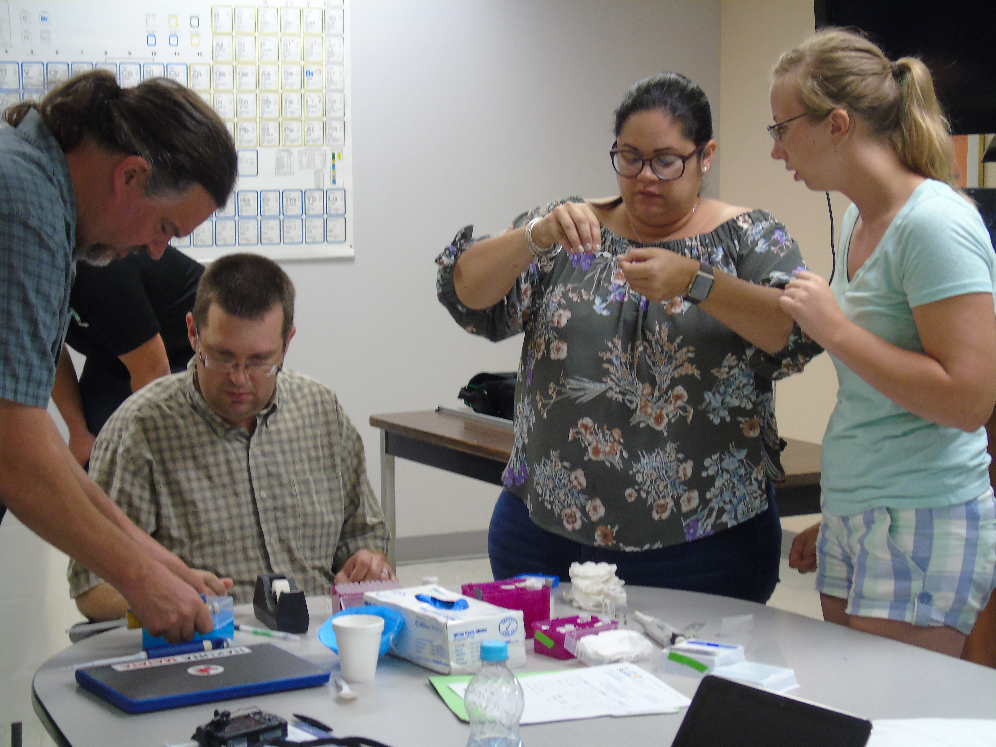
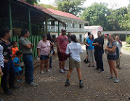
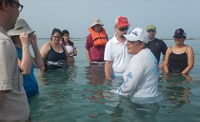
UW MRSEC Research Experience for Teachers Program Provides both Research and Cultural Literacy Experiences
Materials Research Science and Engineering Centers DMR-1121288
2017
Education Group Broader Impacts
Anne Lynn Gillian-Daniel
University of Wisconsin Madison MRSEC
Teachers from Wisconsin (4) and Puerto Rico (2) came together in Puerto Rico in July 2017 for the capstone week of their Research Experiences for Teachers Program (RET). Throughout the 6-week program, the teachers had the opportunity to do authentic research and develop a new curriculum module in the laboratories of faculty members at either the UW MRSEC or the University of Puerto Rico Mayagüez (UPRM). During the capstone week program, the teachers met in person and presented their research experiences and curriculum modules to one another. The teachers also had the opportunity to learn about the language, culture, and food, as well as agricultural and educational systems in an area of the country that is very different than their home region.
During the 2017 Capstone week, teachers shared their education modules with their cohort (top), learned about agriculturally important coffee (bottom left), and about the impact of climate change on coral reefs (bottom right).

