Slide 1
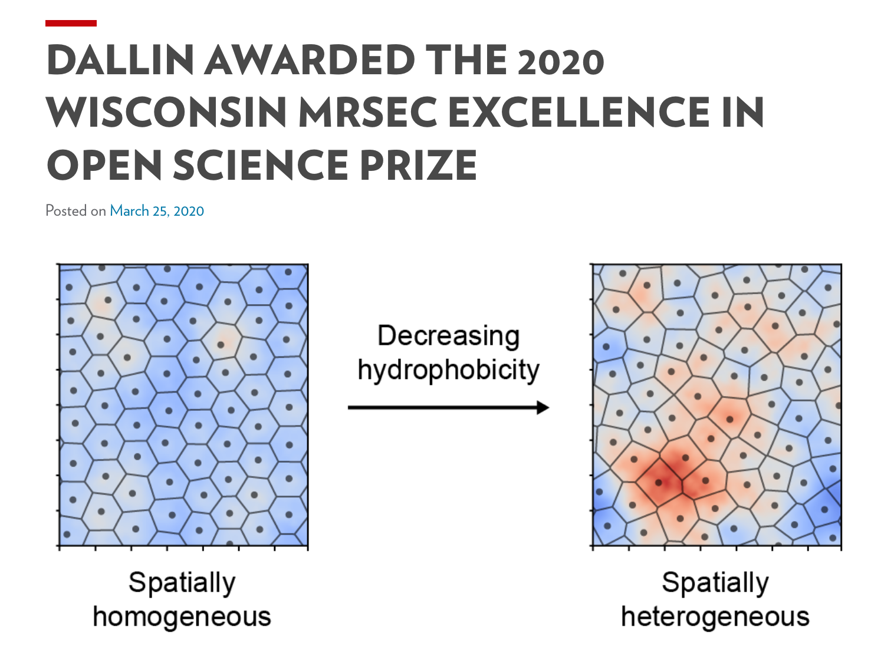
Wisconsin MRSEC Excellence in Open Science Prize
Materials Research Science and Engineering Centers, DMR-1720415
2020 Facilities and Data
The Wisconsin MRSEC is committed to being a leader in Open Science, which shares data in digital forms following FAIR¹ principles. As part of these efforts the Center has developed a new web site, a best practices guide, and held informational events. This year the Center launched the first Wisconsin MRSEC Excellence in Open Science Prize.
The $500 prize was for demonstrating exceptional development and dissemination of impactful data for the scientific community. The competition attracted multiple applicants, drawing attention to Open Science throughout the Wisconsin MRSEC community.
The winner was graduate student Bradley Dallin² for his work on molecules interacting with water, with potential applications from understanding human blood to protein folding diseases like Alzheimer’s. Bradley shared his results in papers, but also shared all his simulations and tools in an open accessible format for the community, increasing the impact of his work.
Dane Morgan and Victor Zavala, University of Wisconsin-Madison
(Top) Bradley Dallin; (Bottom) His open science prize announcement
Wilkinson, et al, Scientific Data 3, 160018 (2016)
Prize announcement https://mrsec.wisc.edu/2020/03/25/dallin-awarded-the-2020-wisconsin-mrsec-excellence-in-open-science-prize/
Notes:
The Wisconsin MRSEC is committed to open science, including dissemination of its research results and research data consistent with FAIR principles. The Wisconsin MRSEC Excellence in Open Science Prize is the latest effort to promote best practices and demonstrate the Center’s commitment. The prize was open to all MRSEC-supported researchers.
This year’s prize winner with graduate student Bradley Dallin. Bradley used molecular dynamics and sophisticated data analysis tools to study the properties of molecules interacting with water. The work was published in “Molecular Order Affects Interfacial Water Structure and Temperature-Dependent Hydrophobic Interactions between Nonpolar Self-Assembled Monolayers”, Bradley C. Dallin, Hongseung Yeon, Alexis R. Ostwalt, Nicholas L. Abbott, Reid C. Van Lehn, Langmuir 35 2078-2088 (2019). DOI: 10.1021/acs.langmuir.8b03287. The molecular dynamics data, including starting structures and trajectories, as well as all of the analysis software methods, we published using the Zenodo repository at https://zenodo.org/record/3345942#.XTm15OhKhaQ.

