Slide 1
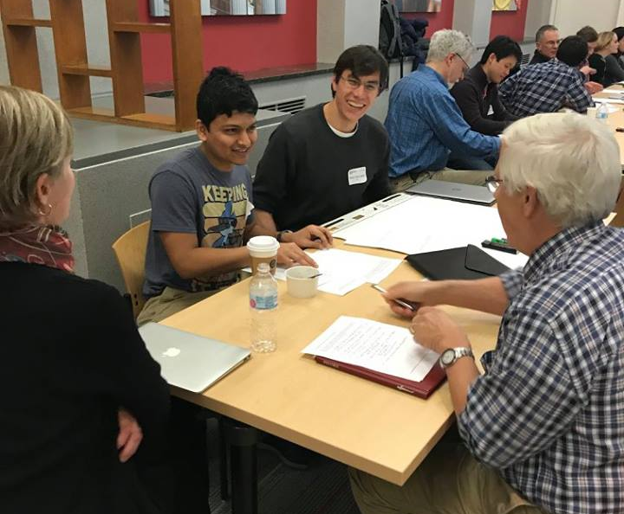
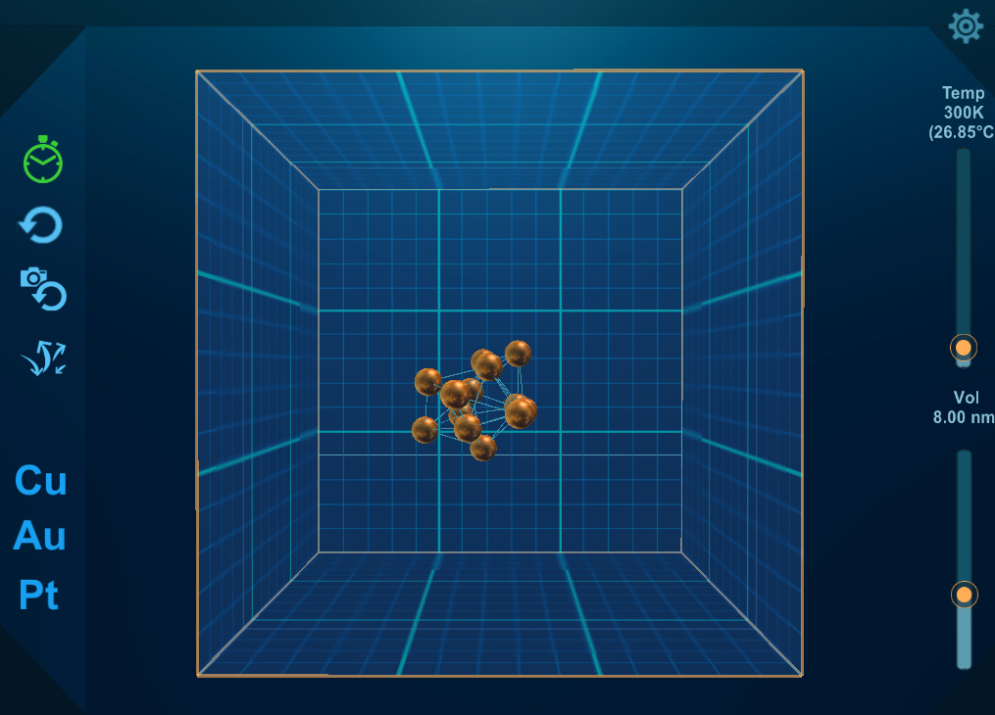
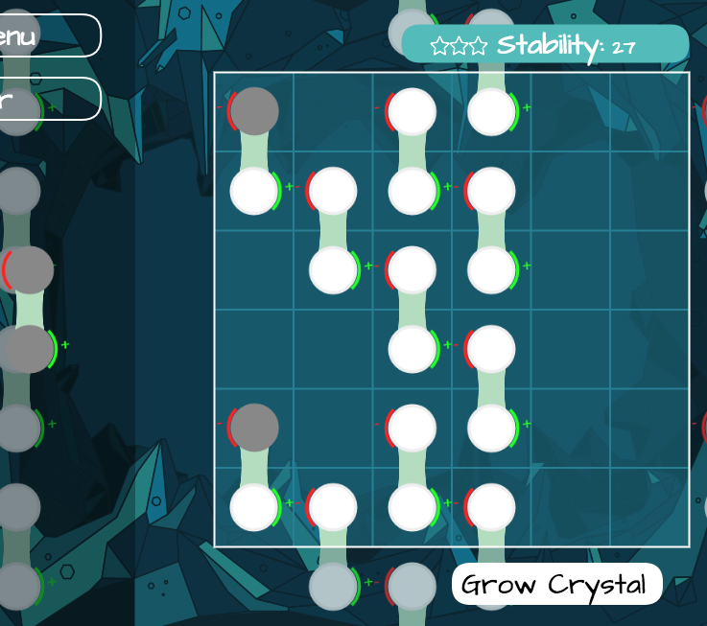
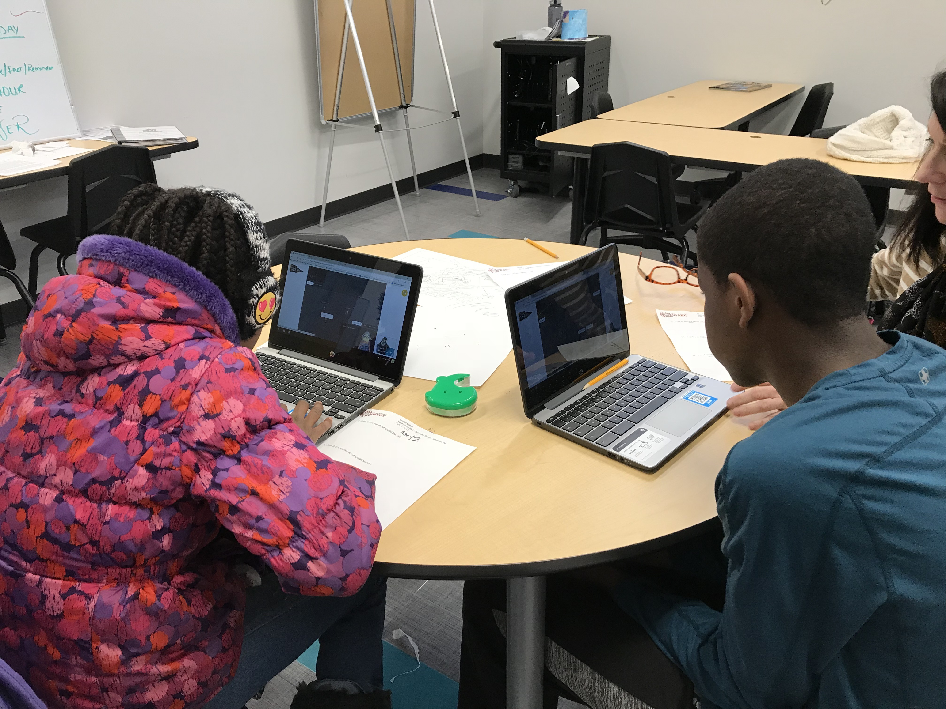
Wisconsin MRSEC Researchers and Teachers Collaborate to Create Digital Educational Games
Materials Research Science and Engineering Centers DMR-1720415
2018
MRSEC Education Group Broader Impacts
Anne Lynn Gillian-Daniel
University of Wisconsin-Madison MRSEC
The Wisconsin MRSEC has developed research-inspired educational digital games that are each being played over 1900 times/week. Atom Touch teaches students about atom behavior, bonding, and forces. Crystal Cave lets students explore how molecules form repeating patterns to grow into large crystals. During development, local K-12 teachers provided input on how to make the games more engaging for student learning. Prototypes of the games were tested with local students, K-12 teachers, MRSEC members, and content experts, with their feedback being used to improve later versions. Due to the success of this project, MRSEC is developing a third game designed to teach students how to make data-driven models. An early version of Marvelous Modeling is undergoing monthly testing with local students to inform further development.
MRSEC members generate ideas for digital games (top left). Two games, Atom Touch (top right) and Crystal Cave (bottom left), have been played over 33,000 times since they were released. Students test the games (bottom right) to help improve them.

