Slide 1
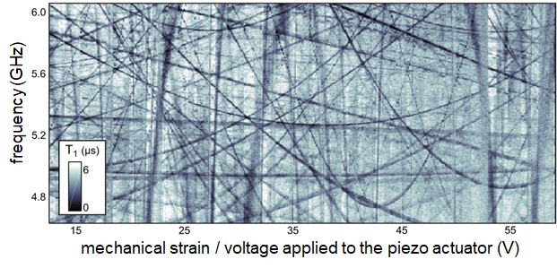
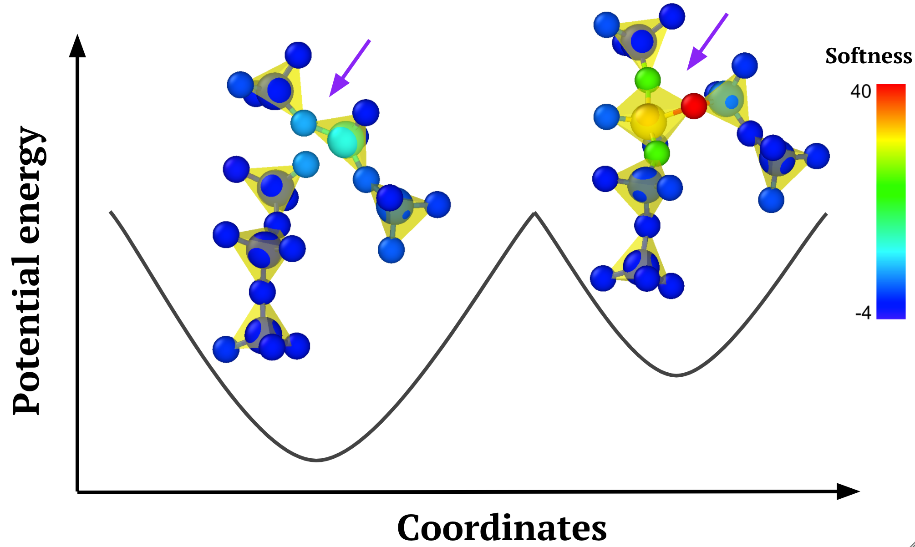
Low temperature properties of glass and its connection to glass stability
Materials Research Science and Engineering Centers, DMR-1720415
IRG 1, 2021
Because the structure of glass is random, some of the atoms can jump between two positions, with two different energies. The two atom configurations are called “two level systems” (TLS) and switching from one to another absorbs energy that interferes with the propagation of sound and the operation of qubits.
Wisconsin MRSEC IRG 1 developed a new theory describing how sound waves couple two level systems together. Experiments using a superconducting qubit measured the coupling of many TLS, one at a time, and showed that they are consistent with the theory. Machine learning applied to simulations identified the atomic arrangements associated with TLS and showed that as the glass grows more stable, the TLS density decreases.
These results present a clear path to better glasses for quantum computers, extremely reflective mirrors, and other technologies that require very low loss insulating glasses.
Clare Yu, University of California, Irvine; Bu Wang, University of Wisconsin-Madison
Every arc is the qubit coupled to a single TLS
Carruzzo, H.M., Bilmes, A., Lisenfeld, J., Yu, Z., Wang, B., Wan, Z., Schmidt, J.R. and Clare, C.Y., 2021. Distribution of two-level system couplings to strain and electric fields in glasses at low temperatures. Physical Review B, 104(13), p.134203.
Notes:
Yu previously proposed a theory that two-level systems (TLS) in glasses couple with one another via phonons with a random distribution of coupling strengths caused to the random orientation TLS elastic dipoles. This theory has now been tested using qubit spectroscopy. When the qubit is resonant with a single TLS in it’s insulator, the relaxation time dramatically decreases, so each arc in the top figure represents the energy splitting of a single TLS. By analyzing many such splittings, the IRG showed that it is consistent with the new theory of random coupling and inconsistent with the previous model assuming constant coupling for all TLS. Similar structures were identified in molecular dynamics simulations of glasses based on the machine learning concept of softness, which predicts propensity for motion based on static structure. The softness-identified TLS decrease in density with the fictive temperature of the glass, which is a measure of glass stability. This connect between TLS density and stability connects the low temperature and high temperature properties of glasses and points to increasing stability experimentally as a pathway to creating glasses with lower losses for technologies including qubits.

